Slide 1
General License Class
Chapter 3
Rules & Regulations
Notes:
I teach General chapter 1, you teach chapter 2 and then we split chapter 3. I’ll take the first half (through slide 60) and you take slide 61 to the end. It’s mostly questions, but it’s still work.

Slide 2
Regulatory Agencies
International Telecommunications Union (ITU)
  United Nations Agency
  Responsible for international radio regulations.
  Responsible for radio frequency allocations.
  Assigns call sign blocks. (back of chart)
  World divided into 3 regions.
    US is in Region 2 (the only thing we care about).
    Different Regions may have different rules/frequency allotments

Slide 3
Regulatory Agencies
Operating stations by remote control
  To operate a US station a US operator/primary station license is required.
  To operate a foreign station only rules of that country apply.

Slide 4
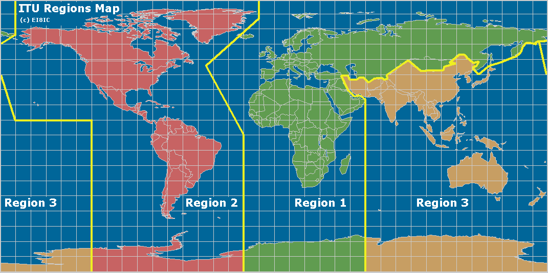
Regulatory Agencies

Slide 5
Regulatory Agencies
FCC Structure & Authority
  Established by Communications Act of 1934.
  Authority over all non-governmental communications in the United States & territories.
  Influences government agencies.
PRB-1 (1985)
  Amateur Service communications must be reasonably accommodated.
  Regulations must constitute the minimum practical.
  Excludes voluntary covenants.

Slide 6
Regulatory Agencies
FCC Structure & Authority
  Code of Federal Regulations (CFR) Title 47
    Part 2 – Frequency allocations and radio treaty matters; general rules and regulations
    Part 15 – Interference
    Part 17 – Antenna Structures
    Part 97 – Amateur Radio Service
      http://arrl.org/part-97-amateur-radio
  If something is covered in one part, it probably won’t be included in another part.

Slide 7
Regulatory Agencies
FCC Structure & Authority
  Amateur Radio Service is primarily self-policing.
    ARRL Volunteer Monitoring (VM) Program.
      Amateur volunteers who are formally enlisted to monitor the airwaves for rules violations
      To encourage amateur radio operators to self-regulate and comply with the rules
    Amateur Auxiliary.
      Consists of the ARRL VM’s and the License Interference Committee (LIC).
      Monitor the airwaves for rules violations.
      Encourage self-regulation and rule compliance.
Notes:
Approved by the ARRL Board of Directors at its July 2018 meeting, the new Volunteer Monitor program is a formal agreement between the FCC and ARRL in which volunteers trained and vetted by the ARRL will monitor the airwaves and collect evidence that can be used both to correct misconduct or recognize exemplary on-air operation. Cases of flagrant violations will be referred to the FCC by the ARRL for action in accordance with FCC guidelines.
The intent of this program is to re-energize enforcement efforts in the Amateur Radio bands. It was proposed by the FCC in the wake of several FCC regional office closures and a reduction in field staff.
Under this program, the FCC will give enforcement priority to cases developed by the Volunteer Monitor program, without the delay of ARRL having to refer cases through the FCC online complaint process.
Candidates who posess the required skills are encouraged to apply using the application below. Applications will be reviewed and candidates notified.

Slide 8
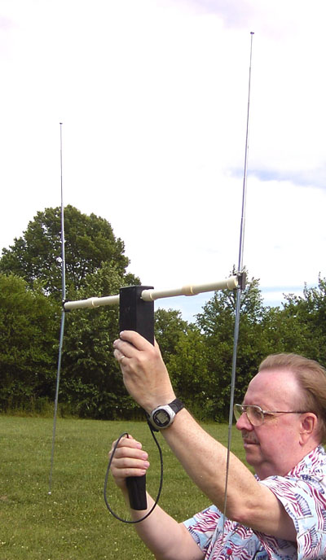
Regulatory Agencies
FCC Structure & Authority
  Amateur Radio Service is primarily self-policing.
    Many amateurs participate in hidden transmitter hunts.
      Radio Direction Finding (aka Fox Hunting).
      Good training for real-world situations.
        Stuck transmitters.
        Interference & jamming.
        Help Volunteer Monitors locate stations
        violating FCC Rules.
        Search and rescue (SAR). (ELT’s & EPIRB’s).

Slide 9
Regulatory Agencies
Federal Aviation Administration (FAA) Rules
  FAA also has jurisdiction over the Amateur Radio Service with regards to antennas & antenna structures.
    If your antenna structure exceeds specified heights, you must:
      Notify FAA
      Register with FCC

Slide 10
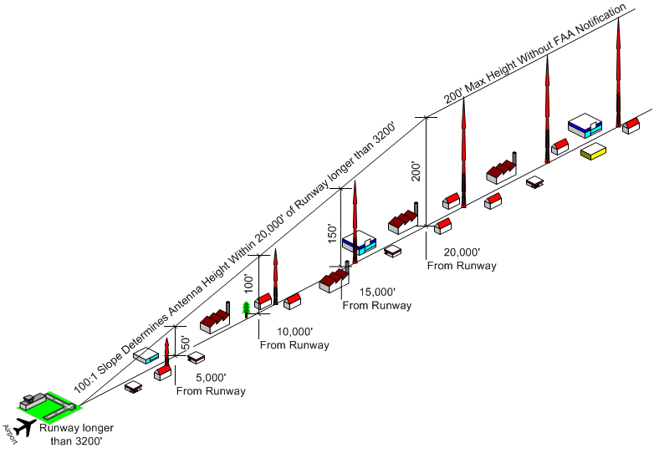
Regulatory Agencies
  FAA Rules
    Antenna Restrictions
    100:1 if runway >3200 ft
    50:1 if runway <3200 ft
    25:1 if heliport
Notes:
100:1. For a 100’ tower you need to be 100 x 100 feet away from runway, or 10,000’ or approx. 2 miles
50:1. 100’ x 50 or 5,000’ or 1 mile

Slide 11
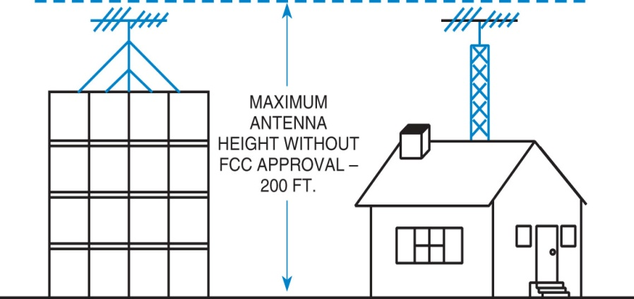
Regulatory Agencies
  FAA Rules
    Antenna Restrictions
    If more than 200 ft above ground level or near public-use airport, must notify FCC & FAA.
    Exceptions:
      <20 ft above existing man-made structure.
      <20 ft above ground.
      Shielded by terrain or by taller structures in congested urban area.
Notes:
Local jurisdictions also might have rules such as for guywires

Slide 12
G1E06 [97.301, ITU Radio Regulations]
The frequency allocations of which ITU region apply to radio amateurs operating in North and South America?
A. Region 4
B. Region 3
C. Region 2
D. Region 1

Slide 13
G1E06 [97.301, ITU Radio Regulations]
The frequency allocations of which ITU region apply to radio amateurs operating in North and South America?
A. Region 4
B. Region 3
C. Region 2
D. Region 1

Slide 14
G1D05 [97.7] When operating a US station by remote control from outside the country, what license is required of the control operator?
A. A US operator/primary station license
B. Only an appropriate US operator/primary license and a special remote station permit from the FCC
C. Only a license from the foreign country, as long as the call sign includes identification of portable operation in the US
D. A license from the foreign country and a special remote station permit from the FCC

Slide 15
G1D05 [97.7] When operating a US station by remote control from outside the country, what license is required of the control operator?
A. A US operator/primary station license
B. Only an appropriate US operator/primary license and a special remote station permit from the FCC
C. Only a license from the foreign country, as long as the call sign includes identification of portable operation in the US
D. A license from the foreign country and a special remote station permit from the FCC

Slide 16
G1D12 [97.507] When operating a station in South America by remote control over the internet from the US, what regulations apply?
A. Those of both the remote station’s country and the FCC
B. Those of the remote station’s country and the FCC’s third-party regulations
C. Only those of the remote station’s country
D. Only those of the FCC

Slide 17
G1D12 [97.507] When operating a station in South America by remote control over the internet from the US, what regulations apply?
A. Those of both the remote station’s country and the FCC
B. Those of the remote station’s country and the FCC’s third-party regulations
C. Only those of the remote station’s country
D. Only those of the FCC

Slide 18
G2D02 -- Which of the following are objectives of the Volunteer Monitor Program?
A. To conduct efficient and orderly amateur licensing examinations
B. To provide emergency and public safety communications
C. To coordinate repeaters for efficient and orderly spectrum usage
D. To encourage amateur radio operators to self-regulate and comply with the rules

Slide 19
G2D02 -- Which of the following are objectives of the Volunteer Monitor Program?
A. To conduct efficient and orderly amateur licensing examinations
B. To provide emergency and public safety communications
C. To coordinate repeaters for efficient and orderly spectrum usage
D. To encourage amateur radio operators to self-regulate and comply with the rules

Slide 20
G2D01 -- What is the Volunteer Monitor Program?
A. Amateur volunteers who are formally enlisted to monitor the airwaves for rules violations
B. Amateur volunteers who conduct amateur licensing examinations
C. Amateur volunteers who conduct frequency coordination for amateur VHF repeaters
D. Amateur volunteers who use their station equipment to help civil defense organizations in times of emergency

Slide 21
G2D01 -- What is the Volunteer Monitor Program?
A. Amateur volunteers who are formally enlisted to monitor the airwaves for rules violations
B. Amateur volunteers who conduct amateur licensing examinations
C. Amateur volunteers who conduct frequency coordination for amateur VHF repeaters
D. Amateur volunteers who use their station equipment to help civil defense organizations in times of emergency

Slide 22
G2D03 -- What procedure may be used by Volunteer Monitors to localize a station whose continuous carrier is holding a repeater on in their area?
A. Compare vertical and horizontal signal strengths on the input frequency
B. Compare beam headings on the repeater input from their home locations with that of other Volunteer Monitors
C. Compare signal strengths between the input and output of the repeater
D. All these choices are correct

Slide 23
G2D03 -- What procedure may be used by Volunteer Monitors to localize a station whose continuous carrier is holding a repeater on in their area?
A. Compare vertical and horizontal signal strengths on the input frequency
B. Compare beam headings on the repeater input from their home locations with that of other Volunteer Monitors
C. Compare signal strengths between the input and output of the repeater
D. All these choices are correct

Slide 24
G1B01 [97.15(a)] What is the maximum height above ground for an antenna structure not near a public use airport without requiring notification to the FAA and registration with the FCC?
A. 50 feet
B. 100 feet
C. 200 feet
D. 250 feet

Slide 25
G1B01 [97.15(a)] What is the maximum height above ground for an antenna structure not near a public use airport without requiring notification to the FAA and registration with the FCC?
A. 50 feet
B. 100 feet
C. 200 feet
D. 250 feet

Slide 26
G1B06 [97.15(b), PRB-1, 101 FCC 2d 952 (1985)] Under what conditions are state and local governments permitted to regulate amateur radio antenna structures?
A. Under no circumstances, FCC rules take priority
B. At any time and to any extent necessary to accomplish a legitimate purpose of the state or local entity, provided that proper filings are made with the FCC
C. Only when such structures exceed 50 feet in height and are clearly visible 1,000 feet from the structure
D. Amateur Service communications must be reasonably accommodated, and regulations must constitute the minimum practical to accommodate a legitimate purpose of the state or local entity

Slide 27
G1B06 [97.15(b), PRB-1, 101 FCC 2d 952 (1985)] Under what conditions are state and local governments permitted to regulate amateur radio antenna structures?
A. Under no circumstances, FCC rules take priority
B. At any time and to any extent necessary to accomplish a legitimate purpose of the state or local entity, provided that proper filings are made with the FCC
C. Only when such structures exceed 50 feet in height and are clearly visible 1,000 feet from the structure
D. Amateur Service communications must be reasonably accommodated, and regulations must constitute the minimum practical to accommodate a legitimate purpose of the state or local entity

Slide 28
Amateur Licensing Rules
License Elements
  To qualify for an amateur radio license, must pass certain exam elements.
    Technician – Element 2
      Element 2 = Technician Class 35-question written exam.
    General – Elements 2 & 3
      Element 3 = General Class 35-question written exam.
    Amateur Extra – Elements 2, 3, & 4
      Element 4 = Amateur Extra Class 50-question written exam.

Slide 29
Amateur Licensing Rules
Exam Element Credit
  Partial credit granted (not revoked)
    General
    Advanced
    Amateur Extra
  Must pass Element 2 (Technician)
  New Call sign with previous privileges
Notes:
The FCC has revised the Amateur Service Part 97 rules (July 2014) to grant partial written examination element credit to holders of expired General, Advanced, and Extra Amateur Radio licenses. A license that has expired and gone beyond the two year grace period will be canceled in the FCC system. The licensee will not automatically qualify for a new license. At a minimum, previous license holders must take the current 35-question Technician exam at a VE exam session to return to Amateur Radio. The FCC will issue a new call sign and a new license when the Technician exam is passed.

Slide 30
Amateur Licensing Rules
Examination Rules
  Volunteer Examiner Coordinator (VEC)
    Created by signed agreement with the FCC.
    Accredits Volunteer Examiners (VE’s).
    Coordinates exam sessions.
    Maintains records of all exam sessions, including passes & failures.
    Forwards successful applications to the FCC for processing.

Slide 31
Amateur Licensing Rules
Examination Rules
  Volunteer Examiner Coordinator (VEC)
    Currently 14 VEC’s nationwide.
      ARRL-VEC
        Administers more exams than other 13 VEC’s combined.
        Exam Fee = $15
      W5YI-VEC
        Administers more exams than remaining 12 VEC’s combined.
        Exam Fee = $14
      Laurel VEC
        Administers more exams than remaining 11 VEC’s combined.
        No Exam Fee

Slide 32
Amateur Licensing Rules
Examination Rules
  National Conference of Volunteer Examiner Coordinators (NCVEC)
    Organization of VEC’s.
    Coordinates actions of the VEC’s.
    Provides liaison between the FCC & the VEC’s.
    Establishes the Question Pool Committee (QPC)
  Exam Preparation
    Question Pools maintained by NCVEC.
    All VEC’s are responsible for question pools.

Slide 33
Amateur Licensing Rules
Examination Rules
  Volunteer Examiner (VE) Requirements
    At least 18 years of age.
    Never had license suspended or revoked.
    General or higher class license to prepare/administer Element 2 (Technician) written exam.
    Advanced or higher class license to prepare/ administer Element 3 (General) written exam.
    Amateur Extra class license to prepare/administer Element 4 (Amateur Extra) written exam.
    Can be a non-U.S. citizen if otherwise qualified.
    VEC accreditation (ARRL, W5YI, Laurel, etc.)

Slide 34
Amateur Licensing Rules
Examination Rules
  Volunteer Examiner (VE) Requirements
VE License Class | Can Prepare & Administer
General | Element 2 (Technician)
Advanced | Element 2 (Technician) Element 3 (General)
Amateur Extra | Element 2 (Technician) Element 3 (General) Element 4 (Amateur Extra)

Slide 35
Amateur Licensing Rules
Examination Rules
  Team of 3 VE’s required.
  Conduct local exam sessions in accordance with policies adopted by the coordinating VEC.
  Forwards all exam session paperwork to VEC for processing.

Slide 36
Amateur Licensing Rules
Examination Rules
§97.511(d) -- No VE may administer an examination to his or her spouse, children, grandchildren, stepchildren, parents, grandparents, stepparents, brothers, sisters, stepbrothers, stepsisters, aunts, uncles, nieces, nephews, and in-laws.
YOU
Siblings
Spouse
Other
Relatives

Slide 37
Amateur Licensing Rules
Examination Rules
  During the Exam
    All 3 VE’s must be present & observing the candidates during the exam.
    Candidates must follow instructions of VE team or have exam terminated.
    All 3 VE’s must immediately grade exam & notify candidate whether pass or fail.
    If fail, return application to candidate.
    If pass, all 3 VE’s must sign application & issue CSCE.
      CSCE good for 365 days

Slide 38

Amateur Licensing Rules
Examination Rules
  After the Exam
    VE team must forward session paperwork to VEC within 10 days after exam session.

Slide 39
Amateur Licensing Rules
Examination Rules
  After the Exam
    New licensees can operate as soon as their call sign appears in the FCC Universal Licensing System (ULS).
      http://wireless.fcc.gov/uls
    Amateurs who upgraded to a higher license class can start using their new privileges immediately.
      When using new privileges, must use special station identification until new license class appears in the FCC Universal Licensing System (ULS).
        New General = <call>/AG (slant or stroke)
        New Amateur Extra = <call>/AE

Slide 40
Amateur Licensing Rules
Re-Administration of Examinations
  FCC can re-administer any exam element to any licensee.
    FCC can designate a VEC to re-administer the exam.
    Licensee MUST appear or license will be cancelled or amended.
  If FCC determines that a VE fraudulently administered or certified an exam, his/her station license can be revoked & operator license suspended.

Slide 41
G1D07 [97.509(b)(1)] Volunteer Examiners are accredited by what organization?
A. The Federal Communications Commission
B. The Universal Licensing System
C. A Volunteer Examiner Coordinator
D. The Wireless Telecommunications Bureau

Slide 42
G1D07 [97.509(b)(1)] Volunteer Examiners are accredited by what organization?
A. The Federal Communications Commission
B. The Universal Licensing System
C. A Volunteer Examiner Coordinator
D. The Wireless Telecommunications Bureau

Slide 43
G1D08 [97.509(b)(3)] Which of the following criteria must be met for a non-US citizen to be an accredited Volunteer Examiner?
A. The person must be a resident of the US for a minimum of 5 years
B. The person must hold an FCC granted amateur radio license of General class or above
C. The person’s home citizenship must be in ITU region 2
D. None of these choices is correct; a non-US citizen cannot be a Volunteer Examiner

Slide 44
G1D08 [97.509(b)(3)] Which of the following criteria must be met for a non-US citizen to be an accredited Volunteer Examiner?
A. The person must be a resident of the US for a minimum of 5 years
B. The person must hold an FCC granted amateur radio license of General class or above
C. The person’s home citizenship must be in ITU region 2
D. None of these choices is correct; a non-US citizen cannot be a Volunteer Examiner

Slide 45
G1D10 [97.509(b)(2)] What is the minimum age that one must be to qualify as an accredited Volunteer Examiner?
A. 16 years
B. 18 years
C. 21 years
D. There is no age limit

Slide 46
G1D10 [97.509(b)(2)] What is the minimum age that one must be to qualify as an accredited Volunteer Examiner?
A. 16 years
B. 18 years
C. 21 years
D. There is no age limit

Slide 47
G1D04 [97.509(3)(i)(c)] Who must observe the administration of a Technician class license examination?
A. At least three Volunteer Examiners of General class or higher
B. At least two Volunteer Examiners of General class or higher
C. At least two Volunteer Examiners of Technician class or higher
D. At least three Volunteer Examiners of Technician class

Slide 48
G1D04 [97.509(3)(i)(c)] Who must observe the administration of a Technician class license examination?
A. At least three Volunteer Examiners of General class or higher
B. At least two Volunteer Examiners of General class or higher
C. At least two Volunteer Examiners of Technician class or higher
D. At least three Volunteer Examiners of Technician class

Slide 49
G1D02 [97.509(b)(3)(i)] What license examinations may you administer as an accredited Volunteer Examiner holding a General class operator license?
A. General and Technician
B. None, only Amateur Extra class licensees may be accredited
C. Technician only
D. Amateur Extra, General, and Technician

Slide 50
G1D02 [97.509(b)(3)(i)] What license examinations may you administer as an accredited Volunteer Examiner holding a General class operator license?
A. General and Technician
B. None, only Amateur Extra class licensees may be accredited
C. Technician only
D. Amateur Extra, General, and Technician

Slide 51
G1D09 [97.9(b)] How long is a Certificate of Successful Completion of Examination (CSCE) valid for exam element credit?
A. 30 days
B. 180 days
C. 365 days
D. For as long as your current license is valid

Slide 52
G1D09 [97.9(b)] How long is a Certificate of Successful Completion of Examination (CSCE) valid for exam element credit?
A. 30 days
B. 180 days
C. 365 days
D. For as long as your current license is valid

Slide 53
G1D03 [97.9(b)] On which of the following band segments may you operate if you are a Technician class operator and have an unexpired Certificate of Successful Completion of Examination (CSCE) for General class privileges?
A. Only the Technician band segments until your upgrade is posted in the FCC database
B. Only on the Technician band segments until you have a receipt for the FCC application fee payment
C. On any General or Technician class band segment
D. On any General or Technician class band segment except 30 meters and 60 meters

Slide 54
G1D03 [97.9(b)] On which of the following band segments may you operate if you are a Technician class operator and have an unexpired Certificate of Successful Completion of Examination (CSCE) for General class privileges?
A. Only the Technician band segments until your upgrade is posted in the FCC database
B. Only on the Technician band segments until you have a receipt for the FCC application fee payment
C. On any General or Technician class band segment
D. On any General or Technician class band segment except 30 meters and 60 meters

Slide 55
G1D06 [97.119(f)(2)]
Until an upgrade to General class is shown in the FCC database, when must a Technician licensee identify with “AG” after their call sign?
A. Whenever they operate using General class frequency privileges
B. Whenever they operate on any amateur frequency
C. Whenever they operate using Technician frequency privileges
D. A special identifier is not required if their General class license application has been filed with the FCC

Slide 56
G1D06 [97.119(f)(2)]
Until an upgrade to General class is shown in the FCC database, when must a Technician licensee identify with “AG” after their call sign?
A. Whenever they operate using General class frequency privileges
B. Whenever they operate on any amateur frequency
C. Whenever they operate using Technician frequency privileges
D. A special identifier is not required if their General class license application has been filed with the FCC

Slide 57
G1D01 [97.501, 97.505(a)]
Who may receive partial credit for the elements represented by an expired amateur radio license?
A. Any person who can demonstrate that they once held an FCC-issued General, Advanced, or Amateur Extra class license that was not revoked by the FCC
B. Anyone who held an FCC-issued amateur radio license that expired not less than 5 and not more than 15 years ago
C. Any person who previously held an amateur license issued by another country, but only if that country has a current reciprocal licensing agreement with the FCC
D. Only persons who once held an FCC issued Novice, Technician, or Technician Plus license

Slide 58
G1D01 [97.501, 97.505(a)]
Who may receive partial credit for the elements represented by an expired amateur radio license?
A. Any person who can demonstrate that they once held an FCC-issued General, Advanced, or Amateur Extra class license that was not revoked by the FCC
B. Anyone who held an FCC-issued amateur radio license that expired not less than 5 and not more than 15 years ago
C. Any person who previously held an amateur license issued by another country, but only if that country has a current reciprocal licensing agreement with the FCC
D. Only persons who once held an FCC issued Novice, Technician, or Technician Plus license

Slide 59
G1D11 [97.505] What action is required to obtain a new General class license after a previously held license has expired and the two-year grace period has passed?
A. They must have a letter from the FCC showing they once held an amateur or commercial license
B. There are no requirements other than being able to show a copy of the expired license
C. Contact the FCC to have the license reinstated
D. The applicant must show proof of the appropriate expired license grant and pass the current Element 2 exam

Slide 60
G1D11 [97.505] What action is required to obtain a new General class license after a previously held license has expired and the two-year grace period has passed?
A. They must have a letter from the FCC showing they once held an amateur or commercial license
B. There are no requirements other than being able to show a copy of the expired license
C. Contact the FCC to have the license reinstated
D. The applicant must show proof of the appropriate expired license grant and pass the current Element 2 exam

Slide 61

Break

Slide 62
Control Operator Privileges & Rules
Frequency Privileges
  US Amateur HF Bands
Talk to anyone, anywhere
  Except for a country that has notified the ITU that they object to such communications.
  In any language (must ID in English)
Band | Frequency Range
160m | 1.800 MHz to 2.000 MHz
80m | 3.500 MHz to 3.600 MHz
75m | 3.800 MHz to 4.000 MHz
60m | 5 Specific Channels
40m | 7.000 MHz to 7.300 MHz
30m | 10.100 MHz to 10.150 MHz
20m | 14.000 MHz to 14.350 MHz
17m | 18.068 MHz to 18.168 MHz
15m | 21.000 MHz to 21.450 MHz
12m | 24.890 MHz to 24.990 MHz
10m | 28.000 MHz to 29.700 MHz

Slide 63
Control Operator Privileges & Rules
General Class HF Band Segments
160m | CW | 1.800 MHz to 2.000 MHz
 | SSB | 1.800 MHz to 2.000 MHz
80m | CW | 3.525 MHz to 3.600 MHz
75m | SSB | 3.800 MHz to 4.000 MHz
60m | SSB | (5 specified channels)
40m | CW | 7.025 MHz to 7.125 MHz
 | SSB | 7.175 MHz to 7.300 MHz
30m | CW | 10.100 MHz to 10.150 MHz
20m | CW | 14.025 MHz to 14.150 MHz
 | SSB | 14.225 MHz to 14.350 MHz
17m | CW | 18.068 MHz to 18.110 MHz
 | SSB | 18.110 MHz to 18.168 MHz
15m | CW | 21.025 MHz to 21.200 MHz
 | SSB | 21.275 MHz to 21.450 MHz
12m | CW | 24.890 MHz to 24.930 MHz
 | SSB | 24.930 MHz to 24.990 MHz
10m | CW | 28.000 MHz to 28.300 MHz
 | SSB+ | 28.300 MHz to 29.700 MHz
Green indicates all amateur frequency privileges on those bands

Slide 64
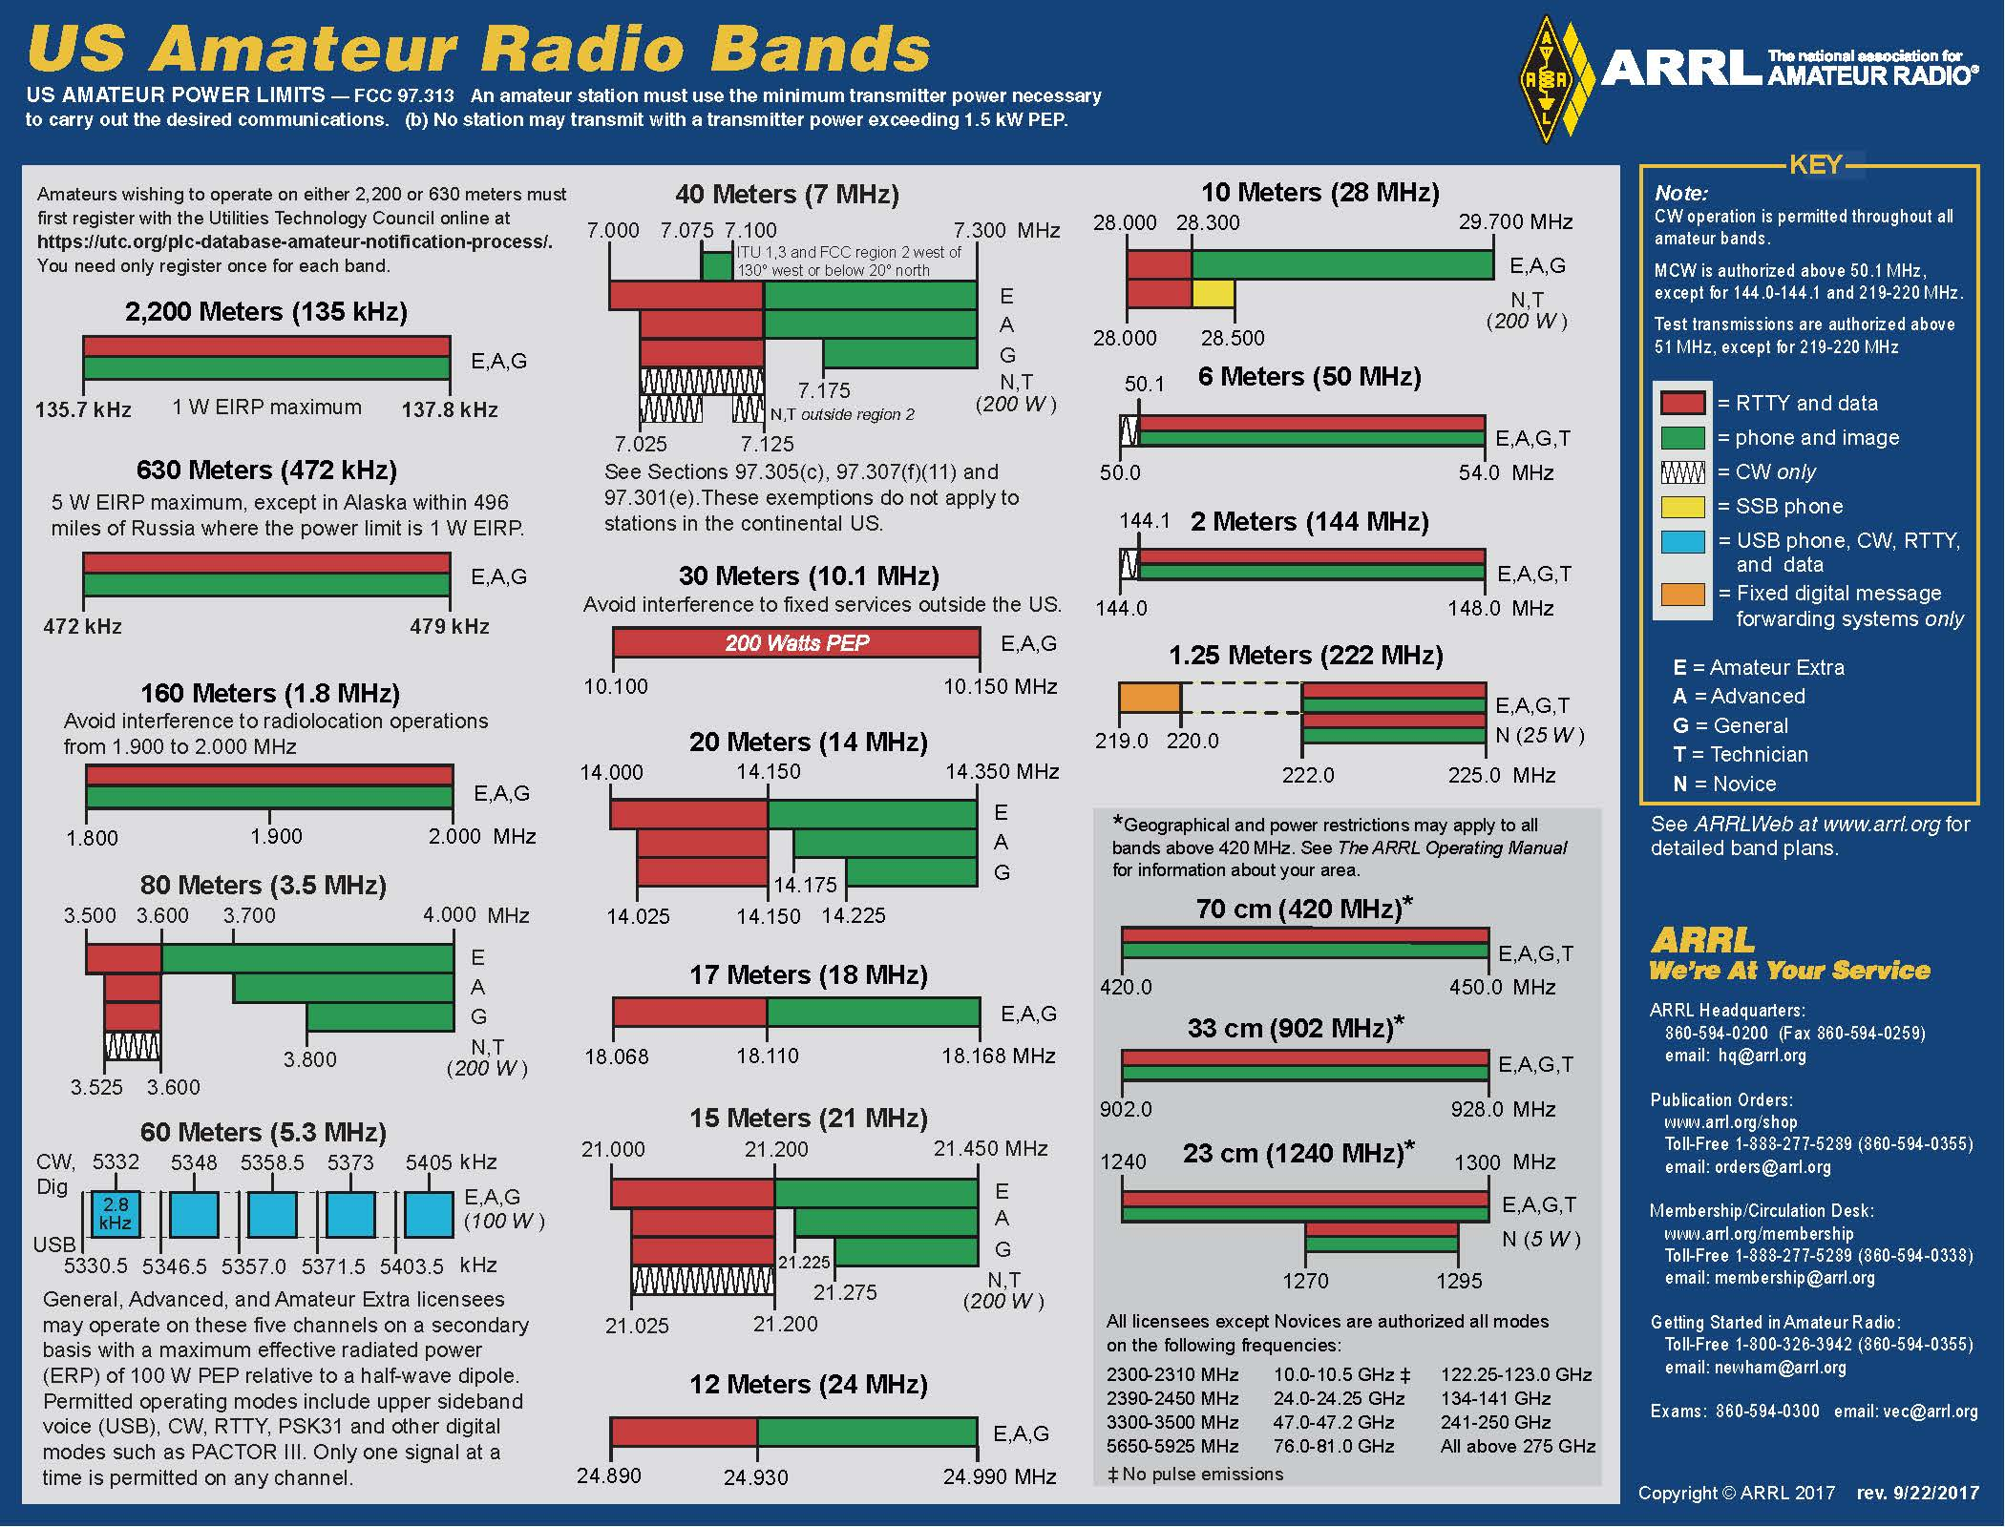

Slide 65
Control Operator Privileges & Rules
Frequency Privileges
  60m Frequency Assignments.
  2.8 kHz Maximum Bandwidth.
Center Frequency | Carrier Frequency
5332.0 kHz | 5330.5 kHz
5348.0 kHz | 5346.5 kHz
5358.5 kHz | 5357.0 kHz
5373.0 kHz | 5371.5 kHz
5405.0 kHz | 5403.5 kHz
Notes:
60m = 100 Watts (ERP respect to a dipole).
30m = 200 Watts PEP.
Spread Spectrum (SS) = 10 Watts PEP
Novice & Technician operators limited to 200 Watts PEP on HF.

Slide 66
Control Operator Privileges & Rules
Frequency Privileges
  When entire CW portion of the band is not available to a control operator holding a General class license, bottom 25 kHz is reserved for Amateur Extra class operators.
  When entire phone portion of the band is not available to a control operator holding a General class license, the upper end of the band is generally available.

Slide 67
Control Operator Privileges & Rules
Frequency Privileges
  Beacons.
    Used for observation of propagation and reception.
    Limited to 100 Watts PEP output power.
    Only one beacon per band at any one location.
    Restricted to specified frequency segments in each band.
    A beacon may be automatically controlled while it is transmitting on the 28.20-28.30 MHz, 50.06-50.08 MHz, 144.275-144.300 MHz, 222.05-222.06 MHz or 432.300-432.400 MHz segments, or on the 33 cm and shorter wavelength bands.

Slide 68
Control Operator Privileges & Rules
Frequency Privileges
  Repeater Operations.
    Restricted to 29.500 MHz to 29.700 MHz on HF.
    Repeater Coordinators work with repeater operators in selecting frequencies to minimize interference.
      If interference occurs between a coordinated repeater and an uncoordinated repeater, the licensee of the uncoordinated system is responsible for resolving the interference.

Slide 69
Control Operator Privileges & Rules
Frequency Privileges
  Primary versus Secondary.
    Amateurs have primary status on most bands.
      Exceptions: 60m, 30m, 70cm, & several microwave bands.
    Amateurs can use bands where the Amateur Radio Service is secondary ONLY if they do not cause harmful interference to primary users.
    Secondary users MUST take any necessary steps to avoid interfering with primary users.
      Suggest movement to a clear frequency.
    Must accept interference from primary users.
Notes:
None shared with the Citizen’s Band Radio Service.

Slide 70
Control Operator Privileges & Rules
Frequency Privileges
  Harmful interference must be avoided:
    Secondary allocation users to primary allocation users.
    When transmitting spread spectrum.
    When operating within one mile of an FCC monitoring station.
    When adjacent to emergency communications activities.
    Consider the “good neighbor” policy and SSF.

Slide 71
Control Operator Privileges & Rules
Third-Party Traffic
  Message sent by licensed amateur radio operators on behalf of a ”third party”.
  Third Parties:
    A non-licensed individual.
    An organization.
    A licensed amateur radio operator who is not eligible to be the control operator of the station sending/receiving the message.
  The third party may or may not be at either station location.

Slide 72
Control Operator Privileges & Rules
Third-Party Traffic
  The third party may participate in sending/ receiving the message.
    May speak into microphone.
    May manipulate key or keyboard.
  Can NEVER be sent to/from any individual whose amateur radio license has been suspended or revoked.

Slide 73
Control Operator Privileges & Rules
Third-Party Traffic
  International Considerations.
    Messages on behalf of a third party can ONLY be sent internationally under the following circumstances:
      Message must be related to Amateur Radio or of a personal and inconsequential nature.
      Messages relating to emergencies or disaster relief.
      Only in a country that specifically allows third-party traffic to/from US amateurs.
    During an emergency, special temporary agreements can be established to permit third-party traffic while the emergency exists.

Slide 74
Control Operator Privileges & Rules
Prohibited & Restricted Communications
  Excessive tuning & testing.
  Obscene, indecent, or profane language or meaning.
  Music.
    Exception: Incidental part of a manned spacecraft retransmission.

Slide 75
Control Operator Privileges & Rules
Prohibited & Restricted Communications
  Abbreviations, pro words, codes & ciphers.
    May not obscure the meaning of a message.
    Exception: When used to control a space station.
  Business communications.
    It is okay to notify other amateurs that you have equipment normally used in an amateur radio station for sale, as long as it is not done on a regular basis.
    It is okay to send a message to a business as long as neither the operator nor his employer have a financial interest in the communications.

Slide 76
Control Operator Privileges & Rules
Prohibited & Restricted Communications
  Cross-Band Repeaters.
    The repeater control operator’s license class governs.
    A Technician Class control operator may transmit on a 2m frequency to activate a repeater with an output on 10m (the trustee must be at least General class).
  Relay for Broadcast (to public)
    Must directly relate to the immediate safety of human life or protection of property.
    Must be no other means of communication reasonably available before or at the time.

Slide 77
Control Operator Privileges & Rules
Prohibited & Restricted Communications
  Cross-service communications prohibited.
    Other license services
      Such as the military on the 70cm band.
    Unlicensed services
      Such as on the shared 2.4GHz shared Wi-Fi frequencies.
  One-Way transmissions.
    Exception: Transmissions necessary to assist learning the International Morse code (as done by W1AW).
    Exception: Bulletins of interest to and intended for amateur radio operators.

Slide 78
Control Operator Privileges & Rules
Written Records
  A complete log of your station operations is useful.
  Only the following records are required:
    Call signs of other amateurs operating your station.
    If using an antenna other than a dipole on 60m, manufacturer’s specifications or gain calculations for the antenna used.

Slide 79
G1A05 [97.301(d)] On which of the following frequencies are General class licensees prohibited from operating as control operator?
A. 7.125 MHz to 7.175 MHz
B. 28.000 MHz to 28.025 MHz
C. 21.275 MHz to 21.300 MHz
D. All these choices are correct

Slide 80
G1A05 [97.301(d)] On which of the following frequencies are General class licensees prohibited from operating as control operator?
A. 7.125 MHz to 7.175 MHz
B. 28.000 MHz to 28.025 MHz
C. 21.275 MHz to 21.300 MHz
D. All these choices are correct

Slide 81
G1A07 [97.305(a)] On which amateur frequencies in the 10-meter band may stations with a General class control operator transmit CW emissions?
A. 28.000 MHz to 28.025 MHz only
B. 28.000 MHz to 28.300 MHz only
C. 28.025 MHz to 28.300 MHz only
D. The entire band

Slide 82
G1A07 [97.305(a)] On which amateur frequencies in the 10-meter band may stations with a General class control operator transmit CW emissions?
A. 28.000 MHz to 28.025 MHz only
B. 28.000 MHz to 28.300 MHz only
C. 28.025 MHz to 28.300 MHz only
D. The entire band

Slide 83
G1A08 [97.301(b)] Which HF bands have segments exclusively allocated to Amateur Extra licensees?
A. All HF bands
B. 80 meters, 40 meters, 20 meters, and 15 meters
C. All HF bands except 160 meters and 10 meters
D. 60 meters, 30 meters, 17 meters, and 12 meters

Slide 84
G1A08 [97.301(b)] Which HF bands have segments exclusively allocated to Amateur Extra licensees?
A. All HF bands
B. 80 meters, 40 meters, 20 meters, and 15 meters
C. All HF bands except 160 meters and 10 meters
D. 60 meters, 30 meters, 17 meters, and 12 meters

Slide 85
G1A09 [97.301(d)] Which of the following frequencies is within the General class portion of the 15-meter band?
A. 14250 kHz
B. 18155 kHz
C. 21300 kHz
D. 24900 kHz

Slide 86
G1A09 [97.301(d)] Which of the following frequencies is within the General class portion of the 15-meter band?
A. 14250 kHz
B. 18155 kHz
C. 21300 kHz
D. 24900 kHz

Slide 87
G1A11 [97.301] When General class licensees are not permitted to use the entire voice portion of a band, which portion of the voice segment is available to them?
A. The lower frequency portion
B. The upper frequency portion
C. The lower frequency portion on frequencies below 7.3 MHz, and the upper portion on frequencies above 14.150 MHz
D. The upper frequency portion on frequencies below 7.3 MHz, and the lower portion on frequencies above 14.150 MHz

Slide 88
G1A11 [97.301] When General class licensees are not permitted to use the entire voice portion of a band, which portion of the voice segment is available to them?
A. The lower frequency portion
B. The upper frequency portion
C. The lower frequency portion on frequencies below 7.3 MHz, and the upper portion on frequencies above 14.150 MHz
D. The upper frequency portion on frequencies below 7.3 MHz, and the lower portion on frequencies above 14.150 MHz

Slide 89
G1A01 [97.301(d)] On which HF and/or MF amateur bands are there portions where General class licensees cannot transmit?
A. 60 meters, 30 meters, 17 meters, and 12 meters
B. 160 meters, 60 meters, 15 meters, and 12 meters
C. 80 meters, 40 meters, 20 meters, and 15 meters
D. 80 meters, 20 meters, 15 meters, and 10 meters

Slide 90
G1A01 [97.301(d)] On which HF and/or MF amateur bands are there portions where General class licensees cannot transmit?
A. 60 meters, 30 meters, 17 meters, and 12 meters
B. 160 meters, 60 meters, 15 meters, and 12 meters
C. 80 meters, 40 meters, 20 meters, and 15 meters
D. 80 meters, 20 meters, 15 meters, and 10 meters

Slide 91
G1A10 [97.205(b)] What portion of the 10-meter band is available for repeater use?
A. The entire band
B. The portion between 28.1 MHz and 28.2 MHz
C. The portion between 28.3 MHz and 28.5 MHz
D. The portion above 29.5 MHz

Slide 92
G1A10 [97.205(b)] What portion of the 10-meter band is available for repeater use?
A. The entire band
B. The portion between 28.1 MHz and 28.2 MHz
C. The portion between 28.3 MHz and 28.5 MHz
D. The portion above 29.5 MHz

Slide 93
G1A04 [97.303(h)] Which of the following amateur bands is restricted to communication only on specific channels, rather than frequency ranges?
A. 11 meters
B. 12 meters
C. 30 meters
D. 60 meters

Slide 94
G1A04 [97.303(h)] Which of the following amateur bands is restricted to communication only on specific channels, rather than frequency ranges?
A. 11 meters
B. 12 meters
C. 30 meters
D. 60 meters

Slide 95
G1A02 [97.305] On which of the following bands is phone operation prohibited?
A. 160 meters
B. 30 meters
C. 17 meters
D. 12 meters

Slide 96
G1A02 [97.305] On which of the following bands is phone operation prohibited?
A. 160 meters
B. 30 meters
C. 17 meters
D. 12 meters

Slide 97
G1A03 [97.305] On which of the following bands is image transmission prohibited?
A. 160 meters
B. 30 meters
C. 20 meters
D. 12 meters

Slide 98
G1A03 [97.305] On which of the following bands is image transmission prohibited?
A. 160 meters
B. 30 meters
C. 20 meters
D. 12 meters

Slide 99
G1A06 [97.303] Which of the following applies when the FCC rules designate the amateur service as a secondary user on a band?
A. Amateur stations must record the call sign of the primary service station before operating on a frequency assigned to that station
B. Amateur stations may use the band only during emergencies
C. Amateur stations must not cause harmful interference to primary users and must accept interference from primary users
D. Amateur stations may only operate during specific hours of the day, while primary users are permitted 24-hour use of the band

Slide 100
G1A06 [97.303] Which of the following applies when the FCC rules designate the amateur service as a secondary user on a band?
A. Amateur stations must record the call sign of the primary service station before operating on a frequency assigned to that station
B. Amateur stations may use the band only during emergencies
C. Amateur stations must not cause harmful interference to primary users and must accept interference from primary users
D. Amateur stations may only operate during specific hours of the day, while primary users are permitted 24-hour use of the band

Slide 101
G1E07 [97.111] In what part of the 2.4 GHz band may an amateur station communicate with non-licensed Wi-Fi stations?
A. Anywhere in the band
B. Channels 1 through 4
C. Channels 42 through 45
D. No part

Slide 102
G1E07 [97.111] In what part of the 2.4 GHz band may an amateur station communicate with non-licensed Wi-Fi stations?
A. Anywhere in the band
B. Channels 1 through 4
C. Channels 42 through 45
D. No part

Slide 103
G8C01 -- On what band do amateurs share channels with the unlicensed Wi-Fi service?
A. 432 MHz
B. 902 MHz
C. 2.4 GHz
D. 10.7 GHz

Slide 104
G8C01 -- On what band do amateurs share channels with the unlicensed Wi-Fi service?
A. 432 MHz
B. 902 MHz
C. 2.4 GHz
D. 10.7 GHz

Slide 105
G1E04 [97.13(b), 97.303, 97.311(b)] Which of the following conditions require a licensed amateur radio operator to take specific steps to avoid harmful interference to other users or facilities?
A. When operating within one mile of an FCC Monitoring Station
B. When using a band where the Amateur Service is secondary
C. When a station is transmitting spread spectrum emissions
D. All these choices are correct

Slide 106
G1E04 [97.13(b), 97.303, 97.311(b)] Which of the following conditions require a licensed amateur radio operator to take specific steps to avoid harmful interference to other users or facilities?
A. When operating within one mile of an FCC Monitoring Station
B. When using a band where the Amateur Service is secondary
C. When a station is transmitting spread spectrum emissions
D. All these choices are correct

Slide 107
G1B03 [97.3(a)(9)] Which of the following is a purpose of a beacon station as identified in the FCC rules?
A. Observation of propagation and reception
B. Automatic identification of repeaters
C. Transmission of bulletins of general interest to amateur radio licensees
D. All these choices are correct

Slide 108
G1B03 [97.3(a)(9)] Which of the following is a purpose of a beacon station as identified in the FCC rules?
A. Observation of propagation and reception
B. Automatic identification of repeaters
C. Transmission of bulletins of general interest to amateur radio licensees
D. All these choices are correct

Slide 109
G1B02 [97.203(b)] With which of the following conditions must beacon stations comply?
A. No more than one beacon station may transmit in the same band from the same station location
B. The frequency must be coordinated with the National Beacon Organization
C. The frequency must be posted on the internet or published in a national periodical
D. All these choices are correct

Slide 110
G1B02 [97.203(b)] With which of the following conditions must beacon stations comply?
A. No more than one beacon station may transmit in the same band from the same station location
B. The frequency must be coordinated with the National Beacon Organization
C. The frequency must be posted on the internet or published in a national periodical
D. All these choices are correct

Slide 111
G1B10 [97.203(c)] What is the power limit for beacon stations?
A. 10 watts PEP output
B. 20 watts PEP output
C. 100 watts PEP output
D. 200 watts PEP output

Slide 112
G1B10 [97.203(c)] What is the power limit for beacon stations?
A. 10 watts PEP output
B. 20 watts PEP output
C. 100 watts PEP output
D. 200 watts PEP output

Slide 113
G1B09 [97.203(d)] On what HF frequencies are automatically controlled beacons permitted?
A. On any frequency if power is less than 1 watt
B. On any frequency if transmissions are in Morse code
C. 21.08 MHz to 21.09 MHz
D. 28.20 MHz to 28.30 MHz

Slide 114
G1B09 [97.203(d)] On what HF frequencies are automatically controlled beacons permitted?
A. On any frequency if power is less than 1 watt
B. On any frequency if transmissions are in Morse code
C. 21.08 MHz to 21.09 MHz
D. 28.20 MHz to 28.30 MHz

Slide 115
G1E10 [97.101] Why should an amateur operator normally avoid transmitting on 14.100, 18.110, 21.150, 24.930 and 28.200 MHz?
A. A system of propagation beacon stations operates on those frequencies
B. A system of automatic digital stations operates on those frequencies
C. These frequencies are set aside for emergency operations
D. These frequencies are set aside for bulletins from the FCC

Slide 116
G1E10 [97.101] Why should an amateur operator normally avoid transmitting on 14.100, 18.110, 21.150, 24.930 and 28.200 MHz?
A. A system of propagation beacon stations operates on those frequencies
B. A system of automatic digital stations operates on those frequencies
C. These frequencies are set aside for emergency operations
D. These frequencies are set aside for bulletins from the FCC

Slide 117
G1E05 [97.115(a)(2), 97.117] What are the restrictions on messages sent to a third party in a country with which there is a Third-Party Agreement?
A. They must relate to emergencies or disaster relief
B. They must be for other licensed amateurs
C. They must relate to amateur radio, or remarks of a personal character, or messages relating to emergencies or disaster relief
D. The message must be limited to no longer than 1 minute in duration and the name of the third party must be recorded in the station log

Slide 118
G1E05 [97.115(a)(2), 97.117] What are the restrictions on messages sent to a third party in a country with which there is a Third-Party Agreement?
A. They must relate to emergencies or disaster relief
B. They must be for other licensed amateurs
C. They must relate to amateur radio, or remarks of a personal character, or messages relating to emergencies or disaster relief
D. The message must be limited to no longer than 1 minute in duration and the name of the third party must be recorded in the station log

Slide 119
G1E12 [97.115] When may third-party messages be transmitted via remote control?
A. Under any circumstances in which third party messages are permitted by FCC rules
B. Under no circumstances except for emergencies
C. Only when the message is intended for licensed radio amateurs
D. Only when the message is intended for third parties in areas where licensing is controlled by the FCC

Slide 120
G1E12 [97.115] When may third-party messages be transmitted via remote control?
A. Under any circumstances in which third party messages are permitted by FCC rules
B. Under no circumstances except for emergencies
C. Only when the message is intended for licensed radio amateurs
D. Only when the message is intended for third parties in areas where licensing is controlled by the FCC

Slide 121
G1E01 [97.115(b)(2)] Which of the following would disqualify a third party from participating in sending a message via an amateur station?
A. The third party’s amateur license has been revoked and not reinstated
B. The third party is not a US citizen
C. The third party is speaking in a language other than English
D. All these choices are correct

Slide 122
G1E01 [97.115(b)(2)] Which of the following would disqualify a third party from participating in sending a message via an amateur station?
A. The third party’s amateur license has been revoked and not reinstated
B. The third party is not a US citizen
C. The third party is speaking in a language other than English
D. All these choices are correct

Slide 123
G1B05 [97.111((5)(b)] Which of the following one-way transmissions are permitted?
A. Unidentified test transmissions of less than 10 seconds in duration
B. Transmissions to assist with learning the International Morse code
C. Regular transmissions offering equipment for sale, if intended for amateur radio use
D. All these choices are correct

Slide 124
G1B05 [97.111((5)(b)] Which of the following one-way transmissions are permitted?
A. Unidentified test transmissions of less than 10 seconds in duration
B. Transmissions to assist with learning the International Morse code
C. Regular transmissions offering equipment for sale, if intended for amateur radio use
D. All these choices are correct

Slide 125
G1B04 [97.113(c)] Which of the following transmissions is permitted for all amateur stations?
A. Unidentified transmissions of less than 10 seconds duration for test purposes only
B. Automatic retransmission of other amateur signals by any amateur station
C. Occasional retransmission of weather and propagation forecast information from US government stations
D. Encrypted messages, if not intended to facilitate a criminal act

Slide 126
G1B04 [97.113(c)] Which of the following transmissions is permitted for all amateur stations?
A. Unidentified transmissions of less than 10 seconds duration for test purposes only
B. Automatic retransmission of other amateur signals by any amateur station
C. Occasional retransmission of weather and propagation forecast information from US government stations
D. Encrypted messages, if not intended to facilitate a criminal act

Slide 127
G1B08 -- [97.111(a)(1)] When is it permissible to communicate with amateur stations in countries outside the areas administered by the Federal Communications Commission?
A. Only when the foreign country has a formal third-party agreement filed with the FCC
B. When the contact is with amateurs in any country except those whose administrations have notified the ITU that they object to such communications
C. Only when the contact is with amateurs licensed by a country which is a member of the United Nations, or by a territory possessed by such a country
D. Only when the contact is with amateurs licensed by a country which is a member of the International Amateur Radio Union, or by a territory possessed by such a country

Slide 128
G1B08 -- [97.111(a)(1)] When is it permissible to communicate with amateur stations in countries outside the areas administered by the Federal Communications Commission?
A. Only when the foreign country has a formal third-party agreement filed with the FCC
B. When the contact is with amateurs in any country except those whose administrations have notified the ITU that they object to such communications
C. Only when the contact is with amateurs licensed by a country which is a member of the United Nations, or by a territory possessed by such a country
D. Only when the contact is with amateurs licensed by a country which is a member of the International Amateur Radio Union, or by a territory possessed by such a country

Slide 129
G1B07 [97.113(a)(4)] What are the restrictions on the use of abbreviations or procedural signals in the amateur service?
A. Only “Q” signals are permitted
B. They may be used if they do not obscure the meaning of a message
C. They are not permitted
D. They are limited to those expressly listed in Part 97 of the FCC rules

Slide 130
G1B07 [97.113(a)(4)] What are the restrictions on the use of abbreviations or procedural signals in the amateur service?
A. Only “Q” signals are permitted
B. They may be used if they do not obscure the meaning of a message
C. They are not permitted
D. They are limited to those expressly listed in Part 97 of the FCC rules

Slide 131
G1E02 [97.205(b)] When may a 10-meter repeater retransmit the 2-meter signal from a station that has a Technician class control operator?
A. Under no circumstances
B. Only if the station on 10-meters is operating under a Special Temporary Authorization allowing such retransmission
C. Only during an FCC-declared general state of communications emergency
D. Only if the 10-meter repeater control operator holds at least a General class license

Slide 132
G1E02 [97.205(b)] When may a 10-meter repeater retransmit the 2-meter signal from a station that has a Technician class control operator?
A. Under no circumstances
B. Only if the station on 10-meters is operating under a Special Temporary Authorization allowing such retransmission
C. Only during an FCC-declared general state of communications emergency
D. Only if the 10-meter repeater control operator holds at least a General class license

Slide 133
Technical Rules & Standards
Good Amateur Practices
  In all respects not specifically covered by FCC Rules each amateur station must be operated in accordance with good engineering and good amateur practice. [§97.101(a)]
    Band plans.
    Repeater coordination.
    Courtesy.
    RFI.
    FCC’s determines compliance.

Slide 134
Technical Rules & Standards
Transmitters & Amplifier Power
  An amateur station must use the minimum transmitter power necessary to carry out the desired communications [§97.313].
  Maximum power output = 1500 Watts PEP.
    PEP = Peak Envelop Power (specified by FCC rules)
    Exceptions:
      60m = 100 Watts (PEP respect to a dipole).
      30m = 200 Watts PEP.
      Spread Spectrum (SS) = 10 Watts PEP
      Novice & Technician operators limited to 200 Watts PEP on HF.
Notes:
Slide showed 60 m = 100 watts ERP but question showed PEP

Slide 135
Technical Rules & Standards
Transmitters & Amplifier Power
  Effective Radiated Power (ERP).
    (Transmitter Power) x (Antenna Gain) / (Feedline Loss)
  QRP
    Low power transmit operations
    5-10 watts or less.
    5 W or less output for CW
    10 W PEP output or less for SSB
    QRPP 1 W or less (unofficial)

Slide 136
Technical Rules & Standards
Digital Transmissions
  Protocol must be public so that anyone can monitor before use.
  Limits on symbol rate. (technology may drive changes)
    Higher symbol rate = wider bandwidth.
Band | Maximum Symbol Rate | Maximum Bandwidth
160m – 12m | 300 baud | 1 kHz
10m | 1200 baud | 1 kHz
6m & 2m | 19.6 kilobaud | 20 kHz
1.25m & 70cm | 56 kilobaud | 100 kHz
33cm & up | No limit | No Limit

Slide 137
G1B11 [97.101(a)] Who or what determines “good engineering and good amateur practice,” as applied to the operation of an amateur station in all respects not covered by the Part 97 rules?
A. The FCC
B. The control operator
C. The IEEE
D. The ITU

Slide 138
G1B11 [97.101(a)] Who or what determines “good engineering and good amateur practice,” as applied to the operation of an amateur station in all respects not covered by the Part 97 rules?
A. The FCC
B. The control operator
C. The IEEE
D. The ITU

Slide 139
G1C02 What is the maximum transmitter power an amateur station may use on the 12-meter band?
A. 50 watts PEP output
B. 200 watts PEP output
C. 1500 watts PEP output
D. An effective radiated power equivalent to 100 watts from a half-wave dipole

Slide 140
G1C02 What is the maximum transmitter power an amateur station may use on the 12-meter band?
A. 50 watts PEP output
B. 200 watts PEP output
C. 1500 watts PEP output
D. An effective radiated power equivalent to 100 watts from a half-wave dipole

Slide 141
G1C06 [97.313] What is the limit for transmitter power on the 1.8 MHz band?
A. 200 watts PEP output
B. 1000 watts PEP output
C. 1200 watts PEP output
D. 1500 watts PEP output

Slide 142
G1C06 [97.313] What is the limit for transmitter power on the 1.8 MHz band?
A. 200 watts PEP output
B. 1000 watts PEP output
C. 1200 watts PEP output
D. 1500 watts PEP output

Slide 143
G1C11 [97.313] What measurement is specified by FCC rules that regulate maximum power?
A. RMS output from the transmitter
B. RMS input to the antenna
C. PEP input to the antenna
D. PEP output from the transmitter

Slide 144
G1C11 [97.313] What measurement is specified by FCC rules that regulate maximum power?
A. RMS output from the transmitter
B. RMS input to the antenna
C. PEP input to the antenna
D. PEP output from the transmitter

Slide 145
G2D10 -- What is QRP operation?
A. Remote piloted model control
B. Low-power transmit operation
C. Transmission using Quick Response Protocol
D. Traffic relay procedure net operation

Slide 146
G2D10 -- What is QRP operation?
A. Remote piloted model control
B. Low-power transmit operation
C. Transmission using Quick Response Protocol
D. Traffic relay procedure net operation

Slide 147
G1C01 [97.313(c)(1)] What is the maximum transmitter power an amateur station may use on 10.140 MHz?
A. 200 watts PEP output
B. 1000 watts PEP output
C. 1500 watts PEP output
D. 2000 watts PEP output

Slide 148
G1C01 [97.313(c)(1)] What is the maximum transmitter power an amateur station may use on 10.140 MHz?
A. 200 watts PEP output
B. 1000 watts PEP output
C. 1500 watts PEP output
D. 2000 watts PEP output

Slide 149
G1C03 [97.303(h)(1)] What is the maximum bandwidth permitted by FCC rules for amateur radio stations transmitting on USB frequencies in the 60-meter band?
A. 2.8 kHz
B. 5.6 kHz
C. 1.8 kHz
D. 3 kHz

Slide 150
G1C03 [97.303(h)(1)] What is the maximum bandwidth permitted by FCC rules for amateur radio stations transmitting on USB frequencies in the 60-meter band?
A. 2.8 kHz
B. 5.6 kHz
C. 1.8 kHz
D. 3 kHz

Slide 151
G1C09 [97.313(i)] What is the maximum power limit on the 60-meter band?
A. 1500 watts PEP
B. 10 watts RMS
C. ERP of 100 watts PEP with respect to a dipole
D. ERP of 100 watts PEP with respect to an isotropic antenna

Slide 152
G1C09 [97.313(i)] What is the maximum power limit on the 60-meter band?
A. 1500 watts PEP
B. 10 watts RMS
C. ERP of 100 watts PEP with respect to a dipole
D. ERP of 100 watts PEP with respect to an isotropic antenna

Slide 153
G1C05 What is the limit for transmitter power on the 28 MHz band for a General Class control operator?
A. 100 watts PEP output
B. 1000 watts PEP output
C. 1500 watts PEP output
D. 2000 watts PEP output

Slide 154
G1C05 What is the limit for transmitter power on the 28 MHz band for a General Class control operator?
A. 100 watts PEP output
B. 1000 watts PEP output
C. 1500 watts PEP output
D. 2000 watts PEP output

Slide 155
G1E08 [97.313(j)] What is the maximum PEP output allowed for spread spectrum transmissions?
A. 100 milliwatts
B. 10 watts
C. 100 watts
D. 1500 watts

Slide 156
G1E08 [97.313(j)] What is the maximum PEP output allowed for spread spectrum transmissions?
A. 100 milliwatts
B. 10 watts
C. 100 watts
D. 1500 watts

Slide 157
G1C08 [97.307(f)(3)] What is the maximum symbol rate permitted for RTTY or data emission transmitted at frequencies below 28 MHz?
A. 56 kilobaud
B. 19.6 kilobaud
C. 1200 baud
D. 300 baud
QUESTION DELETED

Slide 158
G1C10 [97.305(c) and 97.307(f)(4)] What is the maximum symbol rate permitted for RTTY or data emission transmissions on the 10-meter band?
A. 56 kilobaud
B. 19.6 kilobaud
C. 1200 baud
D. 300 baud
QUESTION DELETED

Slide 159
G1C07 [97.309(a)(4)] What must be done before using a new digital protocol on the air?
A. Type-certify equipment to FCC standards
B. Obtain an experimental license from the FCC
C. Publicly document the technical characteristics of the protocol
D. Submit a rule-making proposal to the FCC describing the codes and methods of the technique

Slide 160
G1C07 [97.309(a)(4)] What must be done before using a new digital protocol on the air?
A. Type-certify equipment to FCC standards
B. Obtain an experimental license from the FCC
C. Publicly document the technical characteristics of the protocol
D. Submit a rule-making proposal to the FCC describing the codes and methods of the technique

Slide 161

Questions?

Slide 162
Next Week
Chapter 4
Components & Circuits
(Part 1)

