Slide 1
General License Class
Chapter 4
Components & Circuits
(Part 1)

Slide 2
Power and Decibels
Current, Voltage, & Power
  Current (I)
    Movement of electrons past a given point.
    Unit of Measurement = Ampere (A)
      1 Ampere = 6.241 × 10¹⁸ electrons/second
  Voltage (E)
    Electromotive Force
    Unit of Measurement = Volt (V)
  Power (P)
    Rate of at which energy is transferred, used, or transformed.
    Unit of Measurement = Watt (W)

Slide 3
Power and Decibels
Power Formula
P
Watts
E
I
Volts
Amps
P = E x I E = P / I I = P / E

Slide 4

Power and Decibels
Resistance & Ohm’s Law
  Resistance (R)
    Opposition to movement of electrons.
    Unit of Measurement = Ohm (Ω).
  Voltage, current, & resistance are all related by Ohm’s Law.
  E = I R
  Voltage = Current x Resistance

Slide 5
Power and Decibels
Ohm’s Law
E
Volts
I
R
Amps
Ohms
E = I x R I = E / R R = E / I

Slide 6
Power and Decibels
More Power Equations
  Combining Ohm’s Law (E = I x R) with the power equation (P = E x I) gives us 2 more ways to calculate power:
    P = E² / R
    P = I² x R

Slide 7
Power and Decibels
AC and DC Waveforms
  Direct Current (DC)
    Current that always flows in the same direction.
  DC Voltage
    Voltage that always has the same polarity.

Slide 8
Power and Decibels
AC and DC Waveforms
  Alternating Current (AC)
    Current that reverses direction of current flow.
  AC Voltage
    Voltage that changes polarity.

Slide 9
Power and Decibels
AC and DC Waveforms
  Frequency
    Rate at which voltage changes polarity or current changes direction.
    Unit of Measurement = Hertz (Hz).
      1 Hz = 1 cycle per second.

Slide 10
Power and Decibels
AC and DC Waveforms
  Wavelength
    Radio waves travel at the speed of light.
      186,000 miles/second
      300,000,000 meters/second
        300 x 10⁶ meters/second

Slide 11
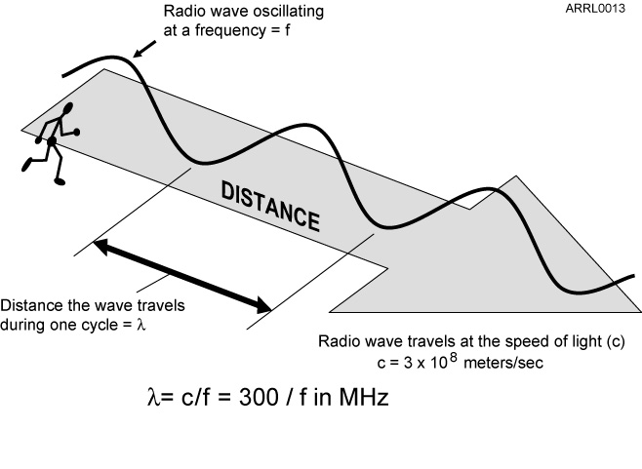
Power and Decibels
AC and DC Waveforms
  Wavelength
    The distance a radio wave travels during the time it takes to complete one cycle.

Slide 12
Power and Decibels
Wavelength
300
f
λ
MHz
meters
300 = f x λ f = 300 / λ λ = 300 / f

Slide 13
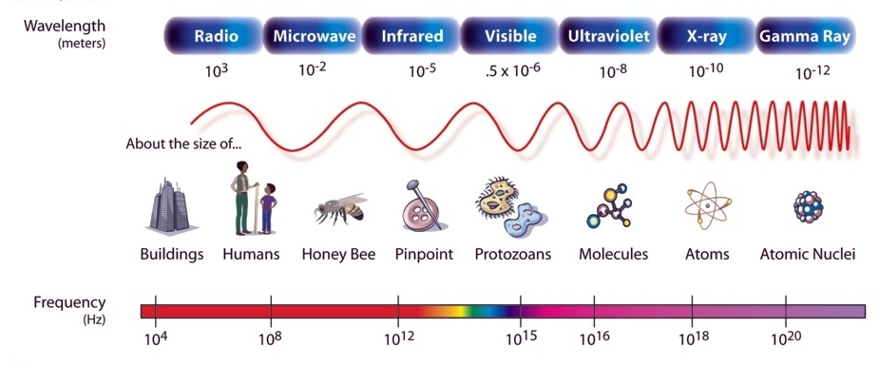
Power and Decibels
AC and DC Waveforms
  Electromagnetic Spectrum

Slide 14
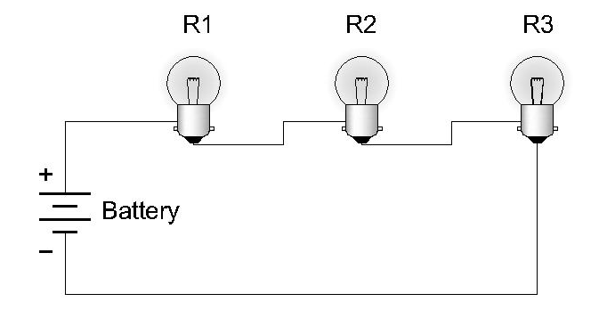
Power and Decibels
Series and Parallel Circuits
  Series Circuit.
    Only one path for current to flow.
    Current is same through each device.

Slide 15
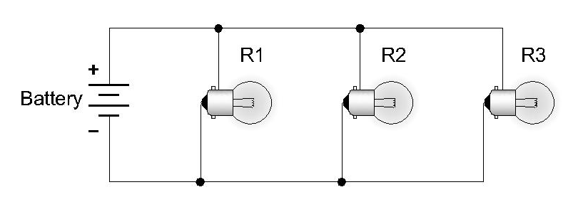
Power and Decibels
Series and Parallel Circuits
  Parallel Circuit.
    Multiple paths for current to flow.
    Voltage is same across each device.

Slide 16
Power and Decibels
Decibels
  Measures a ratio.
    Logarithmic scale.
    Power Ratio:
      dB = 10 log₁₀ (P₁/P₂)
    Voltage Ratio:
      dB = 20 log₁₀ (V₁/V₂)

Slide 17
Power and Decibels
dB | Power Ratio | Voltage Ratio
0 | 1.000 | 1.000
-1 | 0.794 | 0.89
-2 | 0.631 | 0.79
-3 | 0.501 | 0.707
-4 | 0.398 | 0.631
-5 | 0.316 | 0.562
-6 | 0.250 | 0.501
-7 | 0.200 | 0.447
-8 | 0.159 | 0.398
-9 | 0.126 | 0.355
-10 | 0.100 | 0.316
dB | Power Ratio | Voltage Ratio
0 | 1.000 | 1.000
1 | 1.259 | 1.122
2 | 1.585 | 1.259
3 | 1.995 | 1.414
4 | 2.512 | 1.585
5 | 3.162 | 1.778
6 | 4.000 | 1.995
7 | 5.012 | 2.239
8 | 6.310 | 2.512
9 | 7.943 | 2.818
10 | 10.00 | 3.16

Slide 18
G5B01 -- What dB change represents a factor of two increase or decrease in power?
A. Approximately 2 dB
B. Approximately 3 dB
C. Approximately 6 dB
D. Approximately 12 dB

Slide 19
G5B01 -- What dB change represents a factor of two increase or decrease in power?
A. Approximately 2 dB
B. Approximately 3 dB
C. Approximately 6 dB
D. Approximately 12 dB

Slide 20
G5B03 -- How many watts of electrical power are used if 400 VDC is supplied to an 800-ohm load?
A. 0.5 watts
B. 200 watts
C. 400 watts
D. 3200 watts

Slide 21
G5B03 -- How many watts of electrical power are used if 400 VDC is supplied to an 800-ohm load?
A. 0.5 watts
B. 200 watts
C. 400 watts
D. 3200 watts

Slide 22
G5B04 -- How many watts of electrical power are used by a 12-VDC light bulb that draws 0.2 amperes?
A. 2.4 watts
B. 24 watts
C. 6 watts
D. 60 watts

Slide 23
G5B04 -- How many watts of electrical power are used by a 12-VDC light bulb that draws 0.2 amperes?
A. 2.4 watts
B. 24 watts
C. 6 watts
D. 60 watts

Slide 24
G5B05 -- How many watts are consumed when a current of 7.0 milliamperes flows through a 1250 ohm resistance?
A. Approximately 61 milliwatts
B. Approximately 61 watts
C. Approximately 11 milliwatts
D. Approximately 11 watts

Slide 25
G5B05 -- How many watts are consumed when a current of 7.0 milliamperes flows through a 1250 ohm resistance?
A. Approximately 61 milliwatts
B. Approximately 61 watts
C. Approximately 11 milliwatts
D. Approximately 11 watts

Slide 26
G5B10 -- What percentage of power loss is equivalent to a loss of 1 dB?
A. 10.9 percent
B. 12.2 percent
C. 20.6 percent
D. 25.9 percent

Slide 27
G5B10 -- What percentage of power loss is equivalent to a loss of 1 dB?
A. 10.9 percent
B. 12.2 percent
C. 20.6 percent
D. 25.9 percent

Slide 28
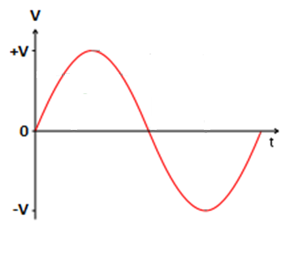
AC Power
RMS: Definition and Measurement
  A DC voltmeter will read the average voltage, which is zero.

Slide 29
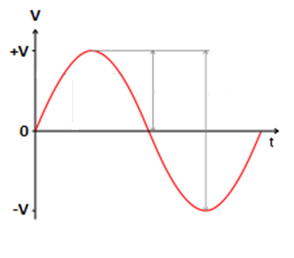
AC Power
RMS: Definition and Measurement
  With an oscilloscope, it is easy to read the peak (maximum) voltage.

Slide 30
AC Power
RMS: Definition and Measurement
    A current will heat up a resistor. The amount of DC current that causes the same amount of heating as the AC current does is the root-mean-square (RMS) value of the AC current.
      RMS = 0.707 x Peak (Sine waves ONLY!)

Slide 31
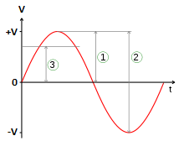
AC Power
RMS: Definition and Measurement
1 = Peak
2 = Peak-to-Peak
3 = Root-Mean-Square (RMS)

Slide 32
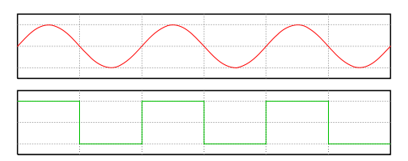
AC Power
RMS: Definition and Measurement
To Calculate | Sine Wave | Square Wave
RMS | 0.707 x Peak | Peak
Peak | 1.414 x RMS | Peak

Slide 33
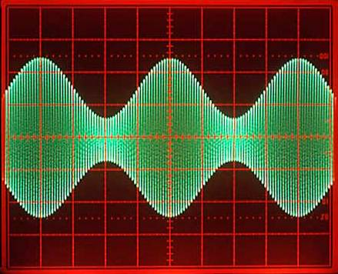
AC Power
PEP: Definition and Measurement
  PEP = Peak Envelope Power
    Average power over one complete cycle at the peak of the RF envelope.

Slide 34
AC Power
PEP: Definition and Measurement
  PEP = Peak Envelope Power
    Measure V_{P} or V_{P-P} using an oscilloscope.
      V_{P-P} = 2 x V_{P}
    Calculate V_{RMS} from V_{P}.
      V_{RMS} = 0.707 x V_{P}
    Calculate PEP from V_{RMS} and load imdepance.
      PEP = V_{RMS}² / R_{load}
  PEP is equal to the average power if no modulation or if FM-modulated.

Slide 35
G5B06 -- What is the PEP produced by 200 volts peak-to-peak across a 50-ohm dummy load?
A. 1.4 watts
B. 100 watts
C. 353.5 watts
D. 400 watts

Slide 36
G5B06 -- What is the PEP produced by 200 volts peak-to-peak across a 50-ohm dummy load?
A. 1.4 watts
B. 100 watts
C. 353.5 watts
D. 400 watts
Notes:
Vp = 200/2 = 100
Vrms = .707 x 100 = 70.7
PEP = (70.7) ² / 50 = 100 (I = E/R = 70.7/50 = 1.414 P= I x E = 70.7 x 1.414 = 100

Slide 37
G5B07 -- Which value of an AC signal results in the same power dissipation as a DC voltage of the same value?
A. The peak-to-peak value
B. The peak value
C. The RMS value
D. The reciprocal of the RMS value

Slide 38
G5B07 -- Which value of an AC signal results in the same power dissipation as a DC voltage of the same value?
A. The peak-to-peak value
B. The peak value
C. The RMS value
D. The reciprocal of the RMS value

Slide 39
G5B08 -- What is the peak-to-peak voltage of a sine wave with an RMS voltage of 120.0 volts?
A. 84.8 volts
B. 169.7 volts
C. 240.0 volts
D. 339.4 volts

Slide 40
G5B08 -- What is the peak-to-peak voltage of a sine wave with an RMS voltage of 120.0 volts?
A. 84.8 volts
B. 169.7 volts
C. 240.0 volts
D. 339.4 volts

Slide 41
G5B09 -- What is the RMS voltage of a sine wave with a value of 17 volts peak?
A. 8.5 volts
B. 12 volts
C. 24 volts
D. 34 volts

Slide 42
G5B09 -- What is the RMS voltage of a sine wave with a value of 17 volts peak?
A. 8.5 volts
B. 12 volts
C. 24 volts
D. 34 volts

Slide 43
G5B11 -- What is the ratio of PEP to average power for an unmodulated carrier?
A. .707
B. 1.00
C. 1.414
D. 2.00

Slide 44
G5B11 -- What is the ratio of PEP to average power for an unmodulated carrier?
A. .707
B. 1.00
C. 1.414
D. 2.00

Slide 45
G5B12 -- What is the RMS voltage across a 50-ohm dummy load dissipating 1200 watts?
A. 173 volts
B. 245 volts
C. 346 volts
D. 692 volts

Slide 46
G5B12 -- What is the RMS voltage across a 50-ohm dummy load dissipating 1200 watts?
A. 173 volts
B. 245 volts
C. 346 volts
D. 692 volts
Notes:
P= IE E=IR
I = P/E E = PR/E E ² = PR
E ² = 1200 x 50 = 60000
E = 245.95 = 245

Slide 47
G5B13 -- What is the output PEP of an unmodulated carrier if the average power is 1060 watts?
A. 530 watts
B. 1060 watts
C. 1500 watts
D. 2120 watts

Slide 48
G5B13 -- What is the output PEP of an unmodulated carrier if the average power is 1060 watts?
A. 530 watts
B. 1060 watts
C. 1500 watts
D. 2120 watts

Slide 49
G5B14 -- What is the output PEP of 500 volts peak-to-peak across a 50-ohm load?
A. 8.75 watts
B. 625 watts
C. 2500 watts
D. 5000 watts
Notes:
Vp = 500/2 = 250
Vrms = .707 x 250 = 176.75
PEP = (176.75) ² / 50 = 625 (I = E/R = 176.75/50 = 3.54 P= I x E = 176.75 x 3.54 = 625

Slide 50
G5B14 -- What is the output PEP of 500 volts peak-to-peak across a 50-ohm load?
A. 8.75 watts
B. 625 watts
C. 2500 watts
D. 5000 watts

Slide 51
Basic Components
Definitions:
  Nominal Value -- Intended value of the component.
  Tolerance -- Amount value of the component may vary from the nominal value.
  Temperature Coefficient -- Amount & direction value of component changes with changes in temperature.
  Power/Voltage/Current Rating -- Maximum power/voltage/current the component will withstand before damage occurs.

Slide 52
Basic Components
Resistors & Resistance
  Resistance
    Opposition to the flow of electrons.
    Converts electrical energy to heat.
    Unit of measurement = Ohm (Ω).
    Symbol used in equations = R.
    Components designed to provide resistance are called “resistors”.

Slide 53
Basic Components
Resistors & Resistance
  Resistors
    Resistances range from <1 Ω to >10 MΩ
      Ω = ohms
      kΩ = kilohms (10³ ohms)
      MΩ = megohms (10⁶ ohms)
    Tolerances of 0.1% to 20%.
    Temperature coefficients can be positive or negative depending on material.
      Positive = Value increases as temperature increases.
      Negative = Value decreases as temperature increases.

Slide 54
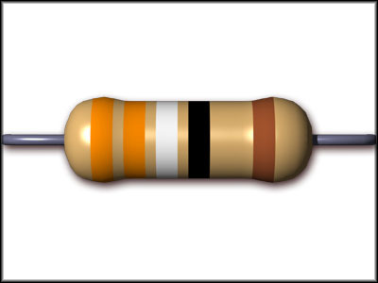
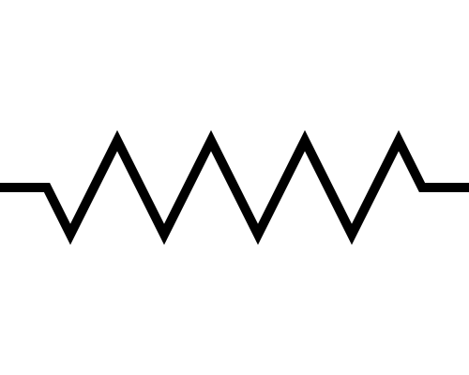
Basic Components
Resistors & Resistance
  Resistances range from <1 Ω to >20 MΩ
  Values often indicated by colored bands on body.

Slide 55
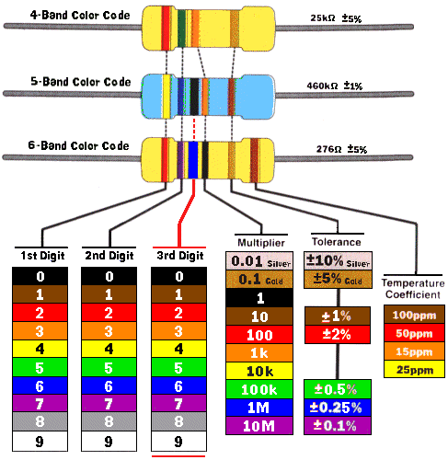
Basic Components
Color | Value
Silver* | 0.01
Gold* | 0.1
Black | 0
Brown | 1
Red | 2
Orange | 3
Yellow | 4
Green | 5
Blue | 6
Violet | 7
Gray | 8
White | 9
* Tolerance & multiplier only

Slide 56
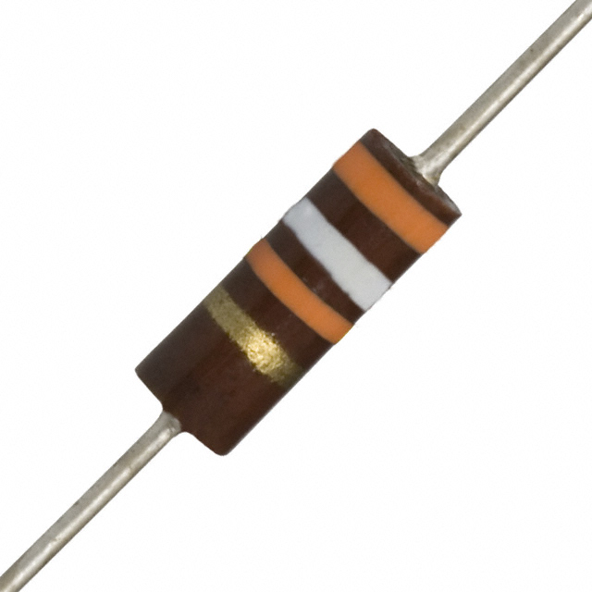
Basic Components
Resistors & Resistance
  Resistor types
    Carbon composition.
      <1 Ω to 22 MΩ.
      1/8 to 2 Watts.
      Tolerance 5%, 10%, & 20%
      Poor temperature stability
      Along with wirewound, oldest technology.
        Not commonly used after 1970.

Slide 57
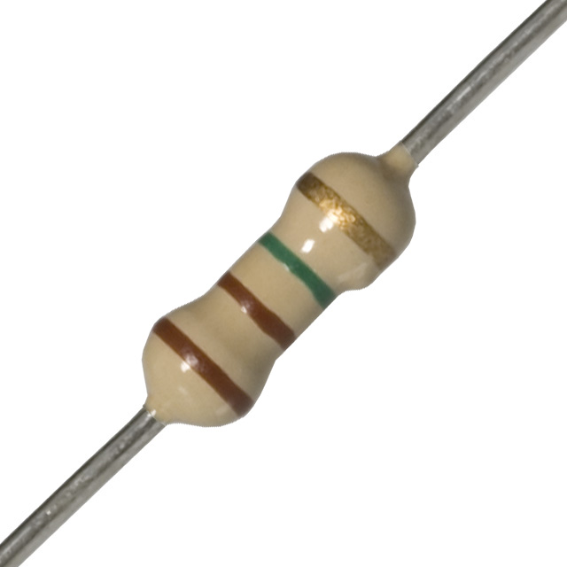
Basic Components
Resistors & Resistance
  Resistor types
    Carbon film.
      1 Ω to 10 MΩ.
      1/8 to 5 Watts.
      Wide operating temperature range.

Slide 58
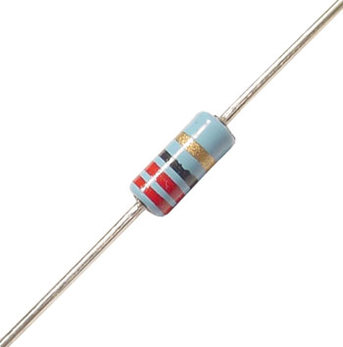
Basic Components
Resistors & Resistance
  Resistor types
    Metal Film.
      <1 Ω to >10 MΩ.
      1/8 to 2 Watts.
      Tolerance 0.1%, 1%, & 2%.
      Good temperature stability.
      Low noise.
      Most commonly used today.

Slide 59
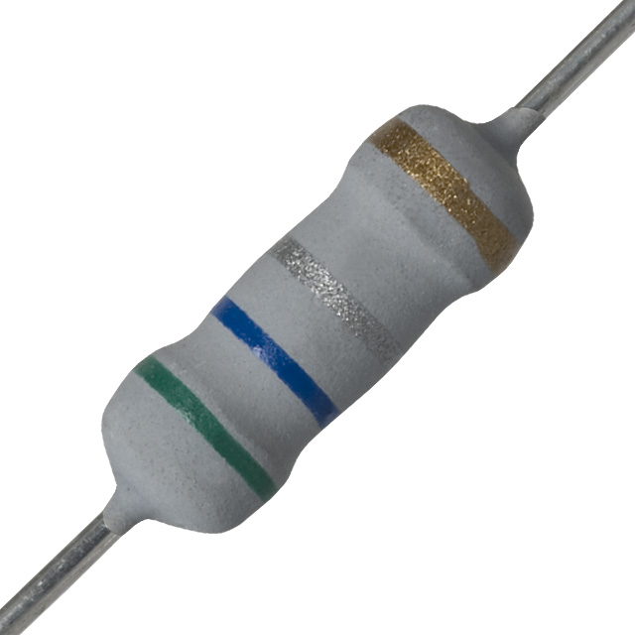
Basic Components
Resistors & Resistance
  Resistor types
    Metal-oxide film.
      Similar to metal film.
      Higher operating temperatures.
      Higher temperature stability.
      Low stray inductance.
        Good for RF circuits.

Slide 60
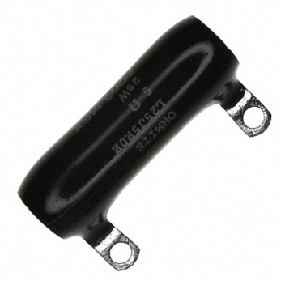
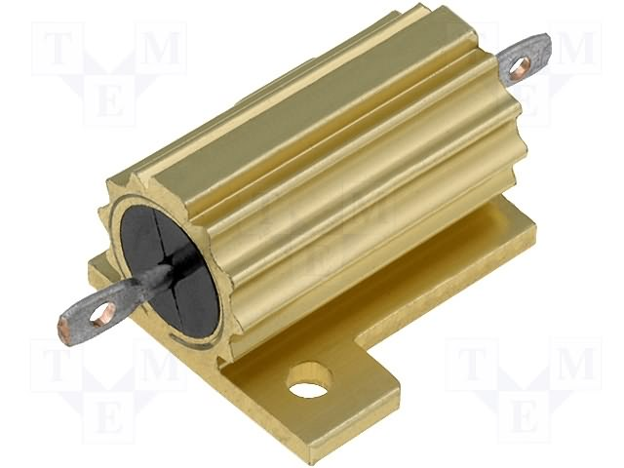
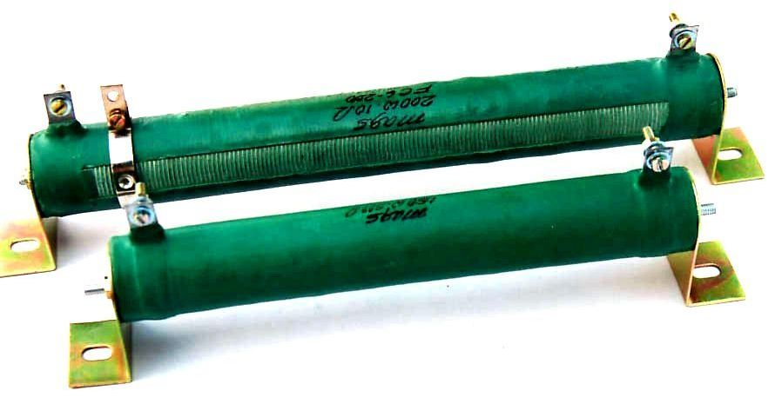
Basic Components
Resistors & Resistance
  Resistor types
    Wirewound.
      High power.
        Up to 200 Watts or more.
      High inductance – not good for RF circuits.
      May have metal case for attaching to a heat sink.
      May be tapped to adjust value.

Slide 61
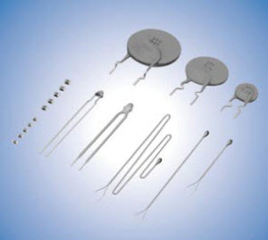
Basic Components
Resistors & Resistance
  Resistor types
    Thermistor.
      Special type of resistor with precisely known temperature coefficient.
        Both positive (PTC) & negative (NTC) temperature coefficients are available.
      Used for temperature sensing.

Slide 62
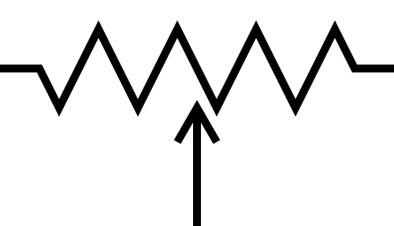
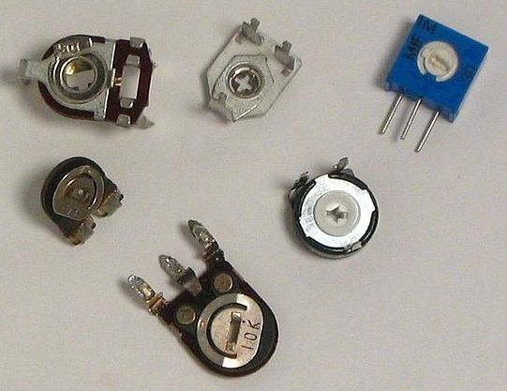
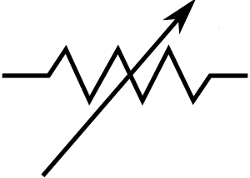
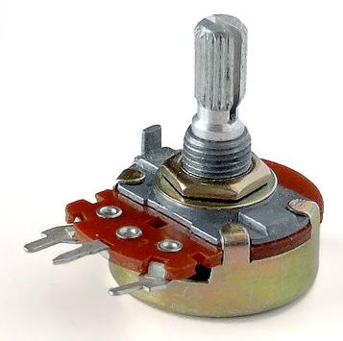
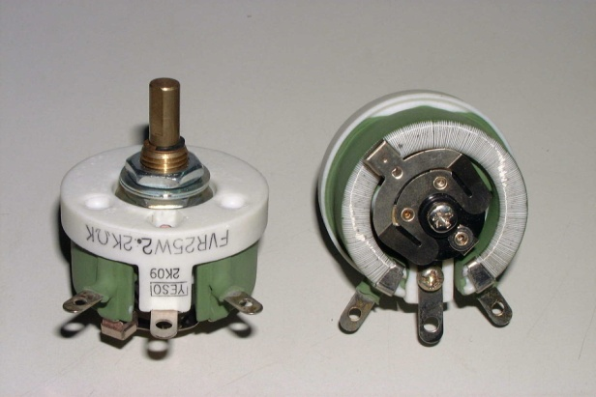
Basic Components
Resistors & Resistance
  Resistor types
    Variable Resistors.
      Potentiometers.
      Rheostats
      Materials
        Graphite.
        Cermet.
        Wirewound.
      Taper.
        Linear.
        Semi-Log.

Slide 63
Basic Components
Resistors & Resistance
  Parasitic inductance.
    Parasitic inductance changes characteristics of resistor at high frequencies.
    Use low-inductance resistors in RF circuits.
      Carbon composition.
      Carbon film.
      Metal film.
      Metal-oxide film.
    Avoid high-inductance resistors.
      Wirewound.

Slide 64
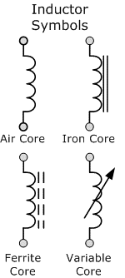
Basic Components
Inductors & Inductance
  Inductance.
    Ability to store energy in a magnetic field.
    Opposes a change in current flow.
    Unit of Measurement = Henry (H)
    Symbol used in equations = L.
    Components designed to provide inductance are called “inductors” or “coils”.

Slide 65
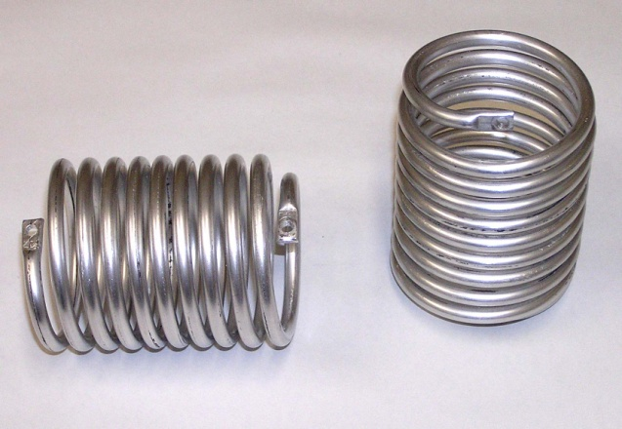
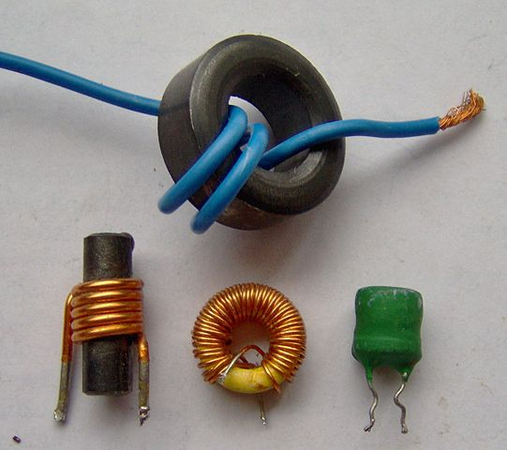
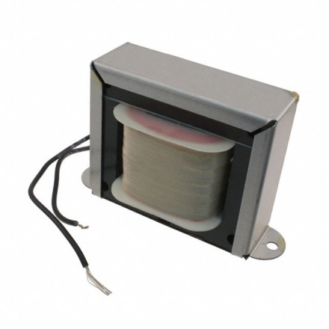
Basic Components
Inductors & Inductance
  Inductors.
    Inductances range from <1 μH to >1 H.
      H = henries
      mH = millihenries (10⁻³ henries)
      μH = microhenries (10⁻⁶ henries)

Slide 66
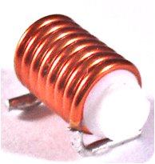
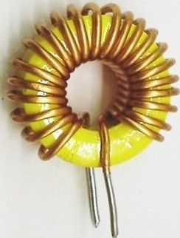
Basic Components
Inductors & Inductance
  Inductors.
    Different shapes.
      Solenoidal
      Toroidal.

Slide 67
Basic Components
Inductors & Inductance
  Inductors.
    Different core materials.
      Laminated iron.
        Used in high-inductance, low-frequency applications such as power supply filter chokes.
      Powdered iron or ferrite.
        Used in medium-inductance applications.
      Air.
        Used in low-inductance, high-frequency applications such as transmitting coils.

Slide 68
Basic Components
Inductors & Inductance
  Inductors.
    Mutual inductance.
      If the magnetic field from one inductor extends to another inductor, then the current flowing in the 1st inductor will effect the current flowing in the 2nd inductor. This is called mutual inductance or transformer action.
      Usually undesirable.
      Minimizing mutual inductance.
        Shield with magnetic material.
        Place solenoidal coils at right angles to one another.
        Use toroidal cores.

Slide 69
Basic Components
Inductors & Inductance
  Inductors.
    At high frequencies, inter-turn capacitance can become significant.
      Inductor can become self-resonant.

Slide 70
Basic Components
Capacitors & Capacitance
  Capacitance
    Ability to store energy in an electric field.
    Opposes a change in voltage.
    Unit of Measurement = Farad (F).
    Symbol used in equations = C.
    Components designed to provide capacitance are called “capacitors” or “condensers”.

Slide 71
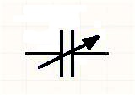
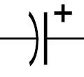
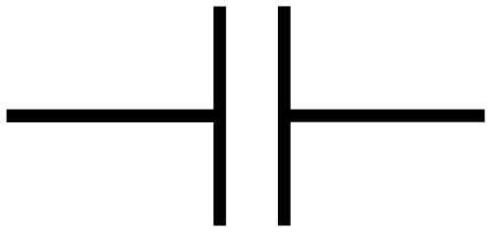
Basic Components
Capacitors & Capacitance
  Capacitors.
    Capacitances range from <1 pF to >1 F.
      F = Farads
      μF = microfarads (10⁻⁶ farads)
      nF = nanofarads (10⁻⁹ farads)
      pF = picofarads (10⁻¹² farads)

Slide 72
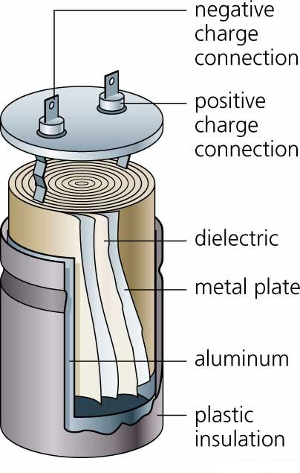
Basic Components
Capacitors & Capacitance
  Capacitors.
    Two conducting plates separated by an insulator.
      The larger the plates, the higher the capacitance.
      The closer the plates, the higher the capacitance.
      The higher the dielectric constant of the insulator, the higher the capacitance.

Slide 73
Basic Components
Capacitors & Capacitance
  Capacitors.
    At high frequencies, inductance of leads can become significant.
      Effective capacitance can be reduced.
      Capacitor can become self-resonant.

Slide 74
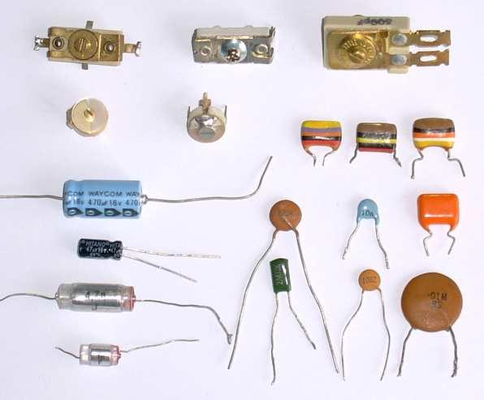
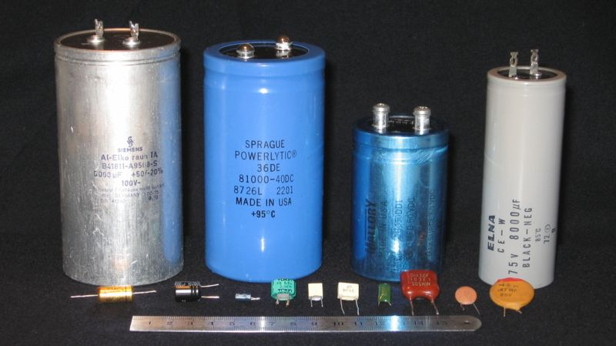
Basic Components
Capacitors & Capacitance
  Capacitors.

Slide 75
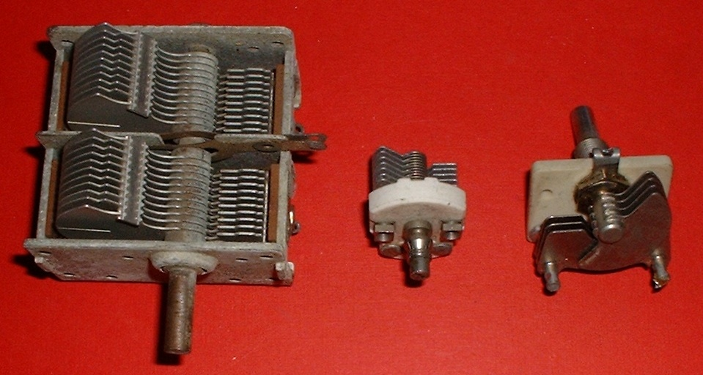
Basic Components
Capacitors & Capacitance
  Variable Capacitors.

Slide 76
Basic Components
Capacitors & Capacitance
  Types of Capacitors.
    Air / Vacuum.
    Mica / Silver Mica.
    Ceramic.
    Plastic Film (Polystyrene or Mylar).
    Paper.
    Oil-filled.
    Electrolytic / Tantalum.

Slide 77
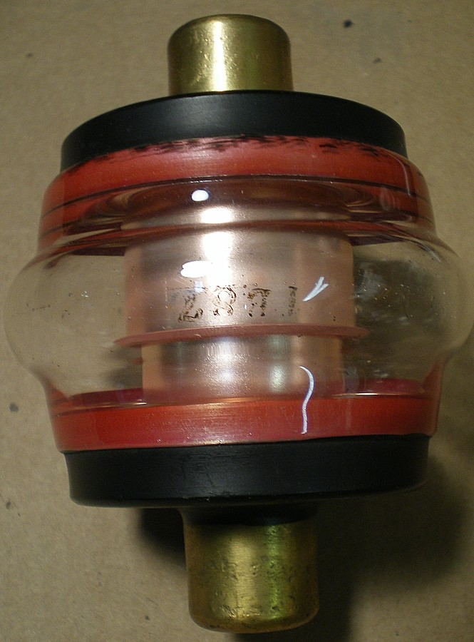
Basic Components
Capacitors & Capacitance
  Types of Capacitors.
    Air / Vacuum.
      High voltage applications.
      Low Capacitance.
      Transmitter circuits.

Slide 78
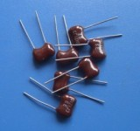
Basic Components
Capacitors & Capacitance
  Types of Capacitors.
    Mica / Silver Mica.
      High stability.
      Low loss.
      RF circuits.

Slide 79
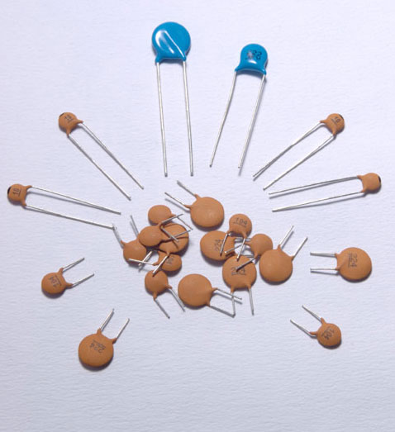
Basic Components
Capacitors & Capacitance
  Types of Capacitors.
    Ceramic.
      Inexpensive.
      Wide range of capacitances available.
      Low to high voltage ratings available.
      RF bypassing & filtering.

Slide 80
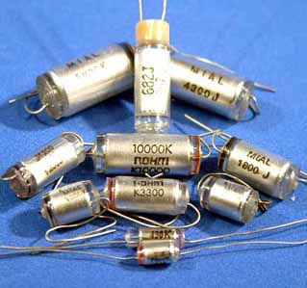
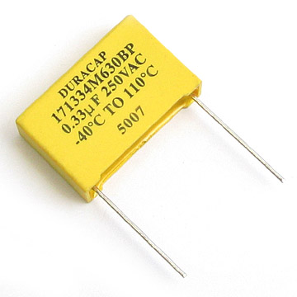
Basic Components
Capacitors & Capacitance
  Types of Capacitors.
    Plastic Film
      Polystyrene or Mylar.
      AF & lower frequencies.
      Susceptible to damage from high temperatures.

Slide 81
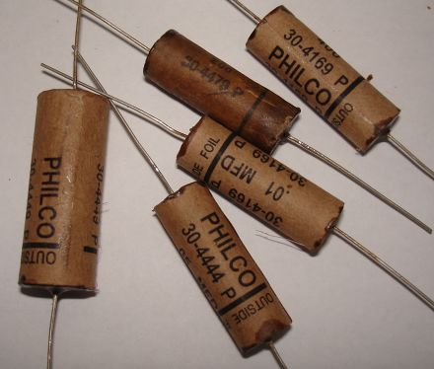
Basic Components
Capacitors & Capacitance
  Types of Capacitors.
    Paper.
      Obsolete.
      Found in antique equipment.

Slide 82
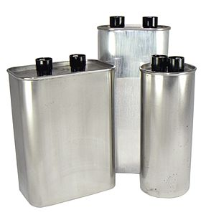
Basic Components
Capacitors & Capacitance
  Types of Capacitors.
    Oil-filled.
      High voltage.
      AC Power circuits.

Slide 83
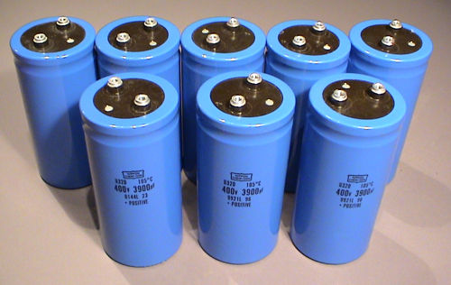
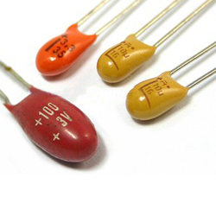
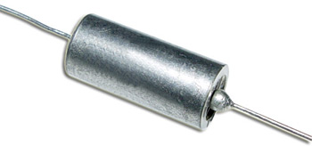
Basic Components
Capacitors & Capacitance
  Types of Capacitors.
    Electrolytic / Tantalum.
      Polarized.
      High capacitance in physically small size.
      Power supply filters.
      Low-impedance AF coupling.

Slide 84
Basic Components
Components in Series & Parallel Circuits
  Kirchoff's Voltage Law: The sum of the voltages around a loop must be zero.
  Kirchoff's Current Law: The sum of all currents entering a node is equal to the sum of all currents leaving the node.

Slide 85
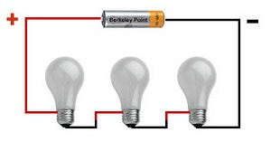
Basic Components
Components in Series & Parallel Circuits
  Series Circuits.
    FACT: Electrons cannot be created or destroyed.
    CONCLUSION: In a series circuit the current through each component is equal.

Slide 86
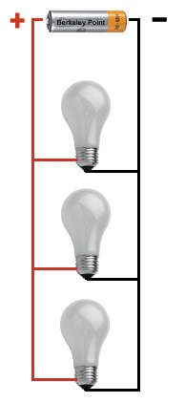
Basic Components
Components in Series & Parallel Circuits
  Parallel Circuits.
    FACT: There is no voltage drop across a junction (or node).
    CONCLUSION: In a parallel circuit the voltage across each component is equal.

Slide 87
Basic Components
Components in Series & Parallel Circuits
  Resistors.
    Series: R_{T} = R₁ + R₂ + R₃ + . . . . +R_{n}
    Parallel: R_{T} = 1 / (1/R₁ + 1/R₂ + 1/R₃ + . . . . + 1/R_{n})
      If only 2 resistors: R_{T} = (R₁ x R₂) / (R₁ + R₂)
      If all resistors are same value: R_{T} = R / (nr of resistors)
      Total resistance always less than lowest value resistor.

Slide 88
Basic Components
Components in Series & Parallel Circuits
  Inductors.
    Series: L_{T} = L₁ + L₂ + L₃ + . . . . +L_{n}
    Parallel: L_{T} = 1 / (1/L₁ + 1/L₂ + 1/L₃ + . . . . + 1/L_{n})
      If only 2 inductors: L_{T} = (L₁ x L₂) / (L₁ + L₂)
      If all inductors are same value: L_{T} = L / (nr of inductors)
      Total inductance always less than lowest value inductor.

Slide 89
Basic Components
Components in Series & Parallel Circuits
  Capacitors.
    Series: C_{T} = 1 / (1/C₁ + 1/C₂ + 1/C₃ + . . . . + 1/C_{n})
      If only 2 capacitors: C_{T} = (C₁ x C₂) / (C₁ + C₂)
      If all capacitors are same value: C_{T} = C / (nr of capacitors)
      Total capacitance always less than lowest value capacitor.
    Parallel: C_{T} = C₁ + C₂ + C₃ + . . . . +C_{n}

Slide 90
Basic Components
Components in Series & Parallel Circuits
  In Summary:
    Voltages add in a series circuit.
    Currents add in a parallel circuit.
Component Type | Adding in Series | Adding in Parallel
Resistor | Increases Total Value | Decreases Total Value
Inductor | Increases Total Value | Decreases Total Value
Capacitor | Decreases Total Value | Increases Total Value

Slide 91
Basic Components
Transformers
  Two or more inductors wound on a common core to maximize mutual inductance.
    Inductors are called “windings”.
    A winding connected to the signal source is called the “primary”.
      In special applications, there may be more than one primary.
    A winding connected to a load is called a “secondary”.
      It is common to have more than one secondary.

Slide 92
Basic Components
Transformers
  Transformers transfer AC power from the primary to each secondary.
  Transformers work equally well in both directions.
    Which winding is the “primary” and which is the “secondary” depends on how the transformer is connected in the circuit.

Slide 93
Basic Components
Transformers
  Turns ratio.
    The primary & secondary windings can have different numbers of turns (and usually do).
      Turns Ratio = N_{P}:N_{S}.
    The ratio of the voltage applied to the primary to the voltage appearing at the secondary is equal to the turns ration.
      Turns Ratio = E_{P}:E_{S}.
    Consequently:
      E_{S} = E_{P} x (N_{P}/N_{S}) and E_{P} = E_{S} x (N_{S}/N_{P})

Slide 94
Basic Components
Transformers
  Turns ratio.
    Power input = power output (ignoring losses).
    If 120V_{AC} is applied to the primary of a transformer with a turns ratio of 10:1, then the secondary voltage will be 12V_{AC}.
    If a 1A current is flowing in the primary, then the current flowing in the secondary will be 10A.
      120V_{AC} x 1A = 120W = 12V_{AC} x 10A

Slide 95

Break

Slide 96

G7A09 -- Which symbol in figure G7-1 represents a field effect transistor?
A. Symbol 2
B. Symbol 5
C. Symbol 1
D. Symbol 4

Slide 97
G7A09 -- Which symbol in figure G7-1 represents a field effect transistor?
A. Symbol 2
B. Symbol 5
C. Symbol 1
D. Symbol 4

Slide 98
G7A10 -- Which symbol in figure G7-1 represents a Zener diode?
A. Symbol 4
B. Symbol 1
C. Symbol 11
D. Symbol 5

Slide 99
G7A10 -- Which symbol in figure G7-1 represents a Zener diode?
A. Symbol 4
B. Symbol 1
C. Symbol 11
D. Symbol 5

Slide 100
G7A11 -- Which symbol in figure G7-1 represents an NPN junction transistor?
A. Symbol 1
B. Symbol 2
C. Symbol 7
D. Symbol 11

Slide 101
G7A11 -- Which symbol in figure G7-1 represents an NPN junction transistor?
A. Symbol 1
B. Symbol 2
C. Symbol 7
D. Symbol 11

Slide 102
G7A12 -- Which symbol in Figure G7-1 represents a solid core transformer?
A. Symbol 4
B. Symbol 7
C. Symbol 6
D. Symbol 1

Slide 103
G7A12 -- Which symbol in Figure G7-1 represents a solid core transformer?
A. Symbol 4
B. Symbol 7
C. Symbol 6
D. Symbol 1

Slide 104
G7A13 -- Which symbol in Figure G7-1 represents a tapped inductor?
A. Symbol 7
B. Symbol 11
C. Symbol 6
D. Symbol 1

Slide 105
G7A13 -- Which symbol in Figure G7-1 represents a tapped inductor?
A. Symbol 7
B. Symbol 11
C. Symbol 6
D. Symbol 1

Slide 106
G6B01 -- What determines the performance of a ferrite core at different frequencies?
A. Its conductivity
B. Its thickness
C. The composition, or “mix,” of materials used
D. The ratio of outer diameter to inner diameter

Slide 107
G6B01 -- What determines the performance of a ferrite core at different frequencies?
A. Its conductivity
B. Its thickness
C. The composition, or “mix,” of materials used
D. The ratio of outer diameter to inner diameter

Slide 108
G6B05 -- What is an advantage of using a ferrite core toroidal inductor?
A. Large values of inductance may be obtained
B. The magnetic properties of the core may be optimized for a specific range of frequencies
C. Most of the magnetic field is contained in the core
D. All these choices are correct

Slide 109
G6B05 -- What is an advantage of using a ferrite core toroidal inductor?
A. Large values of inductance may be obtained
B. The magnetic properties of the core may be optimized for a specific range of frequencies
C. Most of the magnetic field is contained in the core
D. All these choices are correct

Slide 110
G6A04 -- Which of the following is characteristic of an electrolytic capacitor?
A. Tight tolerance
B. Much less leakage than any other type
C. High capacitance for a given volume
D. Inexpensive RF capacitor

Slide 111
G6A04 -- Which of the following is characteristic of an electrolytic capacitor?
A. Tight tolerance
B. Much less leakage than any other type
C. High capacitance for a given volume
D. Inexpensive RF capacitor

Slide 112
G6A08 -- Which of the following is characteristic of low voltage ceramic capacitors?
A. Tight tolerance
B. High stability
C. High capacitance for given volume
D. Comparatively low cost

Slide 113
G6A08 -- Which of the following is characteristic of low voltage ceramic capacitors?
A. Tight tolerance
B. High stability
C. High capacitance for given volume
D. Comparatively low cost

Slide 114
G5C01 -- What causes a voltage to appear across the secondary winding of a transformer when an AC voltage source is connected across its primary winding?
A. Capacitive coupling
B. Displacement current coupling
C. Mutual inductance
D. Mutual capacitance

Slide 115
G5C01 -- What causes a voltage to appear across the secondary winding of a transformer when an AC voltage source is connected across its primary winding?
A. Capacitive coupling
B. Displacement current coupling
C. Mutual inductance
D. Mutual capacitance

Slide 116
G5C02 -- What is the output voltage if an input signal is applied to the secondary winding of a 4:1 voltage step-down transformer instead of the primary winding?
A. The input voltage is multiplied by 4
B. The input voltage is divided by 4
C. Additional resistance must be added in series with the primary to prevent overload
D. Additional resistance must be added in parallel with the secondary to prevent overload

Slide 117
G5C02 -- What is the output voltage if an input signal is applied to the secondary winding of a 4:1 voltage step-down transformer instead of the primary winding?
A. The input voltage is multiplied by 4
B. The input voltage is divided by 4
C. Additional resistance must be added in series with the primary to prevent overload
D. Additional resistance must be added in parallel with the secondary to prevent overload

Slide 118
G5C05 -- Why is the primary winding wire of a voltage step-up transformer usually a larger size than that of the secondary winding?
A. To improve the coupling between the primary and secondary
B. To accommodate the higher current of the primary
C. To prevent parasitic oscillations due to resistive losses in the primary
D. To ensure that the volume of the primary winding is equal to the volume of the secondary winding

Slide 119
G5C05 -- Why is the primary winding wire of a voltage step-up transformer usually a larger size than that of the secondary winding?
A. To improve the coupling between the primary and secondary
B. To accommodate the higher current of the primary
C. To prevent parasitic oscillations due to resistive losses in the primary
D. To ensure that the volume of the primary winding is equal to the volume of the secondary winding

Slide 120
G5C06 -- What is the voltage output of a transformer with a 500-turn primary and a 1500-turn secondary when 120 VAC is applied to the primary?
A. 360 volts
B. 120 volts
C. 40 volts
D. 25.5 volts

Slide 121
G5C06 -- What is the voltage output of a transformer with a 500-turn primary and a 1500-turn secondary when 120 VAC is applied to the primary?
A. 360 volts
B. 120 volts
C. 40 volts
D. 25.5 volts

Slide 122
G5B02 -- How does the total current relate to the individual currents in a circuit of parallel resistors?
A. It equals the average of each branch current
B. It decreases as more parallel branches are added to the circuit
C. It equals the sum of the currents through each branch
D. It is the sum of the reciprocal of each individual voltage drop

Slide 123
G5B02 -- How does the total current relate to the individual currents in a circuit of parallel resistors?
A. It equals the average of each branch current
B. It decreases as more parallel branches are added to the circuit
C. It equals the sum of the currents through each branch
D. It is the sum of the reciprocal of each individual voltage drop

Slide 124
G5C03 -- What is the total resistance of a 10-, a 20-, and a 50-ohm resistor connected in parallel?
A. 5.9 ohms
B. 0.17 ohms
C. 17 ohms
D. 80 ohms

Slide 125
G5C03 -- What is the total resistance of a 10-, a 20-, and a 50-ohm resistor connected in parallel?
A. 5.9 ohms
B. 0.17 ohms
C. 17 ohms
D. 80 ohms

Slide 126
G5C04 -- What is the approximate total resistance of a 100- and a 200-ohm resistor in parallel?
A. 300 ohms
B. 150 ohms
C. 75 ohms
D. 67 ohms

Slide 127
G5C04 -- What is the approximate total resistance of a 100- and a 200-ohm resistor in parallel?
A. 300 ohms
B. 150 ohms
C. 75 ohms
D. 67 ohms

Slide 128
G5C08 -- What is the equivalent capacitance of two 5.0 nanofarad capacitors and one 750 picofarad capacitor connected in parallel?
A. 576.9 nanofarads
B. 1733 picofarads
C. 3583 picofarads
D. 10.750 nanofarads

Slide 129
G5C08 -- What is the equivalent capacitance of two 5.0 nanofarad capacitors and one 750 picofarad capacitor connected in parallel?
A. 576.9 nanofarads
B. 1733 picofarads
C. 3583 picofarads
D. 10.750 nanofarads

Slide 130
G5C09 -- What is the capacitance of three 100 microfarad capacitors connected in series?
A. .30 microfarads
B. .33 microfarads
C. 33.3 microfarads
D. 300 microfarads

Slide 131
G5C09 -- What is the capacitance of three 100 microfarad capacitors connected in series?
A. .30 microfarads
B. .33 microfarads
C. 33.3 microfarads
D. 300 microfarads

Slide 132
G5C10 -- What is the inductance of three 10 millihenry inductors connected in parallel?
A. 0.30 henries
B. 3.3 henries
C. 3.3 millihenries
D. 30 millihenries

Slide 133
G5C10 -- What is the inductance of three 10 millihenry inductors connected in parallel?
A. 0.30 henries
B. 3.3 henries
C. 3.3 millihenries
D. 30 millihenries

Slide 134
G5C11 -- What is the inductance of a circuit with a 20 millihenry inductor connected in series with a 50 millihenry inductor?
A. 0.07 millihenries
B. 14.3 millihenries
C. 70 millihenries
D. 1000 millihenries

Slide 135
G5C11 -- What is the inductance of a circuit with a 20 millihenry inductor connected in series with a 50 millihenry inductor?
A. 0.07 millihenries
B. 14.3 millihenries
C. 70 millihenries
D. 1000 millihenries

Slide 136
G5C12 -- What is the capacitance of a 20 microfarad capacitor connected in series with a 50 microfarad capacitor?
A. 0.07 microfarads
B. 14.3 microfarads
C. 70 microfarads
D. 1000 microfarads

Slide 137
G5C12 -- What is the capacitance of a 20 microfarad capacitor connected in series with a 50 microfarad capacitor?
A. 0.07 microfarads
B. 14.3 microfarads
C. 70 microfarads
D. 1000 microfarads

Slide 138
G5C13 -- Which of the following components should be added to a capacitor to increase the capacitance?
A. An inductor in series
B. A resistor in series
C. A capacitor in parallel
D. A capacitor in series

Slide 139
G5C13 -- Which of the following components should be added to a capacitor to increase the capacitance?
A. An inductor in series
B. A resistor in series
C. A capacitor in parallel
D. A capacitor in series

Slide 140
G5C14 -- Which of the following components should be added to an inductor to increase the inductance?
A. A capacitor in series
B. A resistor in parallel
C. An inductor in parallel
D. An inductor in series

Slide 141
G5C14 -- Which of the following components should be added to an inductor to increase the inductance?
A. A capacitor in series
B. A resistor in parallel
C. An inductor in parallel
D. An inductor in series

Slide 142
Reactance, Impedance, and Resonance
Reactance
  All resistors do is convert electrical energy into heat.
    They don’t care whether current is DC or AC.
  Inductors & capacitors store energy.
    React differently to AC than to DC voltages/currents.
    Response to an AC voltage or current is called “reactance”.
      Unit of measurement = Ohm (Ω)
      Symbol used in equations = X_{L} or X_{C}

Slide 143
Reactance, Impedance, and Resonance
Reactance
  Capacitive reactance.
    X_{C} = 1 / (2πfC)
    In a DC circuit (f = 0), X_{C} = ∞.
      Capacitor looks like an open circuit.
        After initial charging current, the current flow drops to zero.
    At extremely high frequencies (f = ∞), X_{C} = 0.
      Capacitor looks like a short circuit.

Slide 144

Reactance, Impedance, and Resonance
  Reactance
    Capacitive Reactance
      XC = 1 / (2πfC)
      Reactance decreases with increasing frequency.
      Capacitors oppose change in voltage.
      Capacitor looks like open circuit at 0 Hz (DC).
      Capacitor looks like short circuit at very high frequencies.
      A capacitor blocks DC current, resists low-frequency AC current, & passes high-frequency AC current.

Slide 145

Reactance, Impedance, and Resonance
  Reactance
    Capacitive Reactance
      When energy is first applied to a capacitor, the voltage is zero, & the current jumps to a large value.
      As the capacitor charges up, the voltage climbs to the steady state value and the current drops to zero.

Slide 146

Reactance, Impedance, and Resonance
  Reactance
    Inductive Reactance
        X_{L} = 2πfL
      Reactance increases with increasing frequency.
      Inductors oppose change in current.
      Inductor looks like a short circuit at 0 Hz (DC).
      Inductor looks like an open circuit at very high frequencies.
      An inductor passes DC current, resists low-frequency AC current, & blocks high-frequency AC current.

Slide 147

Reactance, Impedance, and Resonance
  Reactance
    Inductive Reactance
      When energy is first applied to a capacitor, the current is zero, & the voltage jumps to a large value.
      As the inductor charges up, the current climbs to the steady state value and the voltage drops to zero.

Slide 148
Reactance, Impedance, and Resonance
  Impedance
    The opposition to current flow in an AC circuit caused by resistance, capacitive reactance, inductive reactance, or any combination thereof.
      Unit of measurement = Ohm (Ω)
      Symbol used in equations = Z.

Slide 149
Reactance, Impedance, and Resonance
  Resonance
    Condition when frequency of applied signal matches “natural” frequency of circuit.
    At the resonant frequency, the inductive & capacitive reactances are equal and cancel each other out, leaving a purely resistive impedance.
      X_{L} = X_{C} → 2πfL = 1 / (2πfC) → f = 1 / 2πLC

Slide 150
Reactance, Impedance, and Resonance
  Resonance
    Resonant circuits are used in:
      Filters.
      Tuned stages in receivers & transmitters.
      Antennas & Traps.
    Parasitic inductances & capacitances can cause a component to become “self-resonant” & lead to unwanted behavior.

Slide 151
Reactance, Impedance, and Resonance
  Impedance Transformation
    In a DC circuit, resistance is calculated using Ohm’s Law:
    R = E / I
    Similarly, in an AC circuit, impedance is also calculated using Ohm’s Law:
    Z = E / I

Slide 152
Reactance, Impedance, and Resonance
  Impedance Transformation
    Since a transformer changes the voltage & current levels in an AC circuit, it also changes the impedance.
      Impedance is calculated from the turns ratio (N_{P}/N_{S}) using the following formulas:
        Z_{P} = Z_{S} x (N_{P}/N_{S})²
        Z_{S} = Z_{P} x (N_{S}/N_{P})²
    The required turns ratio is calculated using the following formula:
        Turns Ratio (N_{S}/N_{P}) = Z_{P}/Z_{S}

Slide 153
Reactance, Impedance, and Resonance
  Impedance Matching
    All power sources have an internal impedance which limits the amount of power that can be delivered.
    Maximum power is delivered only when the load impedance matches the source impedance.
        Z_{S} = Z_{L}

Slide 154
Reactance, Impedance, and Resonance
  Impedance Matching
    Most modern amateur transmitting equipment is designed to have a source impedance of 50 Ohms.
        Z_{S} = 50 Ω
    Therefore, load impedance should be 50 Ohms for maximum power transfer to the load.
    Z_{L} = 50 Ω
    This is not usually the case!

Slide 155
Reactance, Impedance, and Resonance
  Impedance Matching
    Antenna impedance varies from one frequency to another.
    A matching network is needed to transform the antenna system impedance to a 50Ω resistive load.
      L-C circuits.
        Most common type.
      Lengths of transmission line.
      Transformers.
        Cannot eliminate reactance.

Slide 156


Reactance, Impedance, and Resonance
  Impedance Matching
    Pi-Network.
      Often used in transmitter output stages to provide 50Ω source impedance.
    T-Network.
      Most common circuit for antenna tuners or “Transmatches”.

Slide 157
G5A02 -- What is reactance?
A. Opposition to the flow of direct current caused by resistance
B. Opposition to the flow of alternating current caused by capacitance or inductance
C. A property of ideal resistors in AC circuits
D. A large spark produced at switch contacts when an inductor is de-energized

Slide 158
G5A02 -- What is reactance?
A. Opposition to the flow of direct current caused by resistance
B. Opposition to the flow of alternating current caused by capacitance or inductance
C. A property of ideal resistors in AC circuits
D. A large spark produced at switch contacts when an inductor is de-energized

Slide 159
G5A03 -- Which of the following is opposition to the flow of alternating current in an inductor?
A. Conductance
B. Reluctance
C. Admittance
D. Reactance

Slide 160
G5A03 -- Which of the following is opposition to the flow of alternating current in an inductor?
A. Conductance
B. Reluctance
C. Admittance
D. Reactance

Slide 161
G5A04 -- Which of the following is opposition to the flow of alternating current in a capacitor?
A. Conductance
B. Reluctance
C. Reactance
D. Admittance

Slide 162
G5A04 -- Which of the following is opposition to the flow of alternating current in a capacitor?
A. Conductance
B. Reluctance
C. Reactance
D. Admittance

Slide 163
G5A05 -- How does an inductor react to AC?
A. As the frequency of the applied AC increases, the reactance decreases
B. As the amplitude of the applied AC increases, the reactance increases
C. As the amplitude of the applied AC increases, the reactance decreases
D. As the frequency of the applied AC increases, the reactance increases

Slide 164
G5A05 -- How does an inductor react to AC?
A. As the frequency of the applied AC increases, the reactance decreases
B. As the amplitude of the applied AC increases, the reactance increases
C. As the amplitude of the applied AC increases, the reactance decreases
D. As the frequency of the applied AC increases, the reactance increases

Slide 165
G5A06 -- How does a capacitor react to AC?
A. As the frequency of the applied AC increases, the reactance decreases
B. As the frequency of the applied AC increases, the reactance increases
C. As the amplitude of the applied AC increases, the reactance increases
D. As the amplitude of the applied AC increases, the reactance decreases

Slide 166
G5A06 -- How does a capacitor react to AC?
A. As the frequency of the applied AC increases, the reactance decreases
B. As the frequency of the applied AC increases, the reactance increases
C. As the amplitude of the applied AC increases, the reactance increases
D. As the amplitude of the applied AC increases, the reactance decreases

Slide 167
G5A09 -- What unit is used to measure reactance?
A. Farad
B. Ohm
C. Ampere
D. Siemens

Slide 168
G5A09 -- What unit is used to measure reactance?
A. Farad
B. Ohm
C. Ampere
D. Siemens

Slide 169
G6A06 -- Why should wire-wound resistors not be used in RF circuits?
A. The resistor’s tolerance value would not be adequate
B. The resistor’s inductance could make circuit performance unpredictable
C. The resistor could overheat
D. The resistor’s internal capacitance would detune the circuit

Slide 170
G6A06 -- Why should wire-wound resistors not be used in RF circuits?
A. The resistor’s tolerance value would not be adequate
B. The resistor’s inductance could make circuit performance unpredictable
C. The resistor could overheat
D. The resistor’s internal capacitance would detune the circuit

Slide 171
G5A01 -- What happens when inductive and capacitive reactance are equal in a series LC circuit?
A. Resonance causes impedance to be very high
B. Impedance is equal to the geometric mean of the inductance and capacitance
C. Resonance causes impedance to be very low
D. Impedance is equal to the arithmetic mean of the inductance and capacitance

Slide 172
G5A01 -- What happens when inductive and capacitive reactance are equal in a series LC circuit?
A. Resonance causes impedance to be very high
B. Impedance is equal to the geometric mean of the inductance and capacitance
C. Resonance causes impedance to be very low
D. Impedance is equal to the arithmetic mean of the inductance and capacitance

Slide 173
G5A07 -- What is the term for the inverse of impedance?
A. Conductance
B. Susceptance
C. Reluctance
D. Admittance

Slide 174
G5A07 -- What is the term for the inverse of impedance?
A. Conductance
B. Susceptance
C. Reluctance
D. Admittance

Slide 175
G5A08 -- What is impedance?
A. The ratio of current to voltage
B. The product of current and voltage
C. The ratio of voltage to current
D. The product of current and reactance

Slide 176
G5A08 -- What is impedance?
A. The ratio of current to voltage
B. The product of current and voltage
C. The ratio of voltage to current
D. The product of current and reactance

Slide 177
G5A10 -- Which of the following devices can be used for impedance matching at radio frequencies?
A. A transformer
B. A Pi-network
C. A length of transmission line
D. All these choices are correct

Slide 178
G5A10 -- Which of the following devices can be used for impedance matching at radio frequencies?
A. A transformer
B. A Pi-network
C. A length of transmission line
D. All these choices are correct

Slide 179
G5A11 -- What letter is used to represent reactance?
A. Z
B. X
C. B
D. Y

Slide 180
G5A11 -- What letter is used to represent reactance?
A. Z
B. X
C. B
D. Y

Slide 181
G5A12 -- What occurs in an LC circuit at resonance?
A. Current and voltage are equal
B. Resistance is cancelled
C. The circuit radiates all its energy in the form of radio waves
D. Inductive reactance and capacitive reactance cancel

Slide 182
G5A12 -- What occurs in an LC circuit at resonance?
A. Current and voltage are equal
B. Resistance is cancelled
C. The circuit radiates all its energy in the form of radio waves
D. Inductive reactance and capacitive reactance cancel

Slide 183
G5C07 -- What transformer turns ratio matches an antenna’s 600-ohm feed point impedance to a 50-ohm coaxial cable?
A. 3.5 to 1
B. 12 to 1
C. 24 to 1
D. 144 to 1

Slide 184
G5C07 -- What transformer turns ratio matches an antenna’s 600-ohm feed point impedance to a 50-ohm coaxial cable?
A. 3.5 to 1
B. 12 to 1
C. 24 to 1
D. 144 to 1

Slide 185
G6A11 -- What happens when an inductor is operated above its self-resonant frequency?
A. Its reactance increases
B. Harmonics are generated
C. It becomes capacitive
D. Catastrophic failure is likely

Slide 186
G6A11 -- What happens when an inductor is operated above its self-resonant frequency?
A. Its reactance increases
B. Harmonics are generated
C. It becomes capacitive
D. Catastrophic failure is likely

Slide 187
G7C03 -- What is one reason to use an impedance matching transformer at a transmitter output?
A. To minimize transmitter power output
B. To present the desired impedance to the transmitter and feed line
C. To reduce power supply ripple
D. To minimize radiation resistance

Slide 188
G7C03 -- What is one reason to use an impedance matching transformer at a transmitter output?
A. To minimize transmitter power output
B. To present the desired impedance to the transmitter and feed line
C. To reduce power supply ripple
D. To minimize radiation resistance

Slide 189

Questions?

Slide 190
Next Week
Chapter 4
Components & Circuits
(Part 2)

