Slide 1
General License Class
Chapter 6
Digital Modes

Slide 2
Basics of Digital Modes
What is digital communications?
  Information exchanged as individual characters encoded as digital bits between two computers.
  This includes:
    Email
    Data files
    Keyboard to keyboard typing
    Control data

Slide 3
Basics of Digital Modes
What is digital communications?
  CW, PSK31, and FT8 are examples of amateur only modes.
  Other modes like RTTY are adaption of commercial modes.
Where to find digital activity
  Digital mode signals are restricted to the CW/Data segments of the HF bands.
  Most operations are near the top of the CW segment.

Slide 4
Basics of Digital Modes
Where to find digital activity
  Calling frequencies are incorporated into the band plan.
    Are usually the lowest frequency of operation.
    On 20 meters you will find PSK31 at 14.070 MHz.
    FT8 at 14.074 MHz
    RTTY and other digital modes will be found between 14.070 MHz and 14.112 MHz except at 14.100 MHz, an international beacon frequency.

Slide 5
Basics of Digital Modes
 | Digital Signal Band Plan
Band(Meters) | Frequency Range
160 | 1.800 – 1.810 (1.840 for FT8)
80 | 3.570 – 3.600
60 | 5332, 5348, 5358.5, 5373, and 5405 kHz
40 | 7.070 – 7.125
30 | 10.130 – 10.150
20 | 14.070 – 14.0995 and 14.1005 – 14.112
17 | 18.100 – 18.110
15 | 21.070 – 21.110
12 | 24.920 – 24.930
10 | 28.070 – 28.189

Slide 6
Basics of Digital Modes
Definitions
  Air Link – part of the communication system involving radio transmission and reception.
  Bit – fundamental unit of data, a 1 or 0.
  Bit rate – number of bits per second.
  Baud – number of symbols per second, also know as symbol rate.
  Duty cycle – ratio of transmission on and off time.

Slide 7
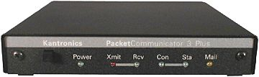
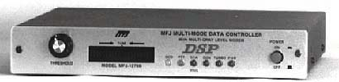
Basics of Digital Modes
Definitions
  Protocol – rules that control the method used.
  Mode – combination of protocol and modulation.
  Modems (modulate-demodulate) translate the bits into tones and back again.
  Terminal Node Controller (TNC) a device used by amateur radio operators to participate in AX. 25 packet radio networks.

Slide 8
Basics of Digital Modes
Definitions
  Are bit rate and baud the same?
    Yes and no.
    Bit rate = the number of bits transmitted per second.
    Baud = the number of symbols transmitted per second.
    A symbol could contain one bit or multiple bits.
    Example: 9600 Baud represents
      2 bits or 19.2 kbps
      4 bits or 38.4 kbps
      6 bits or 56 kbps

Slide 9
Basics of Digital Modes
Definitions
  Digital modes combine a protocol and modulation method.
  AX.25, used by packet, is an example of a protocol.
    It specifies how data is organized; what characters are allowed but not the method of transmission.
    Transmission maybe by SSB or FM determined by the equipment and frequencies.

Slide 10
Basics of Digital Modes
Definitions
  Methods of modulation:
    On-Off keying, OOK, like CW.
    Frequency shift keying, FSK
    Audio frequency shift keying, AFSK
    Phase shift keying, PSK

Slide 11
Basics of Digital Modes
Definitions
  Maximum data rates and signal bandwidths are specified by FCC rules in Part §97.307.
    HF – 2.8kHz bandwidth limit
    VHF – 1200 Baud
    UHF and higher – 9600 Baud
  FCC rules also identify several types of digital codes in Part §97.309.
    5-bit code know as Baudot.
    7-bit code know as AMTOR.
    7-bit code know as ASCII.

Slide 12
Basics of Digital Modes
Frequency Shift Keying (FSK)
  Data is encoded as tones
  The two tones are called Mark and Space
    Space = 0
    Mark = 1
  In true or direct FSK, transmitter’s VFO is controlled directly by the digital data usually via a data input.

Slide 13
Basics of Digital Modes
Frequency Shift Keying (FSK)
  Audio frequency shift keying (AFSK).
    Is used to modulate an SSB or FM transmitter via the Mic input.
    Is convenient but must manage audio levels to avoid noise and distortion.
  Both FSK and AFSK sound the same on the air.

Slide 14
Basics of Digital Modes
Frequency Shift Keying (FSK)
  Multiple frequency shift keying (MFSK)
    Uses multiple tones
    Is more error-resistant
    Sounds musical
    Examples:
      MFSK8
      MFSK16
      MFSK64

Slide 15
Basics of Digital Modes
Phase Shift Keying (PSK)
    Data is encoded as a phase relationship between tones
    One of the tones is inverted, shifting it phase 180°
    Example BPSK31 and QPSK31

Slide 16
Basics of Digital Modes
Digital Voice Modes
  Digital voice modes are regulated as voice emissions by the FCC.
    Icom’s D-STAR.
    Yaesu’s SystemFusion.
    AOR’s digital voice system.
    DMR.
    FreeDV (public domain)

Slide 17
G2E08 – In what segment of the 20-meter band are most digital mode operations commonly found?
A. 14.000 - 14.050 MHz
B. 14.070 - 14.100 MHz
C. 14.150 - 14.225 MHz
D. 14.275 - 14.350 MHz

Slide 18
G2E08 – In what segment of the 20-meter band are most digital mode operations commonly found?
A. 14.000 - 14.050 MHz
B. 14.070 - 14.100 MHz
C. 14.150 - 14.225 MHz
D. 14.275 - 14.350 MHz

Slide 19
G8A01 -- How is direct binary FSK modulation generated?
A. By keying an FM transmitter with a sub-audible tone
B. By changing an oscillator’s frequency directly with a digital control signal
C. By using a transceiver’s computer data interface protocol to change frequencies
D. By reconfiguring the CW keying input to act as a tone generator

Slide 20
G8A01 -- How is direct binary FSK modulation generated?
A. By keying an FM transmitter with a sub-audible tone
B. By changing an oscillator’s frequency directly with a digital control signal
C. By using a transceiver’s computer data interface protocol to change frequencies
D. By reconfiguring the CW keying input to act as a tone generator

Slide 21
G8C11 -- How are the two separate frequencies of a Frequency Shift Keyed (FSK) signal identified?
A. Dot and dash
B. On and off
C. High and low
D. Mark and space

Slide 22
G8C11 -- How are the two separate frequencies of a Frequency Shift Keyed (FSK) signal identified?
A. Dot and dash
B. On and off
C. High and low
D. Mark and space

Slide 23
G2C16 – Which of the following provide digital voice modes?
A. WSPR, MFSK16, and EasyPAL
B. FT8, FT4 and FST4
C. Winlink, PACKTOR II, and PACTOR III
D. DMR, D-STAR, and SystemFusion

Slide 24
G2C16 – Which of the following provide digital voice modes?
A. WSPR, MFSK16, and EasyPAL
B. FT8, FT4 and FST4
C. Winlink, PACKTOR II, and PACTOR III
D. DMR, D-STAR, and SystemFusion

Slide 25
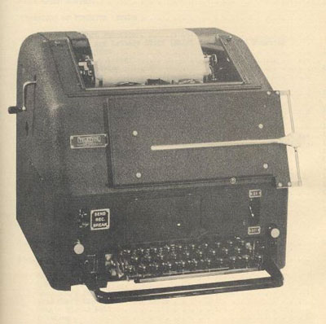

Character-Based Modes
Radioteletype (RTTY).
  Oldest digital mode.
    Still very popular.
    Soundcard and modem software replace teleprinters and terminal units.
    Identified in FCC rules as “narrowband, direct-printing telegraphy”.
  Normal shift = 170 Hz.
    Mark = 2125 Hz
    Space = 2295 Hz
    Equates to 60 WPM (45 Baud) on HF.
  You should always answer a RTTY station at same speed and shift it is using.

Slide 26
Character-Based Modes
Radioteletype (RTTY).
  Baudot code.
    Characters = combinations of 5 bits each.
    Each element = 1 data bit.
    Maximum of 32 (2⁵) characters.
      LTRS & FIGS (shift codes).
      Allows two sets of character increasing characters to 62.
    Start & stop bits frame each character.
      Start bit – initializes the sending of the character.
      Stop bit – pause between characters
      Used to synchronize the transmitting and receiving station.

Slide 27
Character-Based Modes
Phase Shift Keying (PSK31).
  G3PLX developed PSK31 for keyboard-to-keyboard communications.
    31 = data (symbol) rate (31.25 baud).
  Uses variable-length code (Varicode).
    Number of bits per character varies.
      Most common characters have shortest code.
      Upper case letters and punctuation take more bits which means slower transmit time.

Slide 28
Character-Based Modes
Phase Shift Keying (PSK31).
  Sends a single continuous tone.
    Symbols are sent continually
      Reversal of phase from one interval to the next = 0
      No reversal of phase = 1
      Two intervals required to send one symbol.
    Zeros sent continuously when no data present.
      Keeps transmitter and receiver synchronized.
  Bandwidth = 37.5 Hz.
      Narrowest of all HF digital modes, including CW.

Slide 29
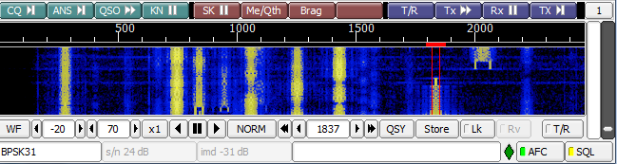
Character-Based Modes
Phase Shift Keying (PSK31).
  Very effective in noisy conditions.
  Uses soundcard DSP to decode and encode the data.
  Example of waterfall with multiple signals:

Slide 30
Character-Based Modes
Phase Shift Keying (PSK31).
  Quadrature phase shift keying (QPSK31).
    A variation of PSK31.
    Uses two audio tones.
    Four possible phase shift combinations.
    Provides some error correction.
    Is sideband sensitive.
    Bandwidth approximately the same as PSK31.

Slide 31
G8C04 -- Which of the following describes Baudot code?
A. A 7-bit code with start, stop, and parity bits
B. A code using error detection and correction
C. A 5-bit code with additional start and stop bits
D. A code using SELCAL and LISTEN

Slide 32
G8C04 -- Which of the following describes Baudot code?
A. A 7-bit code with start, stop, and parity bits
B. A code using error detection and correction
C. A 5-bit code with additional start and stop bits
D. A code using SELCAL and LISTEN

Slide 33
G2E06 -- What is the most common frequency shift for RTTY emissions in the amateur HF bands?
A. 85 Hz
B. 170 Hz
C. 425 Hz
D. 850 Hz

Slide 34
G2E06 -- What is the most common frequency shift for RTTY emissions in the amateur HF bands?
A. 85 Hz
B. 170 Hz
C. 425 Hz
D. 850 Hz

Slide 35
G8A06 -- Which of the following is characteristic of QPSK31?
A. It is sideband sensitive
B. Its encoding provides error correction
C. Its bandwidth is approximately the same as BPSK31
D. All these choices are correct

Slide 36
G8A06 -- Which of the following is characteristic of QPSK31?
A. It is sideband sensitive
B. Its encoding provides error correction
C. Its bandwidth is approximately the same as BPSK31
D. All these choices are correct

Slide 37
G8C12 -- Which type of code is used for sending characters in a PSK31 signal?
A. Varicode
B. Viterbi
C. Volumetric
D. Binary

Slide 38
G8C12 -- Which type of code is used for sending characters in a PSK31 signal?
A. Varicode
B. Viterbi
C. Volumetric
D. Binary

Slide 39
G8C08 -- Which of the following statements is true about PSK31?
A. Upper case letters are sent with more power
B. Upper case letters use longer Varicode bit sequences and thus slow down transmission
C. Error correction is used to ensure accurate message reception
D. Higher power is needed as compared to RTTY for similar error rates

Slide 40
G8C08 -- Which of the following statements is true about PSK31?
A. Upper case letters are sent with more power
B. Upper case letters use longer Varicode bit sequences and thus slow down transmission
C. Error correction is used to ensure accurate message reception
D. Higher power is needed as compared to RTTY for similar error rates

Slide 41
Packet Based Modes and Systems
Packet basics.
  A structured mode derived from early telegraph-over-radio and computer to computer protocols.
  Data to be sent is divided into “chunks”, control/status information is added before & after each "chunk” forming a “packet” also called frames.
    Header -- Control & routing information and sometimes error correction information.
    Data -- Typically 128 or 256 characters.
    Trailer -- Check sum & possibly additional control & status information.

Slide 42
Packet Based Modes and Systems
Packet basics.
  Error detection.
    Cyclic Redundancy Check (CRC).
      A number calculated from all the other bytes in the packet which is appended to the end of the packet.
      Receiving system calculates the CRC of the incoming packet.
      If no mismatch, then an “acknowledge” or “ACK” is sent.
      If a mismatch has been detected, then a “not acknowledged” “NAK” is sent.
      The sending system then resends the packet until it gets an “ACK”.

Slide 43
Packet Based Modes and Systems
Packet basics.
  Error detection (continued)
    Forward Error Correction (FEC).
      Goes beyond simply detecting errors.
      Additional redundant encoded information is added to each packet.
      This allows the receiving station to correct certain types of errors.

Slide 44
Packet Based Modes and Systems
Packet basics.
  Error detection (continued).
    Automatic Repeat ReQuest (ARQ).
      Protocol used by PACTOR, VARA, and packet radio.
      Packet will be sent until an ACK is received indicating no errors or retransmission limit is exceeded.
      Protocol only allows the receiving station to talk to the sender.
      Protocol allows a station to broadcast its presence without establishing a contact.
      Monitor mode allows you to determine if a frequency is in use by two stations having an ARQ mode contact.

Slide 45
Packet Based Modes and Systems
Packet radio.
  Oldest of “modern” digital modes.
      Became widely popular in 1980’s.
      Used almost exclusively on VHF and UHF.
      Uses the AX25 protocol.
        Based on the X25 computer network protocol.
        Amateurs adapted it for radio transmission.
        Every AX.25 packet includes the sender's amateur radio callsign, which satisfies the US FCC requirements for amateur radio station identification.
      The packets are in ASCII format.

Slide 46
Packet Based Modes and Systems
Packet radio.
      Packets are exchanged via FM radios.
        1200 baud on VHF.
        9600 baud on UHF.
      Not practical on HF.
        This may change now that FCC has eliminated the 300 baud symbol rate requirement.
        Very slow when band conditions are noisy.
      It is possible for any packet station to act as a digipeater, linking distant stations with each other through ad hoc networks.
      This makes packet radio especially useful for emergency communications.

Slide 47
Packet Based Modes and Systems
Packet radio.
  American Standard Code for Information Interchange (ASCII).
    Characters = combinations of 7 elements each.
      An 8th bit called a parity bit may be added.
      Or the 8th bit could be an additional data bit.
    Each element = 1 data bits.
    Maximum of 128 (2⁷) characters
      256 (2⁸) maximum characters if 8 data bits.
    Start bit & 1, 1.5, or 2 stop bits frame each character

Slide 48
Packet Based Modes and Systems
PACTOR
  Teletype-Over-Radio (TOR).
    TOR modes developed to improve reliability over RTTY.
      Data sent in short bursts with error detection & error correction information.
        AMTOR.
        G-MOR.
      More reliable, but slow.
    PACTOR (Packet-based TOR) was developed to extend TOR capabilities.

Slide 49
Packet Based Modes and Systems
PACTOR
    PACTOR 1 developed by DL6MAA & DK4FV.
      Is a digital data protocol combining elements of PACKET and AMTOR ARQ.
      Uses FSK modulation.
      Overcomes shortcomings of AMTOR & HF packet.
      Works well in weak-signal & high-noise conditions.
      Is a Terminal Node Controller (TNC)

Slide 50
Packet Based Modes and Systems
PACTOR
    PACTOR 2 , PACTOR 3 and PACTOR 4 are used today.
      Uses advanced PSK modulation (QPSK).
      QPSK shifts 2 signals between 4 phases representing pairs of bits.
      Automatic repeat request (ARQ) used to eliminate errors.
      Adjusts speed (“trains”) to match conditions.
        5 kbps data rates possible.
      Most popular modes for transferring large amounts of data.
      As of January 8 2024, PACTOR 4 is now legal in the US due to the FCC eliminating the symbol rate limit on HF .

Slide 51
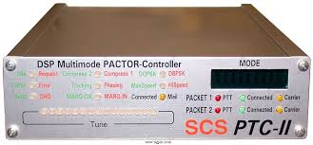
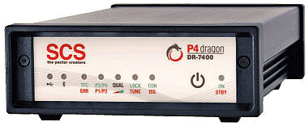
Packet Based Modes and Systems
PACTOR
    PACTOR modems or TNC’s can be expensive.
      PACTOR 1.
        Open technology - $50.00 to $150.00.
      PACTOR 2, PACTOR 3, & PACTOR 4.
        Proprietary technology - $1000.00 to >$1600.00

Slide 52
Packet Based Modes and Systems
VARA MODEM
    Proprietary system developed by Jose Alberto Nieto Ros EA5HVK and can be used under shareware license. (Free and paid versions)
    VARA is a half-duplex ARQ system designed to have maximum efficiency over HF channels, fully compatible with all HF path conditions.
    Bandwidth: VARA is designed for operation within a SSB bandwidth of 2.4 Khz.

Slide 53
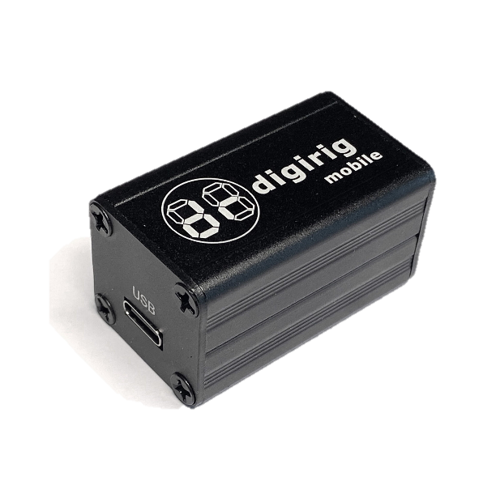
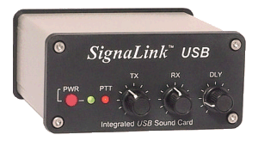
Packet Based Modes and Systems
The WINLINK System
  Also know as Winlink 2000
  Worldwide system for sending and receiving e-mail over radio.
  Used for both personal and public service.
  Uses the Internet to connect via gateways to email servers and mailboxes on HF, VHF, and UHF.
  Only a simple soundcard interface is required.

Slide 54
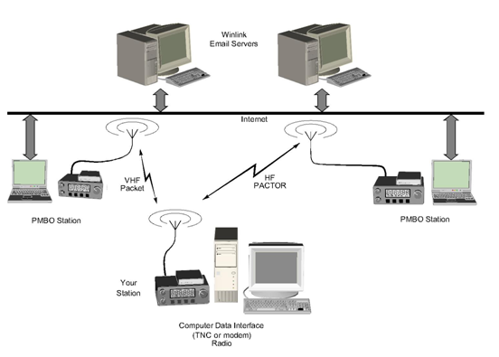
Packet Based Modes and Systems
The WINLINK System

Slide 55
Packet Based Modes and Systems
The WINLINK System
  Winlink Express, formerly RMS Express
    Stations can act as a standalone mailbox
    Can transfer messages between each other without using the internet.
  Its not a mode but a communication system.
    Uses packet, VARA FM, and ARDOP on VHF/UHF
    Uses Pactor, VARA HF, and ARDOP on HF.

Slide 56
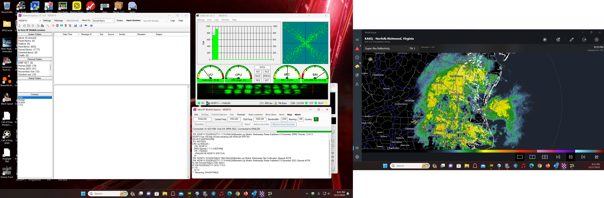
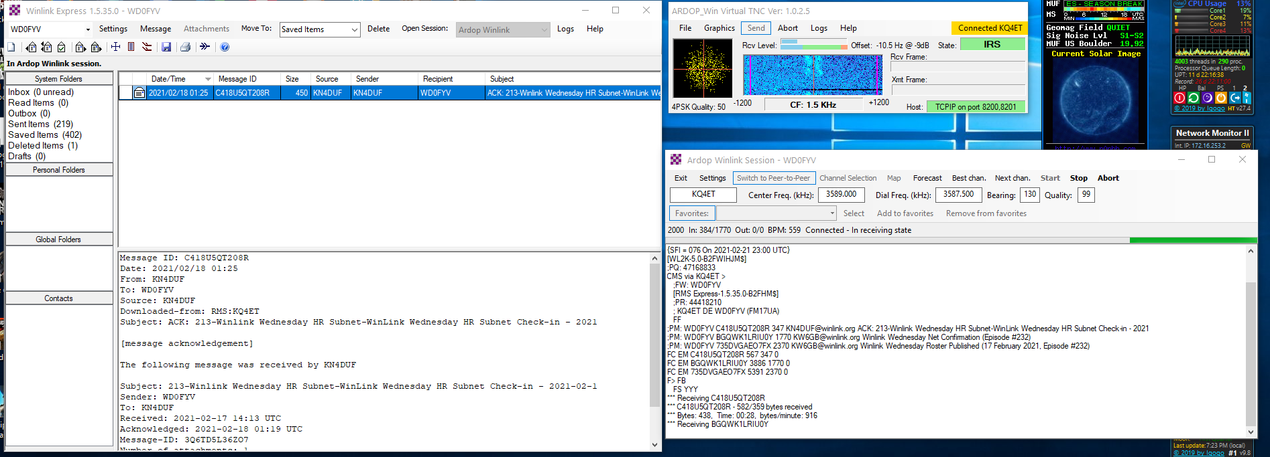
Packet Based Modes and Systems
Winlink Express Software.

Slide 57
Packet Based Modes and Systems
FT8 and WSPR
  Modes supported by the WSJT-X software suite written by Joe Taylor K1JT.
  Both use:
    precisely timed sequences to transmit and receive.
    8-tone FSK modulation.
    Sophisticated error decoding and correction techniques.
    Ability to decode a signal at -30db below the noise floor.
    50 Hz bandwidth.

Slide 58
Packet Based Modes and Systems
FT8 and WSPR
  FT8 exchanges 75-bit messages plus 12 bits of error detection codes
    Call signs
    Grid locators
    Signal reports
      Signal reports are on signal-to-noise ratio, so a report of +03 means 3dB above the noise floor.
    Common locations to find FT8:
      On 20M from 14.074 to 14.077
      On 40M from 7.074 to 7.077

Slide 59
Packet Based Modes and Systems
FT8 and WSPR
  Three new modes have been added:
    Fox and Hound – used by DX-peditions.
    Contest mode – ARRL Field Day and Digi, FT Roundup, and WW Digi, NA and EU VHF.
    FT4 – Twice as fast as FT8 (7.5 seconds vs 15 seconds)
  Requires your computer time to be precisely synchronized to within 1 second of standard time.
    Use programs like Dimension 4 not Windows Time Sync
  When responding to a calling station find a clear space in the waterfall to transmit from.

Slide 60
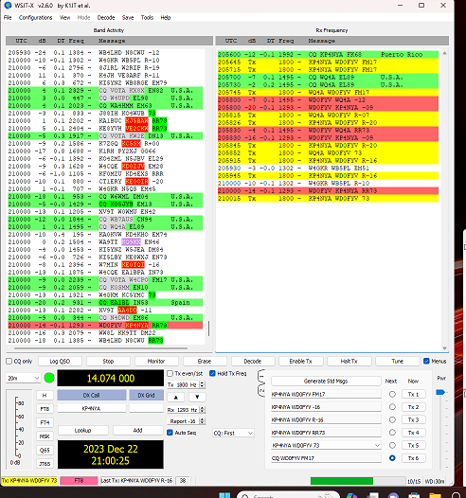
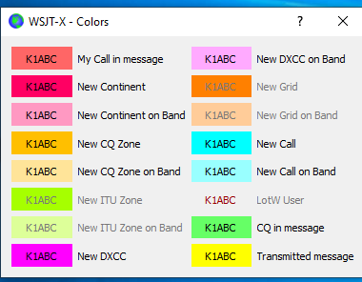
Packet Based Modes and Systems
FT8 Software
  WSJT-X v2.6

Slide 61

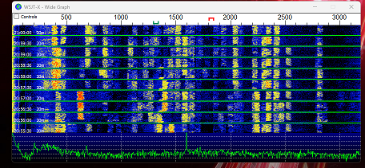
Packet Based Modes and Systems
FT8 Waterfall Display

Slide 62
Packet Based Modes and Systems
FT8 and WSPR
  WSPR
    Weak Signal Packet Reporting system.
    Designed to experiment and assess HF propagation paths using very low signal-to-noise ratios.
    Does not support two-way QSOs.
    Acts as a narrow bandwidth beacon.
    WSPR stations transmit a coded packets.
    Receiving station decodes packets.
      Reports success to websites like wsprnet.org.

Slide 63
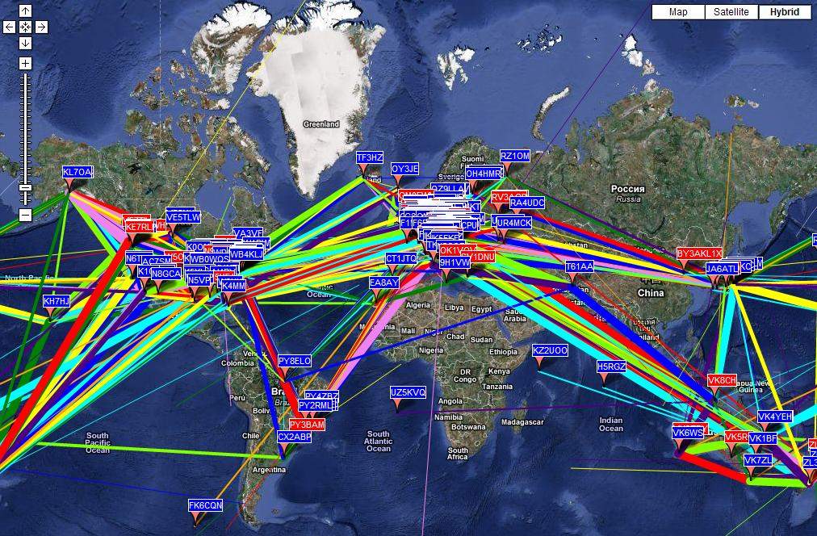
Packet Based Modes and Systems
FT8 and WSPR

Slide 64
Packet Based Modes and Systems
Amateur Wireless Networks
    The following wireless frequencies (wifi) overlap the amateur bands:
      902 – 928
      2390 – 2459 (2.4 GHz channels 1 thru 6)
      3300 – 35003
      5650 – 5925 (5.8 GHz upper channels)
    Modified Part 15 wifi equipment is used within Part 97 rules:
      Can not access Internet sites using HTTPS protocols.
      Can use legal limit power.

Slide 65
Packet Based Modes and Systems
Amateur Wireless Networks
    Two basic network topologies used:
      Mesh (point to point or point to multipoint
      Star
    AREDN (Amateur Radio Emergency Data Network uses mesh.
    HamWan ,Hamnet, and Mi6WAN use star.
    Advantage of mesh is if a node fails a packet will still get through using another node.

Slide 66
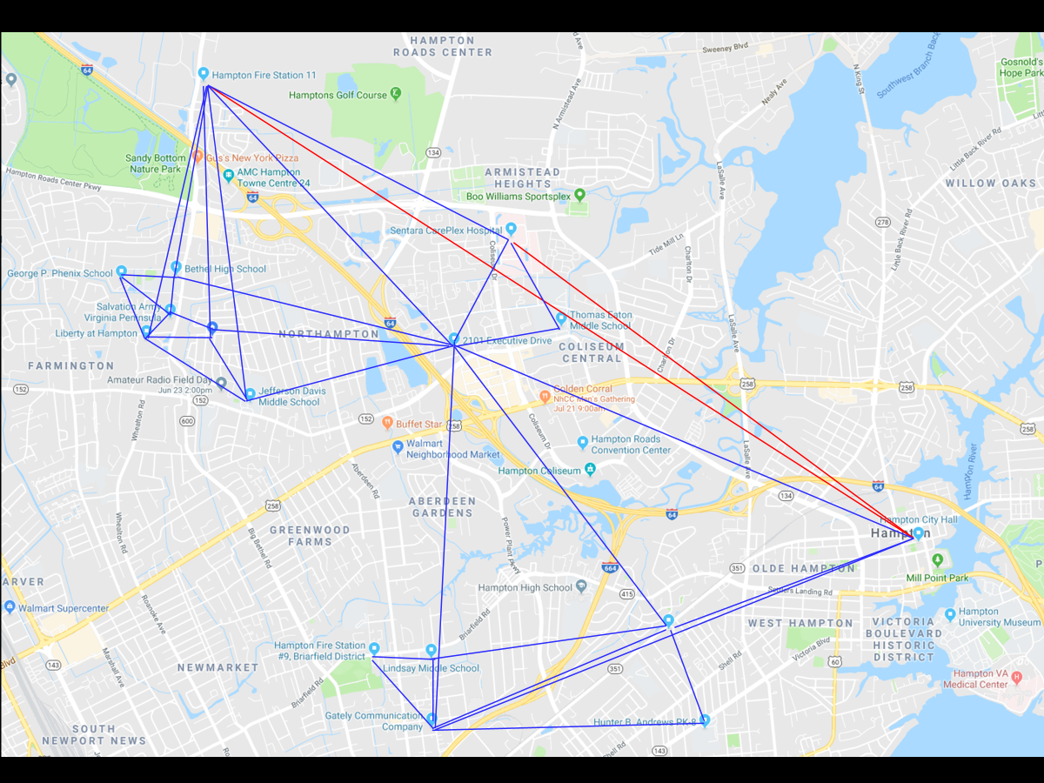
Packet Based Modes and Systems
HPST Mesh Network

Slide 67
Packet Based Modes and Systems
AREDN (Amateur Radio Emergency Data Network
  Uses commercially available routers.
  Stock firmware is replaced.
  Creates a fully functional node in a peer-to-peer network.
  The nodes are:
    Self-discovering
    Self-configuring
    Self-advertising
  Require little networking knowledge to set up.

Slide 68
Packet Based Modes and Systems
AREDN (Amateur Radio Emergency Data Network
  Generally, these networks are used for emergency traffic.
  Also, they can be used for community events such as races and parades.
  A typical node consists of a wireless router and a wireless data access point.
    The router connects to the network.
    The access point supports both WiFi and Ethernet LAN connections.
  Relay nodes and backbone nodes use two or more routers connected via an Ethernet switch.

Slide 69
G8C03 -- What part of a packet radio frame contains the routing and handling information?
A. Directory
B. Preamble
C. Header
D. Footer

Slide 70
G8C03 -- What part of a packet radio frame contains the routing and handling information?
A. Directory
B. Preamble
C. Header
D. Footer

Slide 71
G8C10 -- How does forward error correction (FEC) allow the receiver to correct data errors?
A. By controlling transmitter output power for optimum signal strength
B. By using the Varicode character set
C. By transmitting redundant information with the data
D. By using a parity bit with each character

Slide 72
G8C10 -- How does forward error correction (FEC) allow the receiver to correct data errors?
A. By controlling transmitter output power for optimum signal strength
B. By using the Varicode character set
C. By transmitting redundant information with the data
D. By using a parity bit with each character

Slide 73
G8C05 -- In an ARQ mode, what is meant by a NAK response to a transmitted packet?
A. Request retransmission of the packet
B. Packet was received without error
C. Receiving station connected and ready for transmission
D. Entire file received correctly

Slide 74
G8C05 -- In an ARQ mode, what is meant by a NAK response to a transmitted packet?
A. Request retransmission of the packet
B. Packet was received without error
C. Receiving station connected and ready for transmission
D. Entire file received correctly

Slide 75
G2E09 -- How do you join a contact between two stations using the PACTOR protocol?
A. Send broadcast packets containing your call sign while in MONITOR mode
B. Transmit a steady carrier until the PACTOR protocol times out and disconnects
C. Joining an existing contact is not possible, PACTOR connections are limited to two stations
D. Send a NAK response continuously so that the sending station must stand by

Slide 76
G2E09 -- How do you join a contact between two stations using the PACTOR protocol?
A. Send broadcast packets containing your call sign while in MONITOR mode
B. Transmit a steady carrier until the PACTOR protocol times out and disconnects
C. Joining an existing contact is not possible, PACTOR connections are limited to two stations
D. Send a NAK response continuously so that the sending station must stand by

Slide 77
G8A12 -- What is QPSK modulation?
A. Modulation using quasi-parallel to serial conversion to reduce bandwidth
B. Modulation using quadra-pole sideband keying to generate spread spectrum signals
C. Modulation using Fast Fourier Transforms to generate frequencies at the first, second, third, and fourth harmonics of the carrier frequency to improve noise immunity
D. Modulation in which digital data is transmitted using 0-, 90-, 180- and 270-degrees phase shift to represent pairs of bits

Slide 78
G8A12 -- What is QPSK modulation?
A. Modulation using quasi-parallel to serial conversion to reduce bandwidth
B. Modulation using quadra-pole sideband keying to generate spread spectrum signals
C. Modulation using Fast Fourier Transforms to generate frequencies at the first, second, third, and fourth harmonics of the carrier frequency to improve noise immunity
D. Modulation in which digital data is transmitted using 0-, 90-, 180- and 270-degrees phase shift to represent pairs of bits

Slide 79
G2E12 -- Which of the following describes Winlink?
A. An amateur radio wireless network to send and receive email on the internet
B. A form of Packet Radio
C. A wireless network capable of both VHF and HF band operation
D. All of the above

Slide 80
G2E12 -- Which of the following describes Winlink?
A. An amateur radio wireless network to send and receive email on the internet
B. A form of Packet Radio
C. A wireless network capable of both VHF and HF band operation
D. All of the above

Slide 81
G2E13 -- What is another name for a Winlink Remote Message Server?
A. Terminal Node Controller
B. Gateway
C. RJ-45
D. Printer/Server

Slide 82
G2E13 -- What is another name for a Winlink Remote Message Server?
A. Terminal Node Controller
B. Gateway
C. RJ-45
D. Printer/Server

Slide 83
G2E02 -- What is VARA?
A. A low signal-to-noise digital mode used for EME (moonbounce)
B. A digital protocol used with Winlink
C. A radio direction finding system used on VHF and UHF
D.A DX spotting system using a network of software defined radios

Slide 84
G2E02 -- What is VARA?
A. A low signal-to-noise digital mode used for EME (moonbounce)
B. A digital protocol used with Winlink
C. A radio direction finding system used on VHF and UHF
D.A DX spotting system using a network of software defined radios

Slide 85
G2E07 -- Which of the following is a requirement when using the FT8 digital mode?
A. A special hardware modem
B. Computer time accurate within approximately 1 second
C. Receiver attenuator set to -12 dB
D. A vertically polarized antenna

Slide 86
G2E07 -- Which of the following is a requirement when using the FT8 digital mode?
A. A special hardware modem
B. Computer time accurate within approximately 1 second
C. Receiver attenuator set to -12 dB
D. A vertically polarized antenna

Slide 87
G8A09 -- What type of modulation is used by the FT8 digital mode?
A. 8-tone frequency shift keying
B. Vestigial sideband
C. Amplitude compressed AM
D. Direct sequence spread spectrum

Slide 88
G8A09 -- What type of modulation is used by the FT8 digital mode?
A. 8-tone frequency shift keying
B. Vestigial sideband
C. Amplitude compressed AM
D. Direct sequence spread spectrum

Slide 89
G8C07 -- Which of the following narrow-band digital modes can receive signals with very low signal-to-noise ratios?
A. MSK144
B. FT8
C. AMTOR
D. MFSK32

Slide 90
G8C07 -- Which of the following narrow-band digital modes can receive signals with very low signal-to-noise ratios?
A. MSK144
B. FT8
C. AMTOR
D. MFSK32

Slide 91
G8C15 -- What does an FT8 signal report of +3 mean?
A. The signal is 3 times the noise level of an equivalent SSB signal
B. The signal is S3 (weak signals)
C. The signal-to-noise ratio is equivalent to +3dB in a 2.5 kHz bandwidth
D. The signal is 3 dB over S9

Slide 92
G8C15 -- What does an FT8 signal report of +3 mean?
A. The signal is 3 times the noise level of an equivalent SSB signal
B. The signal is S3 (weak signals)
C. The signal-to-noise ratio is equivalent to +3dB in a 2.5 kHz bandwidth
D. The signal is 3 dB over S9

Slide 93
G2E15 -- Which of the following is a common location for FT8?
A. Anywhere in the voice portion of the band
B. Anywhere in the CW portion of the band
C. Approximately 14.074 MHz to 14.077 MHz
D. Approximately 14.110 MHz to 14.113 MHz

Slide 94
G2E15 -- Which of the following is a common location for FT8?
A. Anywhere in the voice portion of the band
B. Anywhere in the CW portion of the band
C. Approximately 14.074 MHz to 14.077 MHz
D. Approximately 14.110 MHz to 14.113 MHz

Slide 95
G2E04 -- Which of the following is good practice when choosing a transmitting frequency to answer a station calling CQ using FT8?
A. Always call on the station’s frequency
B. Call on any frequency in the waterfall except the station’s frequency
C. Find a clear frequency during the same time slot as the calling station
D. Find a clear frequency during the alternate time slot to the calling station

Slide 96
G2E04 -- Which of the following is good practice when choosing a transmitting frequency to answer a station calling CQ using FT8?
A. Always call on the station’s frequency
B. Call on any frequency in the waterfall except the station’s frequency
C. Find a clear frequency during the same time slot as the calling station
D. Find a clear frequency during the alternate time slot to the calling station

Slide 97
G8C02 -- Which digital mode is used as a low-power beacon for assessing HF propagation?
A. WSPR
B. Olivia
C. PSK31
D. SSB-SC

Slide 98
G8C02 -- Which digital mode is used as a low-power beacon for assessing HF propagation?
A. WSPR
B. Olivia
C. PSK31
D. SSB-SC

Slide 99
G8C09 -- Which is true of mesh microwave nodes?
A. Having more nodes increases signal strengths
B. If one node fails, a packet may still reach its target station via an alternate node
C. Links between two nodes in a network may have different frequencies and bandwidths
D. More nodes reduce overall microwave out of band interference

Slide 100
G8C09 -- Which is true of mesh microwave nodes?
A. Having more nodes increases signal strengths
B. If one node fails, a packet may still reach its target station via an alternate node
C. Links between two nodes in a network may have different frequencies and bandwidths
D. More nodes reduce overall microwave out of band interference

Slide 101
G2E11 -- What is the primary purpose of an Amateur Radio Emergency Data Network (AREDN) mesh network?
A. To provide FM repeater coverage in remote areas
B. To provide real time propagation data by monitoring amateur radio transmissions worldwide
C. To provide high-speed data services during an emergency or community event
D. To provide DX spotting reports to aid contesters and DXers

Slide 102
G2E11 -- What is the primary purpose of an Amateur Radio Emergency Data Network (AREDN) mesh network?
A. To provide FM repeater coverage in remote areas
B. To provide real time propagation data by monitoring amateur radio transmissions worldwide
C. To provide high-speed data services during an emergency or community event
D. To provide DX spotting reports to aid contesters and DXers

Slide 103
Receiving and transmitting digital modes
Overview
  Most digital modes on HF use USB.
    RTTY is an exception, it uses LSB.
  Popular weak signal modes are:
    FT8
    JT65
    JT9
  PSK31 can use either, but most use USB.
  Wrong sideband will prevent proper decoding.

Slide 104
Receiving and transmitting digital modes
Overview
  Most modes are now done in software using a soundcard, either external or in a computer.
  Software or modem must be configured correctly:
    Correct baud rate.
    Correct tone frequencies.
  Typical Software:
    PSK31 – Digipan or Fldigi
    FT8 – WSJT-X
  Some radios provide a data port to use instead of the mic input.

Slide 105
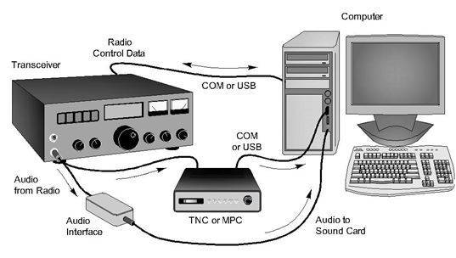
Receiving and transmitting digital modes
Setting Up for Digital Modes.

Slide 106
Receiving and transmitting digital modes
Bandwidth of digital modes
  FCC rules, §97.3(a)(8), defines bandwidth of digital signals the same as any other signals.
  The most common method of generating digital modes is computer sound card to mic input of radio.
  Therefore, all digital modes must not exceed 2.8Khz, standard SSB voice bandwidth.
  Bandwidth changes with symbol rate.
    Increase in symbol rate = increase in bandwidth.

Slide 107
Receiving and transmitting digital modes
Bandwidth of digital modes
    Bandwidth Comparison of Digital Modes
Mode | Bandwidth (HZ)
PSK31 | 50
FT8 | 50
RTTY | 200
MFSK16 | 300
JT65 | 350
Olivia | 1000
MT63 | 2000
PACTOR 3 PACTOR 4 | 2300 2300

Slide 108
Receiving and transmitting digital modes
Transmitter Duty Cycle
  Most amateur transmitters are not designed to operate at full power for extended time.
  Time between full power on and power off.
  Most digital modes are 100% duty cycles.
    PSK31
    RTTY
  Weak signal modes have low duty cycles.
    PACTOR
    FT8

Slide 109
Receiving and transmitting digital modes
Digital Mode Signal Quality
  Most common problem when using AFSK is supplying too little or too much audio from the computer to the radio mic input.
  If using a waterfall display, additional lines on either side of the main signal indicates a distorted signal caused by overmodulation.
  Use digital data input if available.
  Also use less power out.
    10 Watts to 50 Watts for most digital modes.

Slide 110
Receiving and transmitting digital modes
ALC and Digital Modes
  Automatic Level Control (ALC) is used to prevent overdrive of amplifier output stage which will distort the signal.
  For digital signals ALC distortion makes it harder to decode the signal and creates spurious emissions like overmodulation does.
  Therefore, ALC should be disabled or adjusted so it does not activate.

Slide 111
G2E01 -- Which mode is normally used when sending RTTY signals via AFSK with an SSB transmitter?
A. USB
B. DSB
C. CW
D. LSB

Slide 112
G2E01 -- Which mode is normally used when sending RTTY signals via AFSK with an SSB transmitter?
A. USB
B. DSB
C. CW
D. LSB

Slide 113
G2E05 -- What is the standard sideband for JT65, JT9, FT4, or FT8 digital signal when using AFSK?
A. LSB
B. USB
C. DSB
D. SSB

Slide 114
G2E05 -- What is the standard sideband for JT65, JT9, FT4, or FT8 digital signal when using AFSK?
A. LSB
B. USB
C. DSB
D. SSB

Slide 115
G2E14 – What could be wrong if you cannot decode an RTTY or other FSK signal even though it is apparently tuned in properly?
A. The mark and space frequencies may be reversed
B. You may have selected the wrong baud rate
C. You may be listening on the wrong sideband
D. All these choices are correct

Slide 116
G2E14 – What could be wrong if you cannot decode an RTTY or other FSK signal even though it is apparently tuned in properly?
A. The mark and space frequencies may be reversed
B. You may have selected the wrong baud rate
C. You may be listening on the wrong sideband
D. All these choices are correct

Slide 117
G8B10 -- What is the relationship between transmitted symbol rate and bandwidth?
A. Symbol rate and bandwidth are not related
B. Higher symbol rates require wider bandwidth
C. Lower symbol rates require wider bandwidth
D. Bandwidth is always half the symbol rate

Slide 118
G8B10 -- What is the relationship between transmitted symbol rate and bandwidth?
A. Symbol rate and bandwidth are not related
B. Higher symbol rates require wider bandwidth
C. Lower symbol rates require wider bandwidth
D. Bandwidth is always half the symbol rate

Slide 119
G8B08 -- Why is it important to know the duty cycle of the mode you are using when transmitting?
A. To aid in tuning your transmitter
B. Some modes have high duty cycles which could exceed the transmitter's average power rating.
C. To allow time for the other station to break in during a transmission
D. All of these choices are correct

Slide 120
G8B08 -- Why is it important to know the duty cycle of the mode you are using when transmitting?
A. To aid in tuning your transmitter
B. Some modes have high duty cycles which could exceed the transmitter's average power rating.
C. To allow time for the other station to break in during a transmission
D. All of these choices are correct

Slide 121
G8C13 -- What is indicated on a waterfall display by one or more vertical lines on either side of a digital signal?
A. Long path propagation
B. Backscatter propagation
C. Insufficient modulation
D. Overmodulation

Slide 122
G8C13 -- What is indicated on a waterfall display by one or more vertical lines on either side of a digital signal?
A. Long path propagation
B. Backscatter propagation
C. Insufficient modulation
D. Overmodulation

Slide 123
G4A11 -- Why should the ALC system be inactive when transmitting AFSK data signals?
A. ALC will invert the modulation of the AFSK mode
B. The ALC action distorts the signal
C. When using digital modes, too much ALC activity can cause the transmitter to overheat
D. All these choices are correct

Slide 124
G4A11 -- Why should the ALC system be inactive when transmitting AFSK data signals?
A. ALC will invert the modulation of the AFSK mode
B. The ALC action distorts the signal
C. When using digital modes, too much ALC activity can cause the transmitter to overheat
D. All these choices are correct

Slide 125
Digital Operating Procedures
Initiating and Terminating Digital Contacts.
  Initiating a contact.
    Digital QSOs follow the general structure of RTTY operating.
    CQ on RTTY and PSK31 look similar to other modes:
      CQ CQ CQ DE WD0FYV WD0FYV WD0FYV K
    The usual response:
      WD0FYV WD0FYV WD0FYV DE W3AF W3AF W3AF K

Slide 126
Digital Operating Procedures
Initiating and Terminating Digital Contacts.
  Ending a contact.
    Keyboard-to-keyboard contact, RTTY or PSK31, send a SK prosign after your call sign.
      W3AF DE WD0FYV SK
    PACTOR or VARA use a specific disconnect command.
      Bye
      D
    If connection is lost, the station will timeout and return to the disconnect state.

Slide 127
Digital Operating Procedures
Initiating and Terminating Digital Contacts.
  Connecting to Gateway and Mailbox Stations
    Unmanned gateway and mailbox stations monitor a fixed frequency until a connection is made.
    Exact method of contact will be based on:
      Equipment and mode used.
      Type of CONNECT message sent.
    Listening station does not transmit until responding to connect request so knowing the exact frequency is a must.

Slide 128
Digital Operating Procedures
Initiating and Terminating Digital Contacts.
  Connecting to Gateway and Mailbox Stations
    Once a connection is made:
      Training packets exchanged.
      Type and version of protocol selected.
    Classified by FCC as Automatically-controlled Digital Stations.
      No control operator present.
      Restricted to certain band segments.
      Can contact other automatically controlled stations:
        On HF band segments shown in following table
        Anywhere RTTY and data are permitted on 6 meter and higher.

Slide 129
Digital Operating Procedures
Automatic Control Band Segments for RTTY and Data
Band (Meters) | Frequency Range (MHz)
160 | Not permitted
80 | 3.585 – 3.600
60 | Not permitted
40 | 7.100 – 7.105
30 | 10.140 – 10.150
20 | 14.095 – 14.0995 & 14.1005 – 14.112
17 | 18.105 -18.110
15 | 21.090 – 21.100
12 | 24.925 – 24.930
10 | 28.120 – 28.189
6 | 50.1 – 50.4

Slide 130
Digital Operating Procedures
Initiating and Terminating Digital Contacts.
  Connecting to Gateway and Mailbox Stations
    Automatic Control stations operating outside of US amateur allocations.
      Operating in areas not governed by the FCC.
      Stations under FCC rules can contact them legally if:
        Under direct control
        Under remote control
        With a control operator in charge of all transmissions.

Slide 131
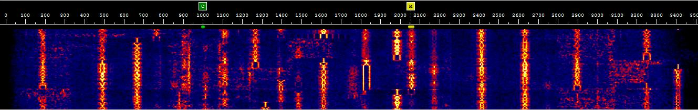
Digital Operating Procedures
During The Contact
  Operating Displays
    Waterfall Display
      Shows presence of signals as a series of lines moving down the screen.
      Scans a range of frequencies.
      Strength of signal or noise is represented by the
        Brightness
        Intensity
        Or Color of line.

Slide 132
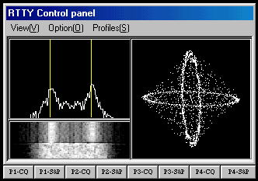
Digital Operating Procedures
During The Contact
  Operating Displays
    RTTY waterfall shows two lines representing the mark and space.
    The crossed-ellipse is used for fine tuning.
      Ellipses approximately equal in size.
      At right angles.

Slide 133
Digital Operating Procedures
During The Contact
  Third-Party Traffic
    FCC rules on third-party messages apply to digital transmissions.
    This includes all types of information included in
      Email
      Digital images
      Web pages
    Internet access though gateways must be very limited.
    Commercial messages may not be transmitted
    Personal business or finances may not be transmitted.

Slide 134
Digital Operating Procedures
During The Contact
  Interfering Signals
    Certain symptoms you can recognize
      Hidden transmitter that occurs with all modes.
        You are in the skip zone between the two stations
        Receiving station hears both of you
        The interference is unintentional but may prevent both you and the hidden transmitter from contacting the desired station.
      Keyboard-to-Keyboard modes, RTTY and PSK31
        Tolerate interference fairly well
        You must interpret any garbled information that was decoded

Slide 135
Digital Operating Procedures
During The Contact
  Interfering Signals
    Certain symptoms you can recognize
      Packet modes, PACTOR or VARA use automatic recovery methods for reception difficulties.
      Typical packet modes response to interference
        Failure to connect – receiver can’t decode your connect request
        Frequent retries or transmission delays – received garbled data so must ask for a retransmissions
        Timeouts or dropped connections – strong or persistent interference causes the number of retries to exceed a preset limit causing a dropped connection.
    For the best chance to make the contact, listen before transmitting.

Slide 136
G2E10 -- Which of the following is a way to establish contact with a digital messaging system gateway station?
A. Send an email to the system control operator
B. Send QRL in Morse code
C. Respond when the station broadcasts its SSID
D. Transmit a connect message on the station’s published frequency

Slide 137
G2E10 -- Which of the following is a way to establish contact with a digital messaging system gateway station?
A. Send an email to the system control operator
B. Send QRL in Morse code
C. Respond when the station broadcasts its SSID
D. Transmit a connect message on the station’s published frequency

Slide 138
G1E11 [97.221, 97.305]-- On what bands may automatically controlled stations transmitting RTTY or data emissions communicate with other automatically controlled digital stations?
A. On any band segment where digital operation is permitted
B. Anywhere in the non-phone segments of the 10-meter or shorter wavelength bands
C. Only in the non-phone Extra Class segments of the bands
D. Anywhere in the 6-meter or shorter wavelength bands, and in limited segments of some of the HF bands

Slide 139
G1E11 [97.221, 97.305]-- On what bands may automatically controlled stations transmitting RTTY or data emissions communicate with other automatically controlled digital stations?
A. On any band segment where digital operation is permitted
B. Anywhere in the non-phone segments of the 10-meter or shorter wavelength bands
C. Only in the non-phone Extra Class segments of the bands
D. Anywhere in the 6-meter or shorter wavelength bands, and in limited segments of some of the HF bands

Slide 140
G1E03 [97.221]-- What is required to conduct communications with a digital station operating under automatic control outside the automatic control band segments?
A. The station initiating the contact must be under local or remote control
B. The interrogating transmission must be made by another automatically controlled station
C. No third-party traffic may be transmitted
D. The control operator of the interrogating station must hold an Amateur Extra Class license

Slide 141
G1E03 [97.221]-- What is required to conduct communications with a digital station operating under automatic control outside the automatic control band segments?
A. The station initiating the contact must be under local or remote control
B. The interrogating transmission must be made by another automatically controlled station
C. No third-party traffic may be transmitted
D. The control operator of the interrogating station must hold an Amateur Extra Class license

Slide 142
G8C14 -- Which of the following describes a waterfall display?
A. Frequency is horizontal, signal strength is vertical, time is intensity
B. Frequency is vertical, signal strength is intensity, time is horizontal
C. Frequency is horizontal, signal strength is intensity, time is vertical
D. Frequency is vertical, signal strength is horizontal, time is intensity

Slide 143
G8C14 -- Which of the following describes a waterfall display?
A. Frequency is horizontal, signal strength is vertical, time is intensity
B. Frequency is vertical, signal strength is intensity, time is horizontal
C. Frequency is horizontal, signal strength is intensity, time is vertical
D. Frequency is vertical, signal strength is horizontal, time is intensity

Slide 144
G1E09 [97.115]-- Under what circumstances are messages that are sent via digital modes exempt from Part 97 third-party rules that apply to other modes of communication?
A. Under no circumstances
B. When messages are encrypted
C. When messages are not encrypted
D. When under automatic control

Slide 145
G1E09 [97.115]-- Under what circumstances are messages that are sent via digital modes exempt from Part 97 third-party rules that apply to other modes of communication?
A. Under no circumstances
B. When messages are encrypted
C. When messages are not encrypted
D. When under automatic control

Slide 146
G2E03 -- What symptoms may result from other signals interfering with a PACTOR or VARA transmission?
A. Frequent retries or timeouts
B. Long pauses in message transmission
C. Failure to establish a connection between stations
D. All these choices are correct

Slide 147
G2E03 -- What symptoms may result from other signals interfering with a PACTOR or VARA transmission?
A. Frequent retries or timeouts
B. Long pauses in message transmission
C. Failure to establish a connection between stations
D. All these choices are correct

Slide 148
G8C06 -- What action results from a failure to exchange information due to excessive transmission attempts when using an ARQ mode?
A. The checksum overflows
B. The connection is dropped
C. Packets will be routed incorrectly
D. Encoding reverts to the default character set

Slide 149
G8C06 -- What action results from a failure to exchange information due to excessive transmission attempts when using an ARQ mode?
A. The checksum overflows
B. The connection is dropped
C. Packets will be routed incorrectly
D. Encoding reverts to the default character set

Slide 150

Questions?

