Slide 1
General License Class
Chapter 9
Electrical
and RF Safety

Slide 2
Electrical Safety
Preventing electrical shock
    Install a master ON/OFF switch for station & workbench.
      Located away from station & workbench.
      Clearly labeled.
      Train family members & safety observers about location & proper use of switch.

Slide 3
Electrical Safety
Preventing electrical shock
  Be aware of your surroundings.
    Avoid placing yourself in harm’s way.
      Avoid locations or positions where likelihood of exposure to shock hazard.
      Avoid locations or positions where hard to rescue.

Slide 4
Electrical Safety
Preventing electrical shock
  Do NOT work on “live” circuits unless ABSOLUTELY necessary.
    If you must work on live equipment:
      ALWAYS have a second person present to act as safety observer.
      Keep one hand in pocket
      Wear shoes with insulated soles.
      Remove unnecessary jewelry.

Slide 5
Electrical Safety
Preventing electrical shock
  NEVER assume equipment is off or circuit is de-energized.
    Check with meter first.
  When working on feedlines or antennas:
    Turn off the transmitter.
    Disconnect the feed line.

Slide 6
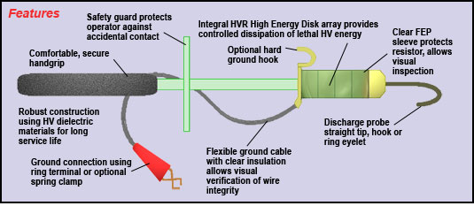
Electrical Safety
Preventing electrical shock
  When working inside equipment:
    Insulate or otherwise secure all loose wires.
    Use bleeder resistor or grounding stick to make certain capacitors are discharged.

Slide 7
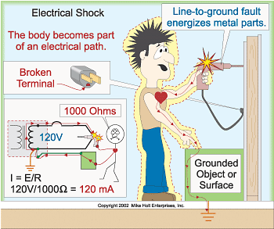
Electrical Safety
Preventing electrical shock

Slide 8
Electrical Safety
Preventing electrical shock
    The National Safety Council estimates that nearly 300 people die in the United States each year from electric shocks on 120V or 277V circuits.
    An electric shock from as little as 30VAC for as little as 1 sec can disrupt the heart's rhythm, causing death in a matter of minutes.

Slide 9
Electrical Safety
Preventing electrical shock
  The current does the damage.
    High voltage is more dangerous ONLY because of Ohm’s Law.
      I = E / R means higher voltage → higher current.
    Resistance of human body is 1 kΩ to 1.5 kΩ.
        Can range from a few hundred ohms to tens of kilohms.
        High voltages can penetrate skin, greatly reducing resistance.

Slide 10
Electrical Safety
Preventing electrical shock
  The current does the damage.
Description | Current Level | Physiological Effect
Threshold | 1-5 mA | Tingling Sensation
Pain | 5-8 mA | Intense or Painful Sensation
“Can’t Let Go” | 6-30 mA | Involuntary muscle contraction
Paralysis | >50 mA | Respiratory paralysis and pain
Fibrillation | 75-1000 mA | Ventricular fibrillation*
Defibrillation | >1000 mA | Sustained myocardial contraction and possible tissue burns

Slide 11
Electrical Safety
Preventing electrical shock
  Fibrillation level
    Function of current over time.
      500mA over 0.2 sec → fibrillation.
      75mA over 0.5 sec. → fibrillation.
    Immediate unconsciousness.
    Have safety observer who knows CPR!

Slide 12
Electrical Safety
Soldering Safety
  Soldering is a part of the electronic experience
  Electronic solder is lead-based with tin and rosin flux
    Ideal electrical solder is 63% lead and 37% tin
    Lead is toxic so solder in a well-ventilated area
    Wash hands after you finish soldering to prevent contamination
  New solder is now lead free
    Don’t mix solder types

Slide 13
Electrical Safety
Wiring Practices
  National Electrical Code (NEC).
  Local building codes.
  Wire size and max fuse.
    15A circuit = #14 AWG.
    20A circuit = #12 AWG.
    30A circuit = #10 AWG.
    55A circuit = #6 AWG.

Slide 14
Electrical Safety
Wiring Practices
  Color codes.
    Hot = Black or Red.
      Brass-colored terminal or screw.
    Neutral = White.
      Silver-colored terminal or screw.
    Ground = Green or uninsulated (bare copper).
      Green-colored or bare copper terminal or screw.
      ALWAYS connected to chassis.

Slide 15
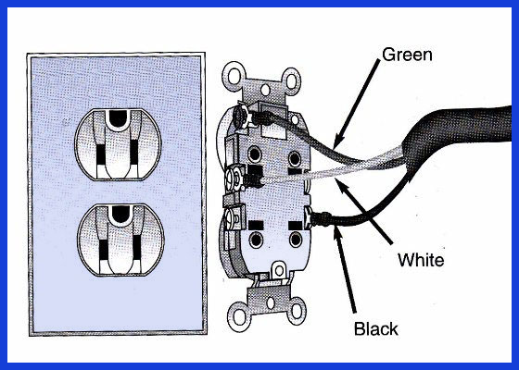
Electrical Safety
Wiring Practices
  Color Code

Slide 16
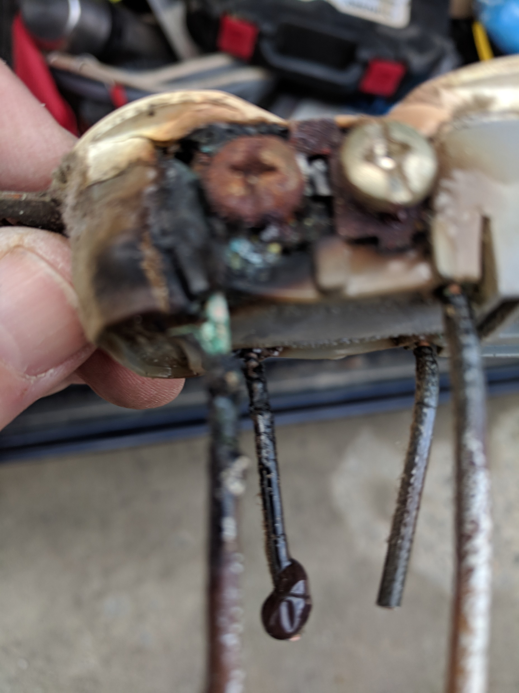
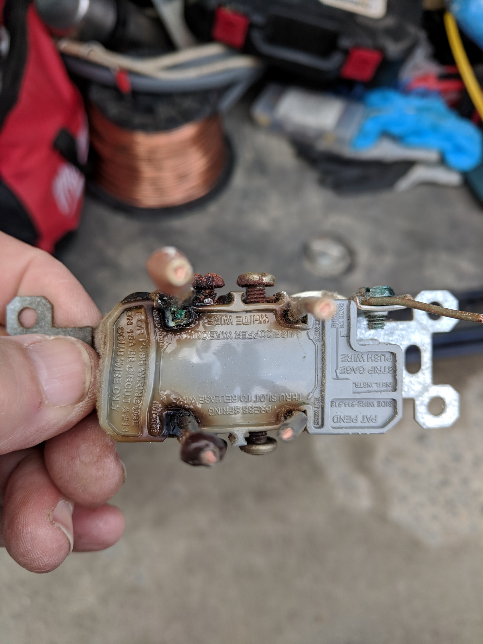
Electrical Safety

Slide 17
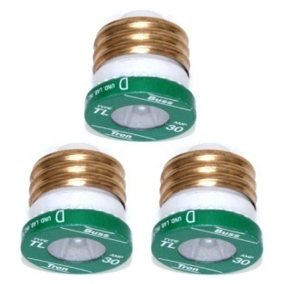
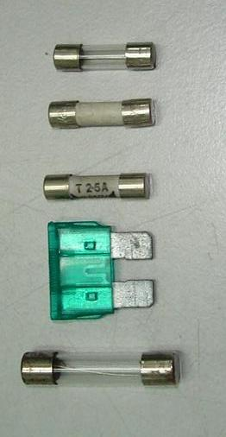
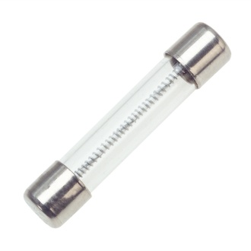
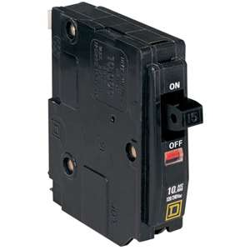
Electrical Safety
Wiring Practices
  Protective Components
    Prevent equipment damage.
    Prevent safety hazards.
    Fuses & circuit breakers.
      Fast-acting.
      Time delay or slo-blo.

Slide 18
Electrical Safety
  Wiring Practices
    Protective Components
      Shock prevention.
        Safety interlock.
          Opens circuit if enclosure is opened.
          Shorts high voltage to ground if enclosure is opened.

Slide 19
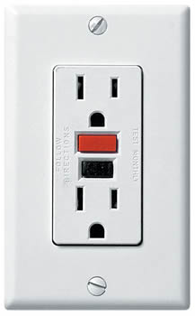
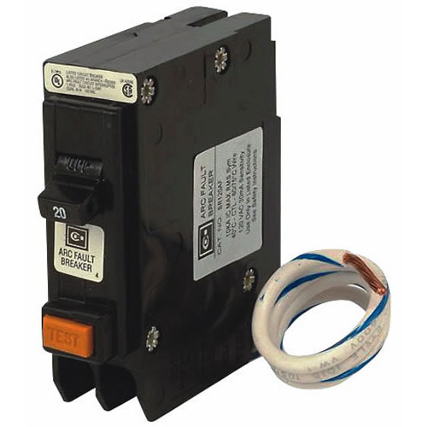
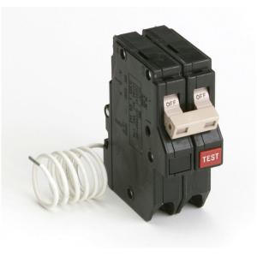
Electrical Safety
  Wiring Practices
    Protective Components
      Shock prevention.
        Ground fault circuit interrupter (GFCI).
          Opens circuit if currents in hot & neutral wires are not equal by more than a few mA.

Slide 20
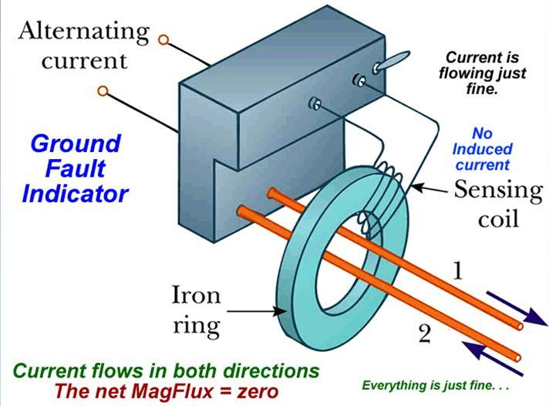
Electrical Safety
Wiring Practices
  Protective Components
    Shock prevention

Slide 21
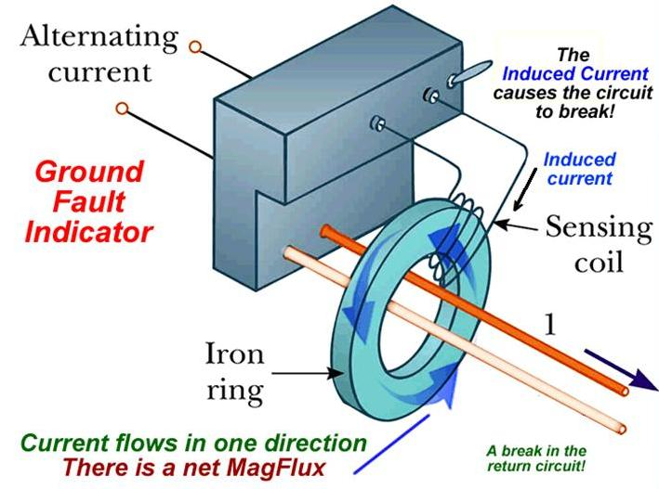
Electrical Safety
Wiring Practices
  Protective Components
    Shock prevention

Slide 22
Electrical Safety
Generator Safety
  Installation.
    Always use in an open, well-ventilated area.
      Always outside.
      Never in an enclosed space -- not even in a garage.
    Locate fire extinguisher near generator but away from fuel.
    Connect generator frame to a ground rod installed at the generator location.

Slide 23
Electrical Safety
Generator Safety
  Refueling.
    Always shut down generator while refueling.
    Always have 2nd person present with fire extinguisher.
    Never store fuel near generator.
      Especially near exhaust.

Slide 24
Electrical Safety
Generator Safety
  Connecting to house wiring.
    Use an approved transfer switch.
      Disconnects house wiring from power company wiring.
    Open main breakers & connect generator on house side of breakers.

Slide 25
Electrical Safety
Generator Safety
  Connecting to house wiring.
    If not disconnected from power company wiring:
      Can back feed into power system & expose power line workers to lethal voltages.
      When power is restored, can damage your generator.

Slide 26
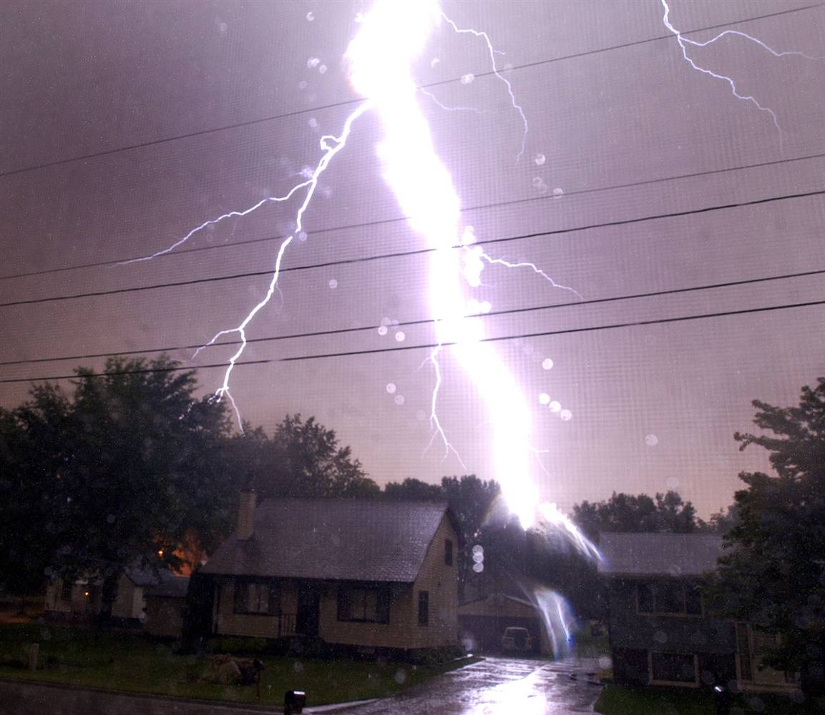
Electrical Safety
Lightning
  Prevent fire.
  Reduce or prevent damage to equipment.

Slide 27
Electrical Safety
Lightning
  Before the storm.
    Disconnect all cables outside of the house.
    Unplug equipment power plugs inside the house.
      Also, disconnect telephone lines & PC connections.

Slide 28
Electrical Safety
Lightning
  When installing station.
    Install grounded metal entry panel for all feedlines & control cables.
      Connect to ground rod with short, heavy metal strap.
      Install lightning arrestors on entry panel.
    Bond ALL ground rods together & to AC wiring safety ground.
    NEVER use soldered connections.

Slide 29
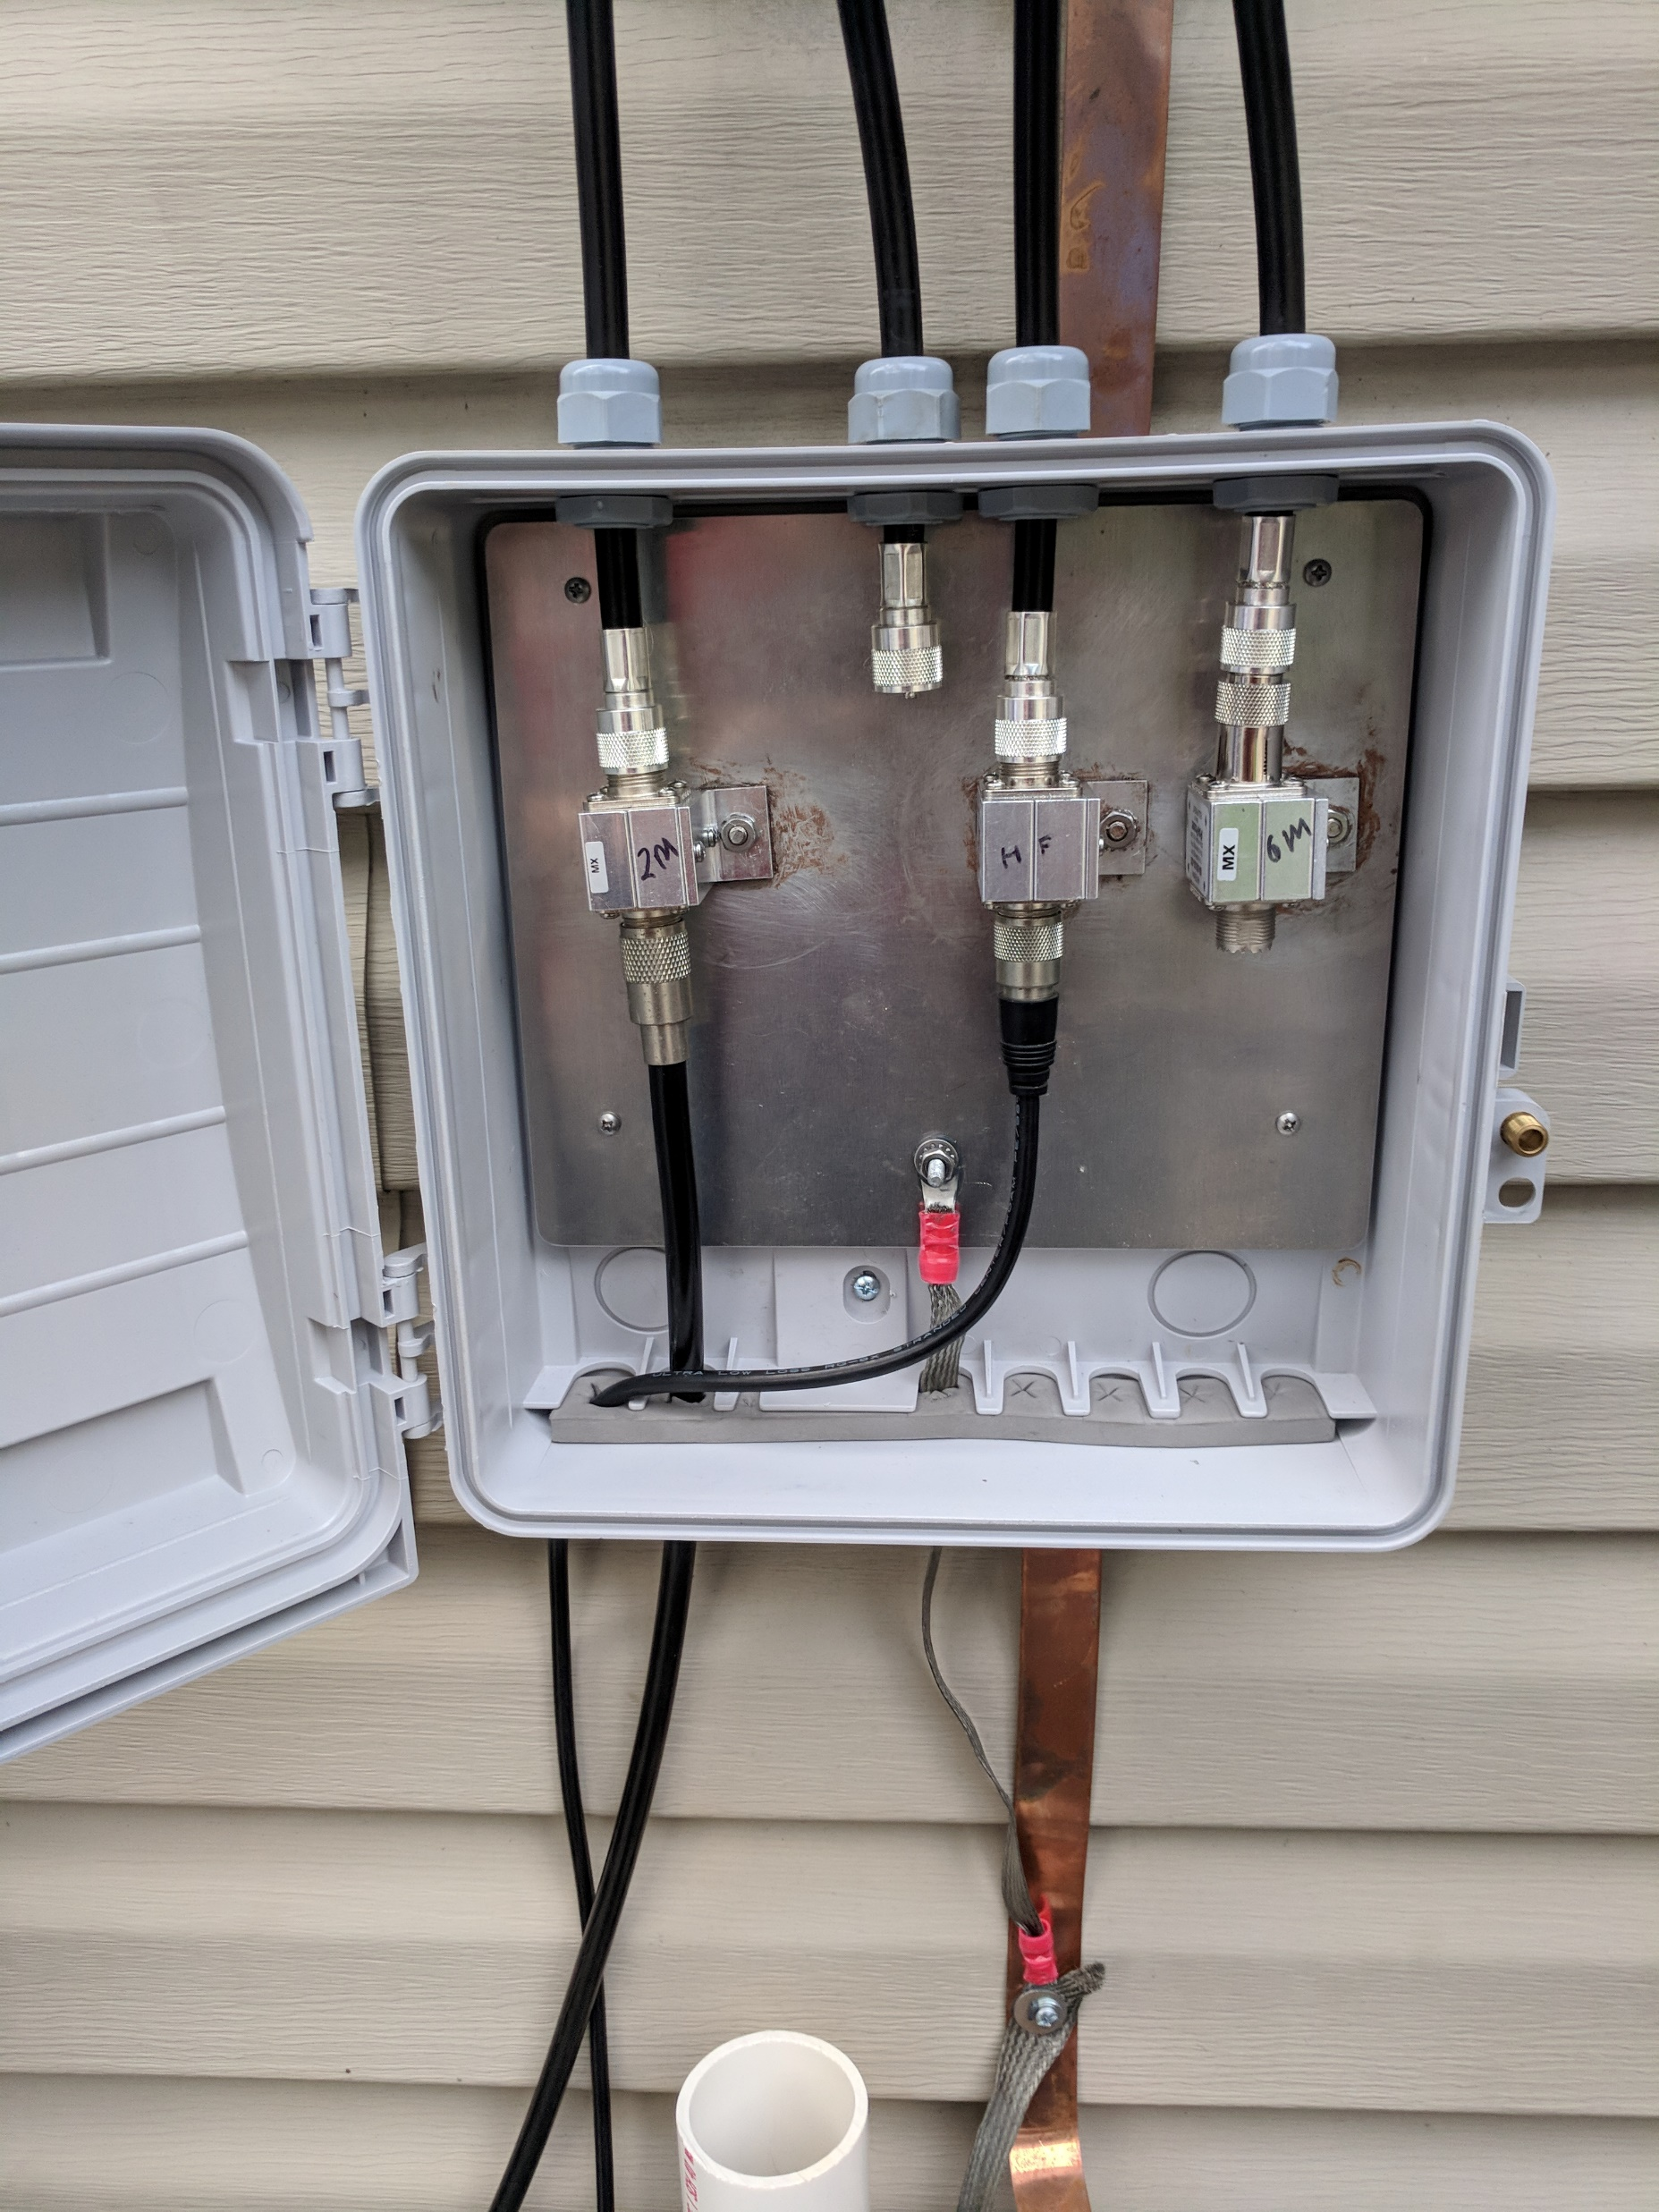
Electrical Safety

Slide 30
Electrical Safety
Lightning
  RF Grounding
    AC safety ground required but not usually adequate for RF.
    Additional RF ground is required.
    Even tower legs need separate ground rods bonded together.
For lightning safety, AC safety ground & RF ground system must be bonded together!

Slide 31
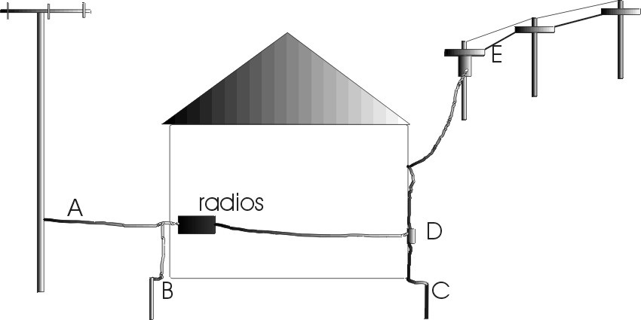
Electrical Safety
Lightning
  Typical station grounding installation.

Slide 32
G0B10 -- Which of the following is a danger from lead-tin solder?
A. Lead can contaminate food if hands are not washed carefully after handling the solder
B. High voltages can cause lead-tin solder to disintegrate suddenly
C. Tin in the solder can “cold flow,” causing shorts in the circuit
D. RF energy can convert the lead into a poisonous gas

Slide 33
G0B10 -- Which of the following is a danger from lead-tin solder?
A. Lead can contaminate food if hands are not washed carefully after handling the solder
B. High voltages can cause lead-tin solder to disintegrate suddenly
C. Tin in the solder can “cold flow,” causing shorts in the circuit
D. RF energy can convert the lead into a poisonous gas

Slide 34
G0B06 -- Which of the following is covered by the National Electrical Code?
A. Acceptable bandwidth limits
B. Acceptable modulation limits
C. Electrical safety of the station
D. RF exposure limits of the human body

Slide 35
G0B06 -- Which of the following is covered by the National Electrical Code?
A. Acceptable bandwidth limits
B. Acceptable modulation limits
C. Electrical safety of the station
D. RF exposure limits of the human body

Slide 36
G0B02 -- According to the National Electrical Code, what is the minimum wire size that may be used safely for wiring with a 20 ampere circuit breaker?
A. AWG number 20
B. AWG number 16
C. AWG number 12
D. AWG number 8

Slide 37
G0B02 -- According to the National Electrical Code, what is the minimum wire size that may be used safely for wiring with a 20 ampere circuit breaker?
A. AWG number 20
B. AWG number 16
C. AWG number 12
D. AWG number 8

Slide 38
G0B03 -- Which size of fuse or circuit breaker would be appropriate to use with a circuit that uses AWG number 14 wiring?
A. 30 amperes
B. 25 amperes
C. 20 amperes
D. 15 amperes

Slide 39
G0B03 -- Which size of fuse or circuit breaker would be appropriate to use with a circuit that uses AWG number 14 wiring?
A. 30 amperes
B. 25 amperes
C. 20 amperes
D. 15 amperes

Slide 40
G0B01 -- Which wire or wires in a four-conductor 240 VAC circuit should be attached to fuses or circuit breakers?
A. Only the hot wires
B. Only the neutral wire
C. Only the ground wire
D. All wires

Slide 41
G0B01 -- Which wire or wires in a four-conductor 240 VAC circuit should be attached to fuses or circuit breakers?
A. Only the hot wires
B. Only the neutral wire
C. Only the ground wire
D. All wires

Slide 42
G0B05 -- Which of the following conditions will cause a ground fault circuit interrupter (GFCI) to disconnect AC power?
A. Current flowing from one or more of the hot wires to the neutral wire
B. Current flowing from one or more of the hot wires directly to ground
C. Overvoltage on the hot wires
D. All these choices are correct

Slide 43
G0B05 -- Which of the following conditions will cause a ground fault circuit interrupter (GFCI) to disconnect AC power?
A. Current flowing from one or more of the hot wires to the neutral wire
B. Current flowing from one or more of the hot wires directly to ground
C. Overvoltage on the hot wires
D. All these choices are correct

Slide 44
G0B12 -- What is the purpose of a power supply interlock?
A. To prevent unauthorized changes to the circuit that would void the manufacturer’s warranty
B. To shut down the unit if it becomes too hot
C. To ensure that dangerous voltages are removed if the cabinet is opened
D. To shut off the power supply if too much voltage is produced

Slide 45
G0B12 -- What is the purpose of a power supply interlock?
A. To prevent unauthorized changes to the circuit that would void the manufacturer’s warranty
B. To shut down the unit if it becomes too hot
C. To ensure that dangerous voltages are removed if the cabinet is opened
D. To shut off the power supply if too much voltage is produced

Slide 46
G0B09 -- Which of the following is true of an emergency generator installation?
A. The generator should be located in a well-ventilated area
B. The generator must be insulated from ground
C. Fuel should be stored near the generator for rapid refueling in case of an emergency
D. All these choices are correct

Slide 47
G0B09 -- Which of the following is true of an emergency generator installation?
A. The generator should be located in a well-ventilated area
B. The generator must be insulated from ground
C. Fuel should be stored near the generator for rapid refueling in case of an emergency
D. All these choices are correct

Slide 48
G4C07 -- Why should soldered joints not be used in lightning protection ground connections?
A. A soldered joint will likely be destroyed by the heat of a lightning strike
B. Solder flux will prevent a low conductivity connection
C. Solder has too high a dielectric constant to provide adequate lightning protection
D. All these choices are correct

Slide 49
G4C07 -- Why should soldered joints not be used in lightning protection ground connections?
A. A soldered joint will likely be destroyed by the heat of a lightning strike
B. Solder flux will prevent a low conductivity connection
C. Solder has too high a dielectric constant to provide adequate lightning protection
D. All these choices are correct

Slide 50
G0B04 -- Where should the station’s lightning protection ground system be located?
A. As close to the station equipment as possible
B. Outside the building
C. Next to the closest power pole
D. Parallel to the water supply line

Slide 51
G0B04 -- Where should the station’s lightning protection ground system be located?
A. As close to the station equipment as possible
B. Outside the building
C. Next to the closest power pole
D. Parallel to the water supply line

Slide 52
G0B11 -- Which of the following is required for lightning protection ground rods?
A. They must be bonded to all buried water and gas lines
B. Bends in ground wires must be made as close as possible to a right angle
C. Lightning grounds must be connected to all ungrounded wiring
D. They must be bonded together with all other grounds

Slide 53
G0B11 -- Which of the following is required for lightning protection ground rods?
A. They must be bonded to all buried water and gas lines
B. Bends in ground wires must be made as close as possible to a right angle
C. Lightning grounds must be connected to all ungrounded wiring
D. They must be bonded together with all other grounds

Slide 54
G0B13 -- Where should lightning arrestors be located?
A. Where the feed lines enter the building
B. On the antenna, opposite the feed point
C. In series with each ground lead
D. At the closest power pole ground electrode

Slide 55
G0B13 -- Where should lightning arrestors be located?
A. Where the feed lines enter the building
B. On the antenna, opposite the feed point
C. In series with each ground lead
D. At the closest power pole ground electrode

Slide 56
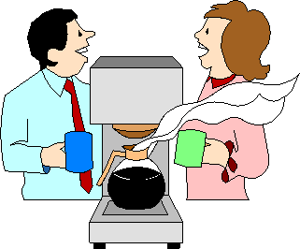
Break

Slide 57
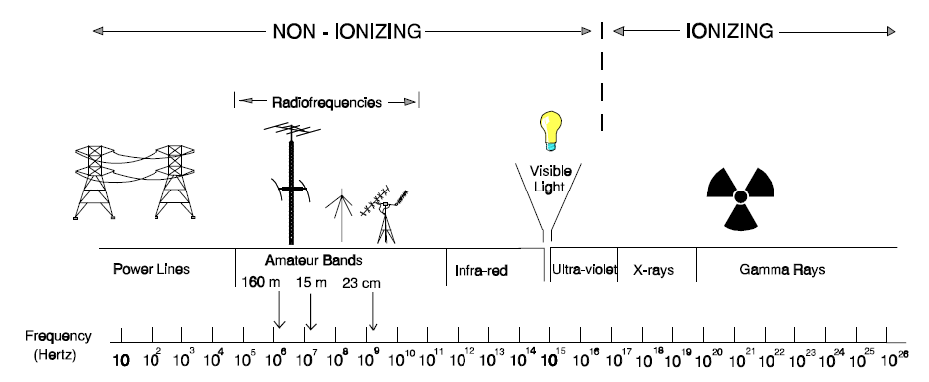
RF Exposure
Ionizing and Non-Ionizing Radiation.

Slide 58
RF Exposure
Exposure to RF at high levels and some frequencies is hazardous.
  Maximum Permissible Exposure (MPE) is the maximum radiation that a person can be exposed too.
  Factors to consider when estimating exposure:
    Minimum distance to antenna
    Transmitting power
    Feed line lose
    Antenna gain
    Frequency
    Exposure time
    Duty cycle

Slide 59
RF Exposure
Exposure to RF at high levels and some frequencies is hazardous.
    Primary factors that determine allowable human exposer:
      Power Density
      Frequency
    All stations that transmit more than 1mW are subject to FCC’s RF exposure rules.
    Stations exceeding exemption criteria must be evaluated according to FCC OET Bulletin 65.

Slide 60
RF Exposure
Power Density.
  Heating is caused by body absorbing RF energy.
  Intensity of RF energy called power density.
    Measured in mW/cm².
    For example:
      Power density = 10 mW/cm².
      Hand = 75 cm².
      Power absorbed = 750 mW.

Slide 61
RF Exposure
Power Density.
  Higher transmitter power → higher power density.
  Higher antenna gain → higher power density.

Slide 62
RF Exposure
Absorption and Limits.
  Specific absorption rate (SAR).
    Rate at which the body absorbs RF energy.
    Varies with frequency & size of body part.
      Range of highest SAR is 30 MHz to 1.5 GHz.
      Torso & limbs -- Highest at VHF (30 MHz to 300 MHz).
      Head – Highest at UHF (300 MHz to 3 GHz).
      Eyes – Highest at microwave frequencies < 1 GHz.

Slide 63
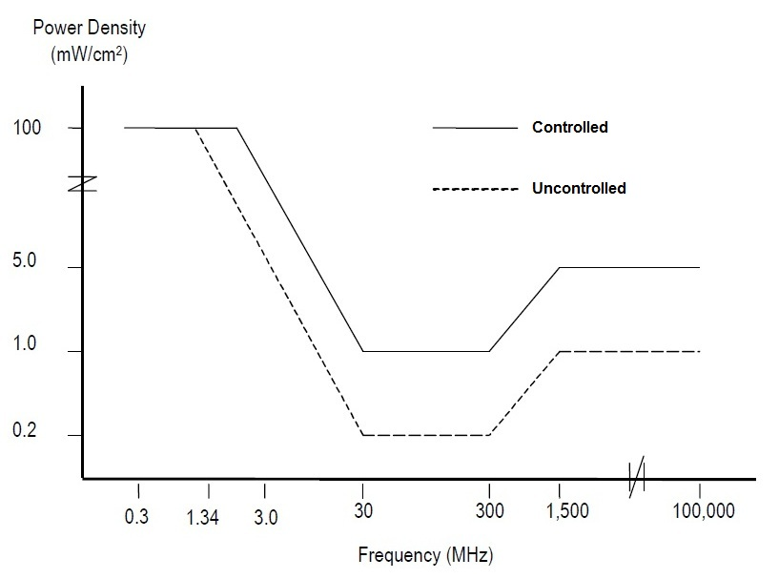
RF Exposure
Absorption and Limits.
  Maximum permissible exposure (MPE).
    Highest level of exposure allowed by FCC regulations.
    Varies by frequency.
    Based on SAR & averaged over time.

Slide 64
RF Exposure
Averaging and Duty Cycle.
  Exposure to RF is averaged over specified time periods.
    Body responds differently to long duration and short duration exposure.
    Different “populations” are averaged over different time periods.
      Occupational.
      General population.

Slide 65
RF Exposure
Averaging and Duty Cycle.
  Occupational.
    Areas where occupants are aware of and knowledgeable about RF exposure.
    Exposure averaged over 6-minute period.
    Less stringent MPE limits.

Slide 66
RF Exposure
Averaging and Duty Cycle.
  General population.
    Areas accessible to persons unaware of RF exposure.
    Exposure averaged over 30-minute period.
    More restrictive MPE limits.

Slide 67
RF Exposure
Averaging and Duty Cycle.
  Operating Duty cycle.
    Ratio of transmitter on time to total time during the exposure.
    Less talk time & more listen time allows higher power densities.

Slide 68
RF Exposure
Averaging and Duty Cycle.
  Emission Duty cycle.
    Transmitter is not at full output power all of the time depending on mode.
    Typical duty cycles:
      SSB (unprocessed) = 20% to 25%.
      SSB (processed) = 40%.
      FM = 100%.
      CW = 40%.
      Digital = 100%.

Slide 69
RF Exposure
Estimating Exposure & Station Evaluation
  All fixed amateur stations must evaluate RF exposure potential whether using high or low power.
    Exempt if transmitter output power is below specified ERP limits:
      HF 3450 x R²/f²
      VHF 3.83 x R²
      UHF 0.0128 x R² x f

Slide 70
RF Exposure
Estimating Exposure and Station Evaluation.
  Methods of Evaluating RF Exposure.
    Calibrated field strength meter.

Slide 71
RF Exposure
Estimating Exposure and Station Evaluation.
  Methods of Evaluating RF Exposure.
    Calculate using formulas.
      Use charts based on formulas.
      Use software based on formulas.

Slide 72
RF Exposure
Estimating Exposure and Station Evaluation.
  Methods of Evaluating RF Exposure.
    Calculate using formulas.
      Need to know:
        Transmitter output power.
        Feedline loss.
        Antenna gain.
        Antenna height above ground.
        Frequency.

Slide 73
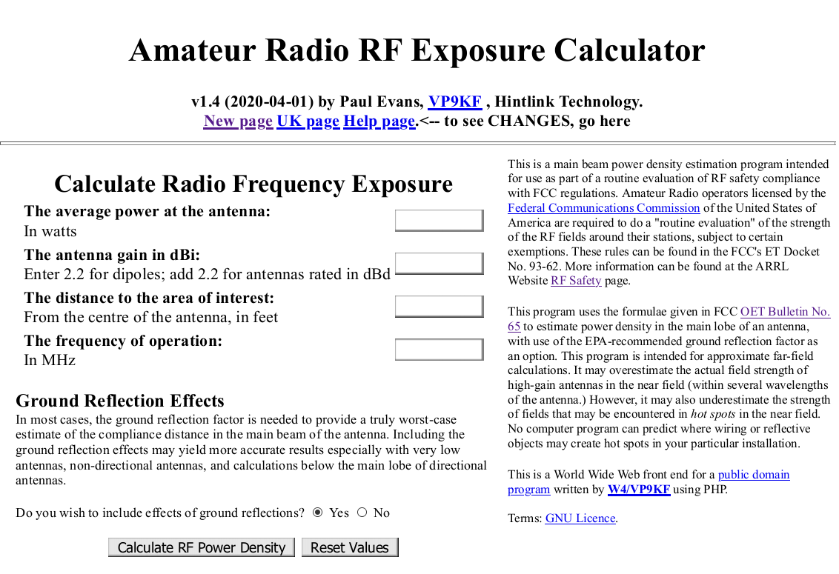
RF Exposure Evaluation Methods
RF Exposure

Slide 74
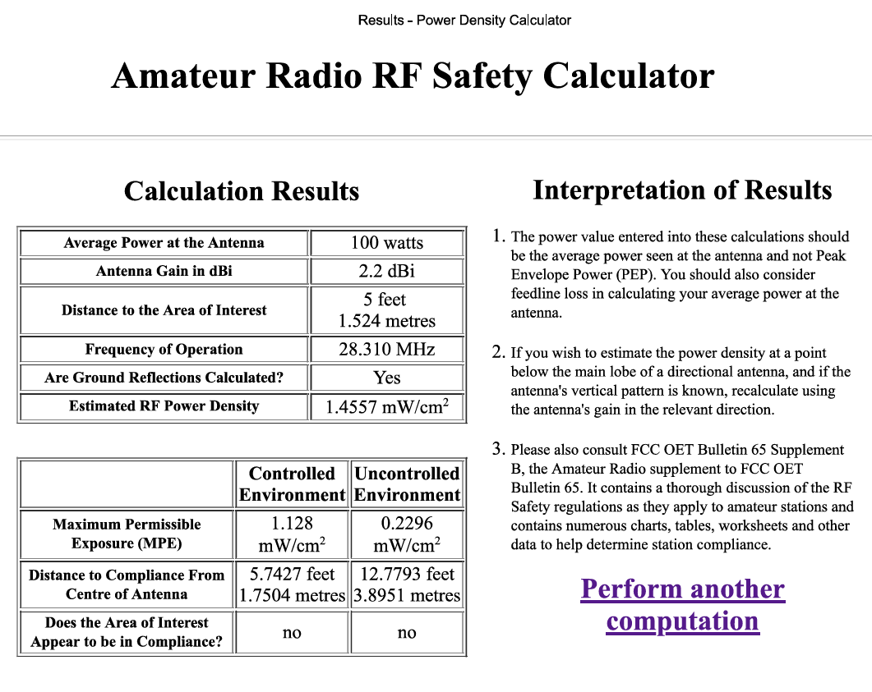
RF Exposure Evaluation Methods
RF Exposure

Slide 75
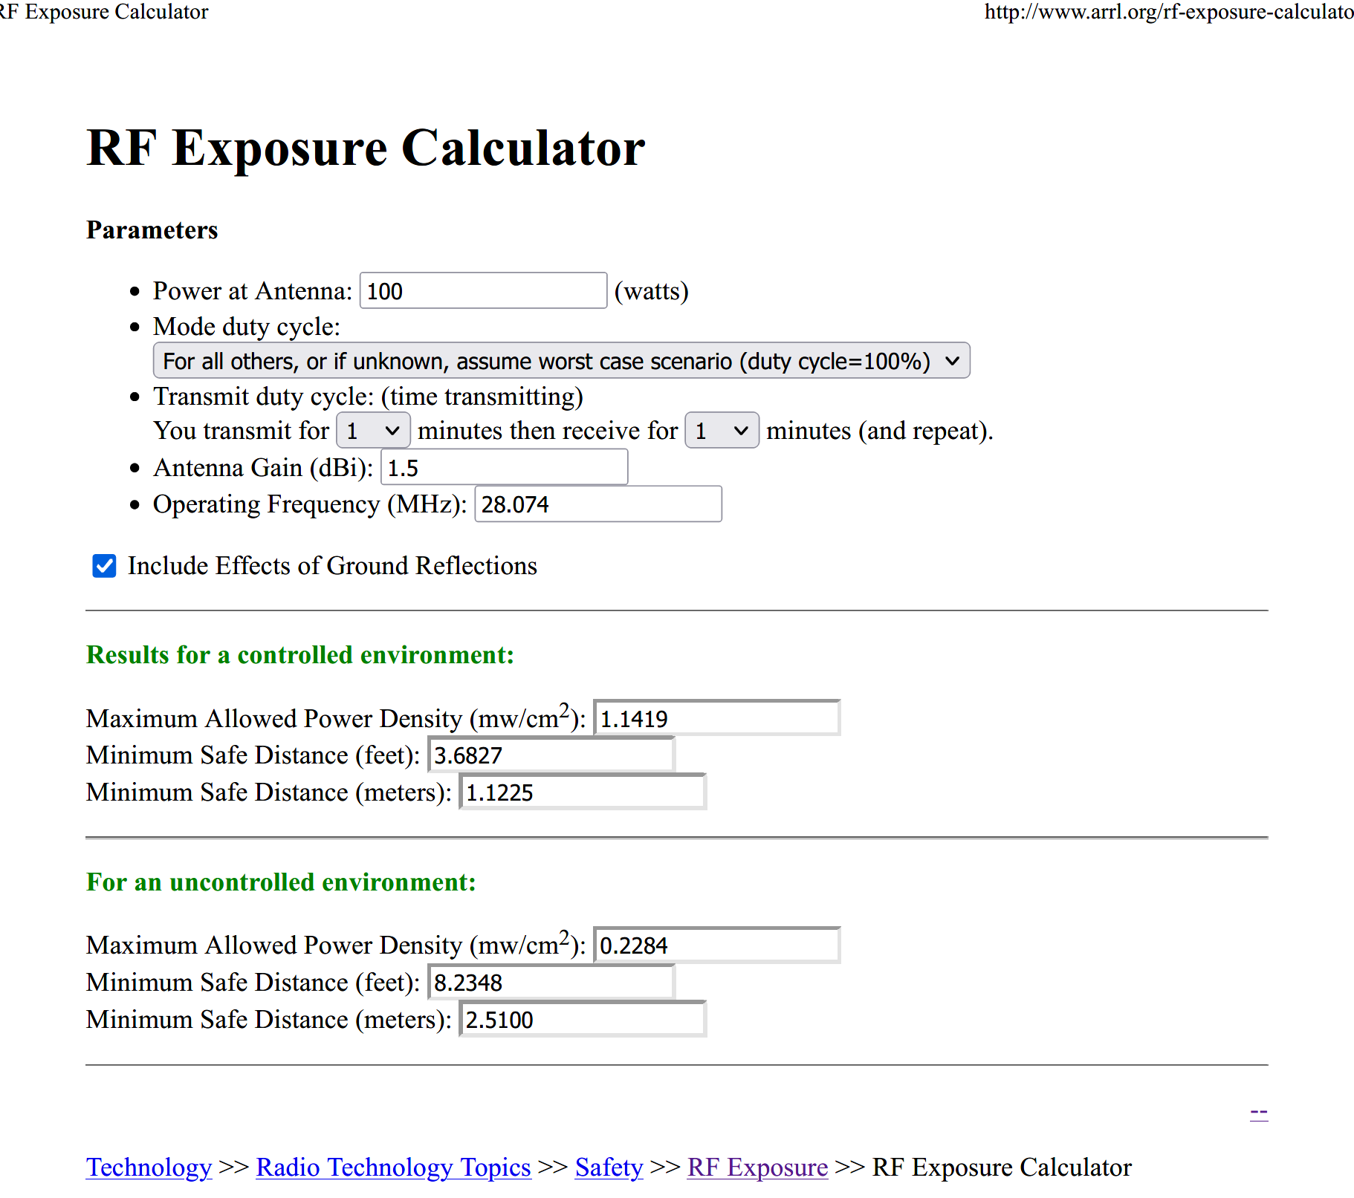

Slide 76
RF Exposure
Exposure Safety Measures.
  Locate antennas where people cannot get near them.
    Mount antennas as high as possible.
  Don’t point antennas at occupied locations.
    Use extra care with high-gain antennas used for VHF/UHF/microwave frequencies.
      Long Yagi antennas.
      Microwave dish antennas.

Slide 77
RF Exposure
Exposure Safety Measures.
  Carefully evaluate exposure from “stealth” antennas.
  Locate VHF/UHF mobile antennas on roof of vehicle or on trunk lid.
  Use external microphone with handheld radios.

Slide 78
RF Exposure
Exposure Safety Measures.
  Use a dummy load when testing transmitter.
  Reduce power of your transmissions.
    §97.313(a) An amateur station must use the minimum transmitter power necessary to carry out the desired communications.
  Reduce duty cycle of your transmissions.
    Listen more, talk less.

Slide 79
G0A02 -- Which of the following is used to determine RF exposure from a transmitted signal?
A. Its duty cycle
B. Its frequency
C. Its power density
D. All of these choices are correct

Slide 80
G0A02 -- Which of the following is used to determine RF exposure from a transmitted signal?
A. Its duty cycle
B. Its frequency
C. Its power density
D. All of these choices are correct

Slide 81
G0A12 [1.1307(1)(b)(3)(i)(A)] -- What stations are subject to the FCC rules on RF exposure?
A. All commercial stations; amateur radio stations are exempt
B. Only stations with antennas lower than one wavelength above the ground
C. Only stations transmitting more than 500 watts PEP
D. All stations with a time-averaged transmission of more than one milliwatt

Slide 82
G0A12 [1.1307(1)(b)(3)(i)(A)] -- What stations are subject to the FCC rules on RF exposure?
A. All commercial stations; amateur radio stations are exempt
B. Only stations with antennas lower than one wavelength above the ground
C. Only stations transmitting more than 500 watts PEP
D. All stations with a time-averaged transmission of more than one milliwatt

Slide 83
G0A06 [97.13(c)(2), 1.1307(1)(b)(3)(i)] -- What must you do if your station fails to meet the FCC RF exposure exemption criteria?
A. Perform an RF Exposure Evaluation in accordance with FCC OET Bulletin 65
B. Contact the FCC for permission to transmit
C. Perform an RF exposure evaluation in accordance with World Meteorological Organization guidelines
D. Use an FCC-approved band-pass filter

Slide 84
G0A06 [97.13(c)(2), 1.1307(1)(b)(3)(i)] -- What must you do if your station fails to meet the FCC RF exposure exemption criteria?
A. Perform an RF Exposure Evaluation in accordance with FCC OET Bulletin 65
B. Contact the FCC for permission to transmit
C. Perform an RF exposure evaluation in accordance with World Meteorological Organization guidelines
D. Use an FCC-approved band-pass filter

Slide 85
G0A01 -- What is one way that RF energy can affect human body tissue?
A. It heats body tissue
B. It causes radiation poisoning
C. It causes the blood count to reach a dangerously low level
D. It cools body tissue

Slide 86
G0A01 -- What is one way that RF energy can affect human body tissue?
A. It heats body tissue
B. It causes radiation poisoning
C. It causes the blood count to reach a dangerously low level
D. It cools body tissue

Slide 87
G0A04 -- What does "time averaging" mean when evaluating RF radiation exposure?
A. The average amount of power developed by the transmitter over a specific 24-hour period
B. The average time it takes RF radiation to have any long-term effect on the body
C. The total time of the exposure
D. The total RF exposure averaged over a certain time

Slide 88
G0A04 -- What does "time averaging" mean when evaluating RF radiation exposure?
A. The average amount of power developed by the transmitter over a specific 24-hour period
B. The average time it takes RF radiation to have any long-term effect on the body
C. The total time of the exposure
D. The total RF exposure averaged over a certain time

Slide 89
G0A07 -- What is the effect of modulation duty cycle on RF exposure?
A. A lower duty cycle permits greater power levels to be transmitted
B. A higher duty cycle permits greater power levels to be transmitted
C. Low duty cycle transmitters are exempt from RF exposure evaluation requirements
D. High duty cycle transmitters are exempt from RF exposure requirements

Slide 90
G0A07 -- What is the effect of modulation duty cycle on RF exposure?
A. A lower duty cycle permits greater power levels to be transmitted
B. A higher duty cycle permits greater power levels to be transmitted
C. Low duty cycle transmitters are exempt from RF exposure evaluation requirements
D. High duty cycle transmitters are exempt from RF exposure requirements

Slide 91
G0A08 [97.13(c)(2)] -- Which of the following steps must an amateur operator take to ensure compliance with RF safety regulations?
A. Post a copy of FCC Part 97.13 in the station
B. Notify neighbors within a 100-foot radius of the antenna of the existence of the station and power levels
C. Perform a routine RF exposure evaluation and prevent access to any identified high exposure areas
D. All these choices are correct

Slide 92
G0A08 [97.13(c)(2)] -- Which of the following steps must an amateur operator take to ensure compliance with RF safety regulations?
A. Post a copy of FCC Part 97.13 in the station
B. Notify neighbors within a 100-foot radius of the antenna of the existence of the station and power levels
C. Perform a routine RF exposure evaluation and prevent access to any identified high exposure areas
D. All these choices are correct

Slide 93
G0A09 -- What type of instrument can be used to accurately measure an RF field strength?
A. A receiver with digital signal processing (DSP) noise reduction
B. A calibrated field strength meter with a calibrated antenna
C. An SWR meter with a peak-reading function
D. An oscilloscope with a high-stability crystal marker generator

Slide 94
G0A09 -- What type of instrument can be used to accurately measure an RF field strength?
A. A receiver with digital signal processing (DSP) noise reduction
B. A calibrated field strength meter with a calibrated antenna
C. An SWR meter with a peak-reading function
D. An oscilloscope with a high-stability crystal marker generator

Slide 95
G0A03 [97.13(c)(1)] -- How can you determine that your station complies with FCC RF exposure regulations?
A. By calculation based on FCC OET Bulletin 65
B. By calculation based on computer modeling
C. By measurement of field strength using calibrated equipment
D. All these choices are correct

Slide 96
G0A03 [97.13(c)(1)] -- How can you determine that your station complies with FCC RF exposure regulations?
A. By calculation based on FCC OET Bulletin 65
B. By calculation based on computer modeling
C. By measurement of field strength using calibrated equipment
D. All these choices are correct

Slide 97
G0A05 [97.13(c)(2), 1.1307(b)] -- What must you do if an evaluation of your station shows that the RF energy radiated by your station exceeds permissible limits for possible human absorption?
A. Take action to prevent human exposure to the excessive RF fields
B. File an Environmental Impact Statement (EIS-97) with the FCC
C. Secure written permission from your neighbors to operate above the controlled MPE limits
D. All these choices are correct

Slide 98
G0A05 [97.13(c)(2), 1.1307(b)] -- What must you do if an evaluation of your station shows that the RF energy radiated by your station exceeds permissible limits for possible human absorption?
A. Take action to prevent human exposure to the excessive RF fields
B. File an Environmental Impact Statement (EIS-97) with the FCC
C. Secure written permission from your neighbors to operate above the controlled MPE limits
D. All these choices are correct

Slide 99
G0A10 -- What should be done if evaluation shows that a neighbor might experience more than the allowable limit of RF exposure from the main lobe of a directional antenna?
A. Change to a non-polarized antenna with higher gain
B. Use an antenna with a higher front-to-back ratio
C. Take precautions to ensure that the antenna cannot be pointed in their direction when they are present
D. All these choices are correct

Slide 100
G0A10 -- What should be done if evaluation shows that a neighbor might experience more than the allowable limit of RF exposure from the main lobe of a directional antenna?
A. Change to a non-polarized antenna with higher gain
B. Use an antenna with a higher front-to-back ratio
C. Take precautions to ensure that the antenna cannot be pointed in their direction when they are present
D. All these choices are correct

Slide 101
G0A11 -- What precaution should you take if you install an indoor transmitting antenna?
A. Locate the antenna close to your operating position to minimize feed-line radiation
B. Position the antenna along the edge of a wall to reduce parasitic radiation
C. Make sure that MPE limits are not exceeded in occupied areas
D. Make sure the antenna is properly shielded

Slide 102
G0A11 -- What precaution should you take if you install an indoor transmitting antenna?
A. Locate the antenna close to your operating position to minimize feed-line radiation
B. Position the antenna along the edge of a wall to reduce parasitic radiation
C. Make sure that MPE limits are not exceeded in occupied areas
D. Make sure the antenna is properly shielded

Slide 103
Outdoor Safety
Installing Antennas
  Place antennas well clear of power lines!
    At least 150% of height of antenna system from nearest power line.
      40 ft tower or mast with 10-ft antenna should be at least 75 feet from power lines.
    If using sling-shot or bow & arrow to shoot support line into tree, make certain flight path beyond tree is clear of power lines.

Slide 104
Outdoor Safety
Installing Antennas
  Place antennas well clear of power lines!
    NEVER run feedlines over or under power lines, including service drops.

Slide 105
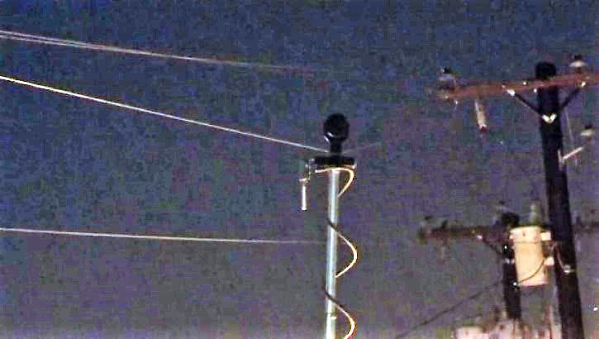
Outdoor Safety

Slide 106
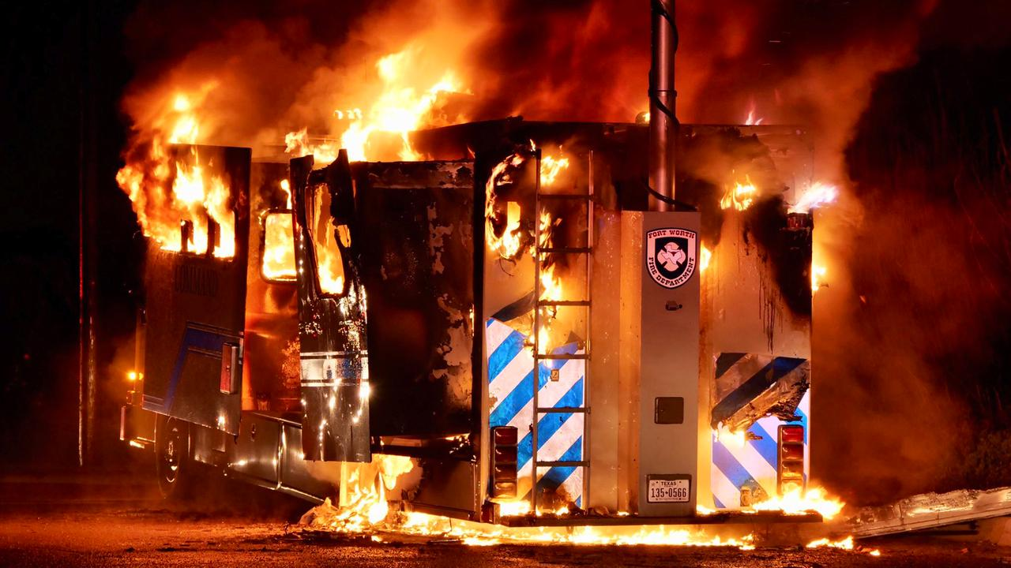
Outdoor Safety

Slide 107
Outdoor Safety
Installing Antennas
  Make certain people cannot come in contact with antenna after installation.
    Put fence around ground-mounted antennas.
  Follow manufacturer’s instructions during installation.

Slide 108
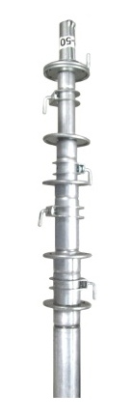
Outdoor Safety
Towers, Masts, & Hardware
  Pipe masts.
    Up to 20-30 feet.
    Bracketed to side of building.
  Push-up masts.
    Up to 50 feet.
    Must be guyed.

Slide 109
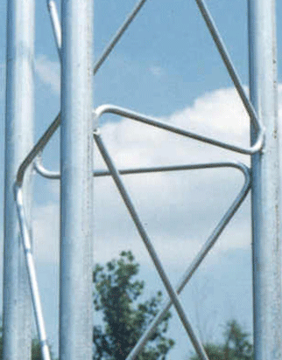
Outdoor Safety
Towers, Masts, & Hardware
  Fixed towers.
    8-ft or 10-ft sections.
    Up to 200 feet or more.
    Normally must be guyed.

Slide 110
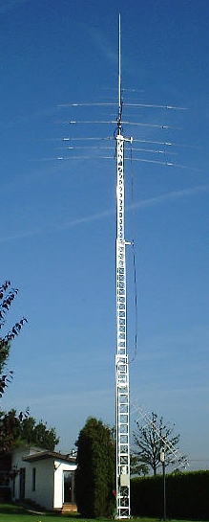
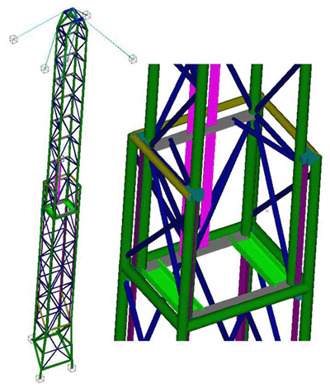
Outdoor Safety
Towers, Masts, & Hardware
  Telescoping towers.
    Up to 120 feet or more.
    Normally self-supporting, but may be guyed.

Slide 111
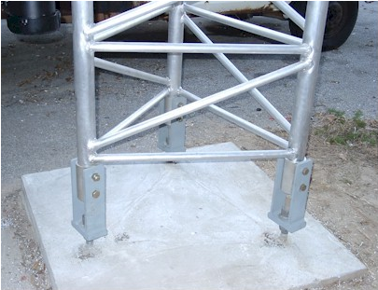
Outdoor Safety
Towers, Masts, & Hardware
  Fold-over towers.
    Fixed tower with special mounting base .

Slide 112
Outdoor Safety
Towers, Masts, & Hardware
  Hardware.
    Stainless steel.
      Anti-seize compound.
    Galvanized.

Slide 113
Outdoor Safety
Towers, Masts, & Hardware
  Hardware.
    Cables should have UV-resistant jacket.
    If burying cables, use conduit or PVC pipe.
      Coaxial cable designed for direct bury.

Slide 114
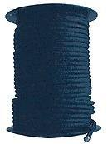
Outdoor Safety
Towers, Masts, & Hardware
  Hardware.
    Ropes should be UV-resistant.
      Black.
      Dacron.
      Polyester.
      Nylon.
      Polypropylene. (Yuck!)

Slide 115
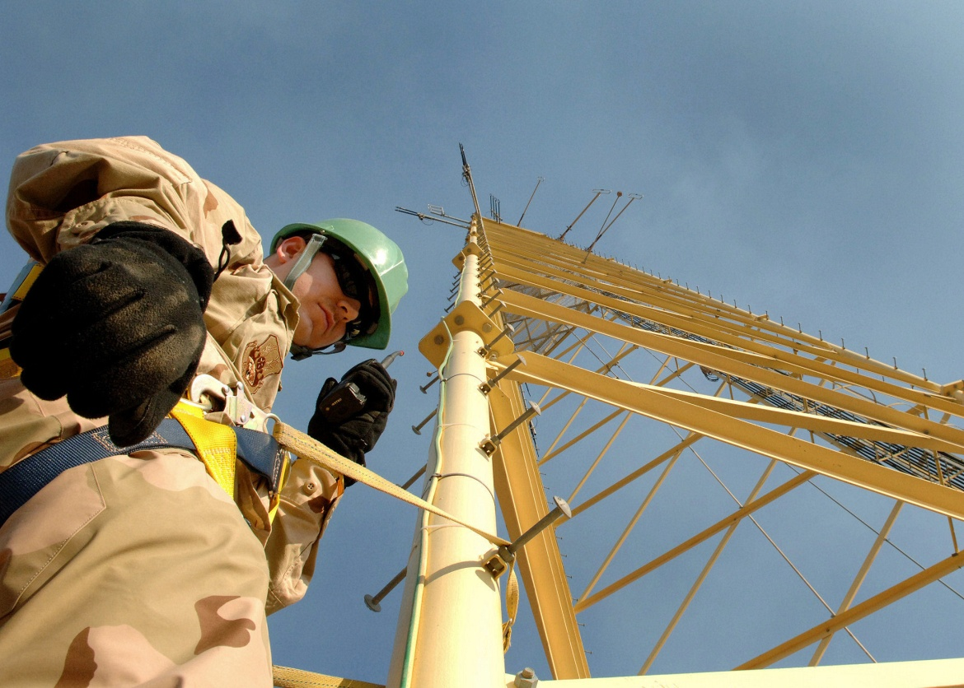
Outdoor Safety
Performing Antenna & Tower Maintenance
  Wear appropriate safety gear.

Slide 116
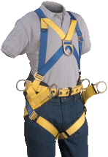
Outdoor Safety
Performing Antenna & Tower Maintenance
  Wear appropriate safety gear.
    Climbing harness.
    Safety helmet.
    Boots or work shoes.
    Safety goggles.
    Gloves.
    Don’t forget the sunscreen!

Slide 117
Outdoor Safety
Performing Antenna & Tower Maintenance
  Wear appropriate safety gear.
    Not just climber.
    Ground crew also.
      Especially safety helmet.

Slide 118
Outdoor Safety
Performing Antenna & Tower Maintenance
  Handheld amateur or FRS radios for communications between climbers & ground crew.

Slide 119
Outdoor Safety
Performing Antenna & Tower Maintenance
  Before climbing:
    Inspect all guy wires & hardware.
    Crank-up towers all the way down.
    Double check climbing gear -- belts, lanyards, & fasteners.
    Inspect all ropes & pulleys.

Slide 120
Outdoor Safety
Performing Antenna & Tower Maintenance
  Before climbing:
    Remove power from all circuits feeding the tower.
      Lock-out / tag-out.
    Disconnect transmitters & feedlines.

Slide 121
Outdoor Safety
Performing Antenna & Tower Maintenance
  While climbing:
    SLOW DOWN! – Speed kills.
    Carabiners completely closed.
    Latch hooks with opening away from tower.
    ALWAYS use safety lanyard or redundant lanyards.

Slide 122
G0B08 -- What should be done before climbing a tower that supports electrically powered devices?
A. Notify the electric company that a person will be working on the tower
B. Make sure all circuits that supply power to the tower are locked out and tagged
C. Unground the base of the tower
D. All these choices are correct

Slide 123
G0B08 -- What should be done before climbing a tower that supports electrically powered devices?
A. Notify the electric company that a person will be working on the tower
B. Make sure all circuits that supply power to the tower are locked out and tagged
C. Unground the base of the tower
D. All these choices are correct

Slide 124
G0B07 -- Which of these choices should be observed when climbing a tower using a safety harness?
A. Always hold on to the tower with one hand
B. Confirm that the harness is rated for the weight of the climber and that it is within its allowable service life
C. Ensure that all heavy tools are securely fastened to the harness
D. All these choices are correct

Slide 125
G0B07 -- Which of these choices should be observed when climbing a tower using a safety harness?
A. Always hold on to the tower with one hand
B. Confirm that the harness is rated for the weight of the climber and that it is within its allowable service life
C. Ensure that all heavy tools are securely fastened to the harness
D. All these choices are correct

Slide 126

Questions?

Slide 127
Next Week
Exam

